Slide 1
What Is It, Zach? (Part 1)
(Adjectives: Length and Distance)

Slide 2

Book and Print Knowledge
Recall proper eye movements.
left to right return sweep
top to bottom

Slide 3
Vocabulary
The meaning of a word depends on how it is used in a sentence. The word ring may mean “the jewelry worn on one’s finger.” It may also mean “what you do with a bell.”
Read the following sentences:
1. My mother still wears her wedding ring.
2. Jayson was asked to ring the bell.

Slide 4
Vocabulary
The word rock has several meanings as well.
Read the sentences below and tell the meaning of rock.
1. Mr. Bautista sat on a big rock while waiting for the campers.
2. Mother rocks the baby as she sings a lullaby.
3. Jess and Mike enjoy listening to rock music.

Slide 5
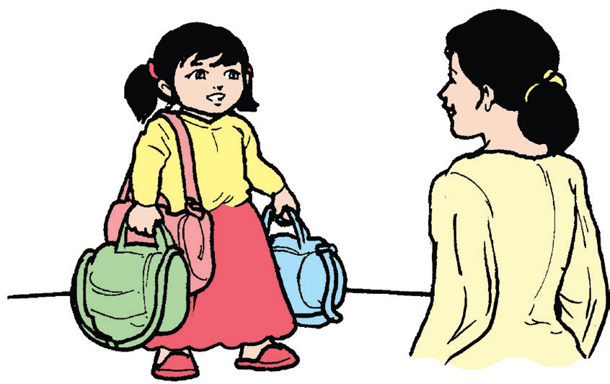
What Is It, Zach? (Part 1)
by Rommel Lumanta
Once a month, the Carandan family visits their farm in Batangas. Zach and Deanne look forward to going to the farm to see their lola and lolo.
One lovely, early morning of Saturday, Daddy Casey asked the children,
“Are you ready to go to Batangas?”
“Yes, we are!” Deanne and Zach shouted excitedly.
“Then, be ready while your Mommy and I
put these bags and baskets inside the car trunk,”
said Daddy Casey.

Slide 6
Deanne rushed upstairs to get her doll, toy kitchen, and dining set. She loved bringing her favorite toys wherever they went.
Zach hurriedly searched in the shelf under the stairs. There was so much noise as he pulled out some of the usual
things he brought.
“Oh, that noise! What is it, Zach?” asked his
Mommy Gienah.

Slide 7
“Oh, nothing, Mommy Gienah.”
“Come on, everybody. Hop in the car,” exclaimed Daddy Casey. When they were all inside the car, Mommy Gienah led the prayer for safety. They always prayed whenever they would travel.
Inside the car, every now and then, Zach would check if he got all the things he needed inside his bagpack. There was a clinking and clanging noise.

Slide 8
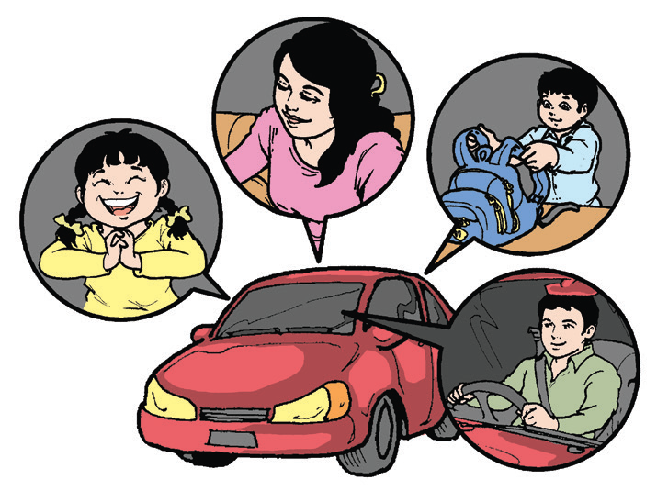
“What is it, Kuya Zach?” asked Deanne.
“Nothing,” replied Zach, with a naughty smile.
In less than two hours, the lovely family reached the large farm. The children hurriedly ran to meet their grandparents. Their happy lola and lolo were so excited to see them. Their lola prepared delicious bibingka and sweet buko juice as a refreshment.

Slide 9
Soon after, Lola and Mommy Gienah started preparing their lunch. Lolo and Daddy Casey visited the poultry.
Zach and Deanne ran hurriedly to the rice fields. Deanne sat under a tree as she played with her doll and other toys. Zach pulled out his magnifying glass. He saw something hopping over the grass near a pond.
(to be continued)

Slide 10

Think Well
1. Why do you think is Zach hiding the magnifying glass he brought?
2. What do you think will he use it for at the farm?
3. Ask questions about the story to each other.

Slide 11
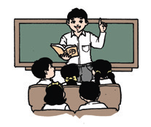
Oral Language
Who, What, Where, When, How, and Why are question words.
Who is the question word used when asking for a person.
What is the question word used when asking for an object, an animal,
or an event.
Where is the question word used when asking for a place.

Slide 12
Oral Language
Who, What, Where, When, How, and Why are question words.
When is the question word used when asking for the day, week, month, year, or time.
Why is the question word used when asking for the reason.
How is the question word used when asking for
manner or ways something was done.

Slide 13
Grammar
Read this paragraph which was taken from the story. Take note of the words in bold. What do they describe?
The lovely family reached the large farm. The children hurriedly ran to meet their grandparents. Their happy lola and lolo were so excited to see them. Their lola prepared delicious bibingka and sweet buko juice as a refreshment.

Slide 14
Grammar
Given below are more sentences. Take note of the words that describe and the words that are being described.
1. Thelma wears a long dress.
2. Mariel is sad to leave her school.
3. Weng is obedient to her parents.
4. Joyce likes to bake delicious cookies.

Slide 15
Grammar
Adjectives describe people, animals, places, and things.
Here are sample adjectives that we can use to describe:
People – kind, lovely, courteous, beautiful, smart, tall, old, young, happy, sad, helpful, generous, angry, and excited
Animals – clever, fast, brave, friendly, loyal, big, tiny, white, black, and angry
Things – useful, heavy, light, small, big, large, clean, dirty, cheap, expensive, brown, and green
Food – delicious, sweet, sour, tasty, and spicy

Slide 16
Writing
Copy the groups of words in cursive writing. Write the letters neatly and
clearly.
1. quiet garden
2. excited people
3. crowded mall
4. clever cat

