Slide 1
My Zoo Is Special
(Adjectives: Sizes, Height and Weight)

Slide 2
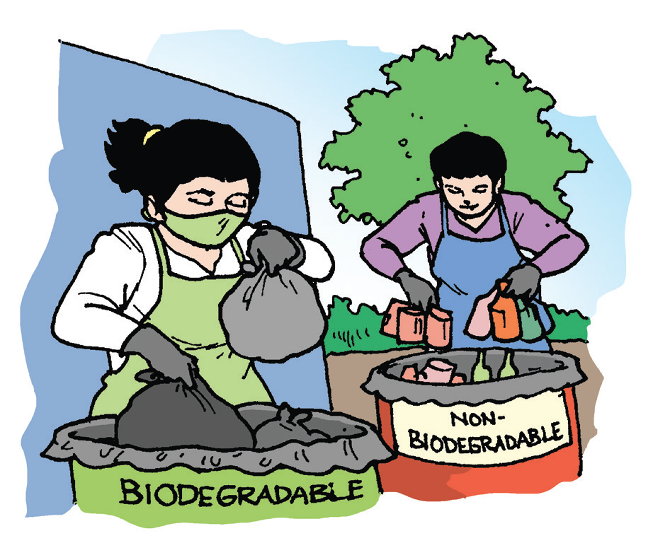
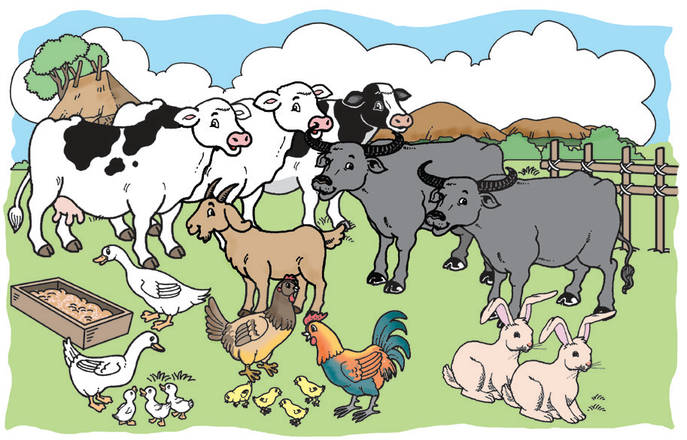
Earth Day is celebrated every year around the
world to make people aware of the importance of
caring for the environment.
Also, taking care of animals shows love for them.

Slide 3
My Zoo Is Special
by Keith Dylan
Would you believe it? I have a zoo where I can go anytime I want to. It is not the same as the city zoo where we see lions, tigers, giraffes, and other animals.
My zoo is special. There are big and tiny animals. There are three cows, two carabaos, a horse, a few goats, a rooster, and rabbits. There are ants, bees, butterflies, moths, frogs, and fireflies.

Slide 4
I watch my father and grandfather use the carabaos in the rice fields. I see them milk the cows and the goats. Our rooster serves as our alarm clock as it crows early in the morning. Rabbits are fun to watch. They make squeaking noises as they run around.

Slide 5
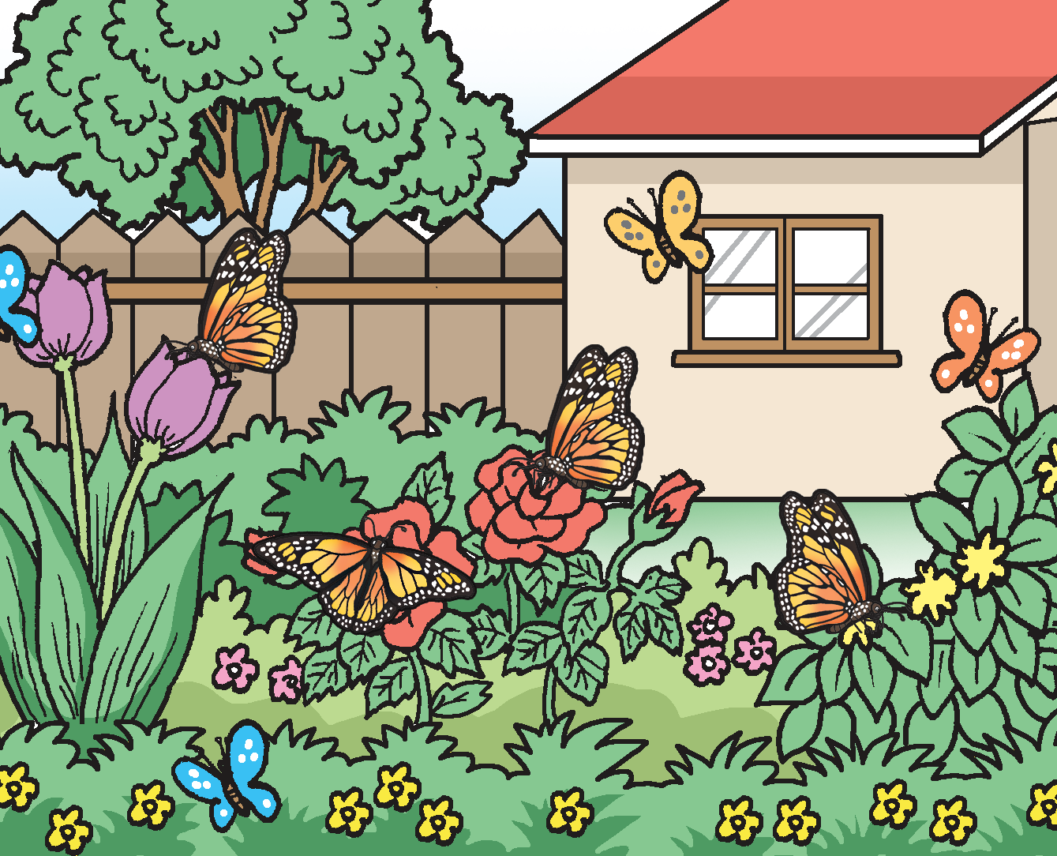
I watch ants as they march in a row, carrying crumbs. Bees and butterflies can be seen in our garden full of flowers. At night, fireflies are a lovely sight as they glow in the dark and moths hover around our lamps at night. On a rainy night, I am entertained by the loud croaks of bullfrogs.
So, there! That’s my zoo. Anybody can visit it and I do not charge any fee. It’s free! Come and visit my zoo.

Slide 6
Question words: Who, What, Where, When, Why, and How
Who, What, Where, When, How, and Why are question words.
Who is a question word that is used when asking for a person.
What is a question word that is used when asking for an object, animal, or an event.
Where is a question word that is used when asking for a place.
When is a question word that is used when asking for a day, week, month, year, or time.
Why is a question word that is used when asking for a reason.
How is a question word that is used when asking for the manner or the way something was done.

Slide 7
Oral Language
With your group mates, prepare for a short performance through a dialogue, a mock interview, or a talk show.
In a dialogue, the members of the group will talk about a common experience they had. Make sure that the sentences to be used contain verbs and adjectives.
If you will choose a dialogue, you may talk about any of the following topics:
1. Taking care of a pet
2. A trip to _______
3. Unique plants

Slide 8
Oral Language
In a mock interview, one or two of the members may pretend to be famous persons who have just arrived in the country. The rest of the members may take the role of press people who write for newspapers or magazines. The press people will ask questions to the newly arrived visitors. Use verbs and adjectives in your questions and statements.
If you will choose a mock interview, one of you may pretend to be a popular artist or singer who encourages fans to be environment-friendly.

Slide 9
Oral Language
In a talk show, two members may pretend to be hosts of a television talk show. They have guests who will pretend to be artists, singers, famous players, or government officials. The hosts will ask questions and the guests answer them using verbs and adjectives.
If you will choose a talk show, you may pretend that the guests are a mayor and vice mayor. Talk about the importance of keeping the city or town clean and green.

Slide 10
Grammar
The words that describe people, places, and things are called adjectives.
Words that describe how much or how many can also be used as adjectives: four, eight, a few, several, many, light, and heavy.
Words that describe size and height such as small, medium, large, tall, and short are used as adjectives.

Slide 11
Writing
Copy the groups of words with adjectives using cursive writing. Write the letters neatly and clearly on your paper.
1. several people
2. short pants
3. interesting book
4. tall buildings

