Slide 1
Conveying Meaning through Creative Writing

Slide 2
Conveying Meaning through Creative Writing
The Comma, Colon, and Semicolon
These punctuation marks are frequently confused with one another because they all can indicate a pause in a sentence. They are also collectively called secondary boundary marks.
1. The comma (,) is used to separate ideas or elements within a sentence. It is also used in letter writing after the salutation and closing.
• When separating elements in a sentence:
Basketball, bowling, and skateboarding are Toby’s favorite activities.

Slide 3
Conveying Meaning through Creative Writing
1. The comma
• When used in a compound sentence:
Daryl goes hunting for food, and Beth makes a campfire.
• In letter writing:
Dear Father,
2. The colon (:) is used after a word or sentence to introduce a series, an explanation, an example, and a statement or to end the formal opening of a business letter. It is also used to separate the hour and minute within time.

Slide 4
Conveying Meaning through Creative Writing
2. The colon
• When introducing a list or series:
Here are the things my son wants for his birthday: a happy family , a new bicycle, and pizza.
• When introducing a statement or explanation:
Yesterday was not really a great day for me because of this : my bag got stolen.
• When ending the formal opening in a business letter:
Hello, Ms. Pabilona:
We would like to invite you to the upcoming event.

Slide 5
Conveying Meaning through Creative Writing
2. The colon
• When indicating time:
6:40 p.m.
3. The semicolon (;) is used to link related independent clauses, and it indicates a closer connection between the clauses than a period does.
• The books I have left in my bag are “The Great Gatsby” by F. Scott Fitzgerald; “The Old Man and the Sea” by Ernest Hemingway; and “The Talisman” by Stephen King.
• Jim loves chocolate; his wife hates it.

Slide 6
Conveying Meaning through Creative Writing
Capitalization Rules
Capitalization is writing the first letter of a word in a capital letter and the rest in lowercase letters. The following words should be capitalized:
• The first letter of the first word of every sentence
The first letter of the first word in a sentence should be capitalized.
• Proper nouns (Examples: Maria Delos Santos, the Philippines, Pepsi)
• Adjectives derived from proper nouns (Example: Canadian citizen)

Slide 7
Conveying Meaning through Creative Writing
Capitalization Rules
• The Pronoun “I” and all of its contractions (I, I’ll, I’m, I’d)
• Nouns and pronouns that pertain to God (Example: Do not worry; He is our God.)
• Most acronyms (Example: LotR for Lord of the Rings)
Note: Acronyms that turned into proper words, for example, laser, are excluded. Also, some acronyms do not capitalize some of their letters.
• Titles of bodies of work (nouns, pronouns, adjectives, verbs, adverbs, and
subordinate conjunctions; articles and coordinating conjunctions are excluded)

Slide 8
Conveying Meaning through Creative Writing
Have you felt or have you seen in other people any of these emotions: extreme disgust, surprise, profound sorrow, or explosive anger? Words that are highly connected to intense emotions are interjections.
An interjection is one or two words uttered or written as an expression of emotion or feeling of a writer or a speaker. These words or phrases can stand alone or be placed before or after a sentence.

Slide 9
Conveying Meaning through Creative Writing
Many times, an interjection is followed by a punctuation mark, often an exclamation point. Interjections may show a speaker’s or an author’s emotions like the following:
jeez
could mean you can’t believe something or you are exasperated
ooh-la-la
slightly comical way to refer to something as fancy or special
phew
expresses relief or shows that you are glad something is over
oops
an exclamation people use when they accidentally do something

Slide 10
Conveying Meaning through Creative Writing
aah
used as a call for help or when someone is scared
ahem
this sound of clearing the throat of someone means “attention” or “listen
boo
to scare someone or to voice disapproval
eww
shows dislike or disgust
hmm
means you are thinking or hesitating
yahoo
expresses joy or happiness

Slide 11
Conveying Meaning through Creative Writing
yeah
shows very strong affirmation or approval
yoo-hoo
used to get someone’s attention and is usually used by women
Inverted Word Order
Fronting (also known as front-focus or preposing) is an example of inverted word order. It is a word group that is placed at the beginning of a sentence and is usually followed by a verb.

Slide 12
Conveying Meaning through Creative Writing
• “Before the march of the flames were flung picket lines of soldiers.” (Jack
London, “Story of an Eyewitness: The San Francisco Earthquake.” Collier’s
Weekly, May 5, 1906)
• “Never have I seen a greater, or more beautiful, or a calmer or more noble thing
than you, brother.” (Ernest Hemingway, The Old Man and the Sea, 1952)
• At the corner of the two streets is a queer-looking house.
• Here comes the great jolly band.

Slide 13
Conveying Meaning through Creative Writing
Informative writing is used purposefully to inform the intended audience. Some writers, however, might cite one or two facts but still don’t leave the reader with enough knowledge of the topic than when he or she began reading the piece. Therefore, you must remember and follow some simple guidelines that will ensure that your written outputs are memorable, informative, and concise.

Slide 14
Conveying Meaning through Creative Writing
Guidelines in Informal Writing
1. Write a thesis statement, a statement that summarizes your main point, in more
basic terms.
2. Keep your words simple and straightforward.
3. Put your feelings aside. Get your facts straight.

Slide 15
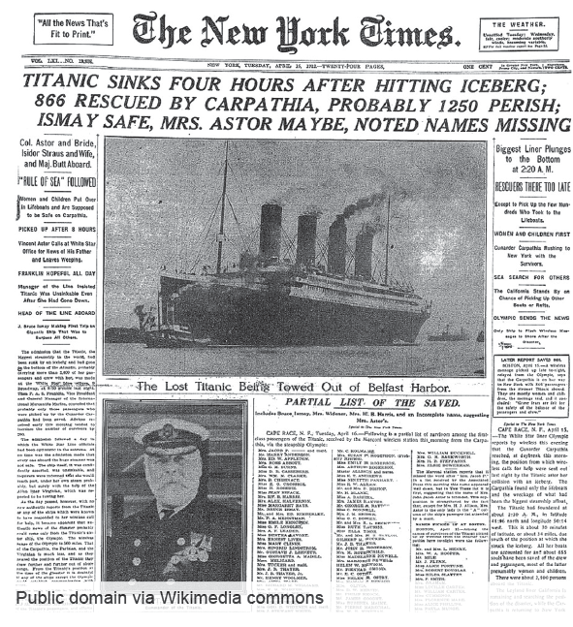
Conveying Meaning through Creative Writing
Journalistic writing
is most often written in a format called the inverted pyramid, which arranges the information in descending order of importance or newsworthiness.
the most important information should come first, such as those that answer the Who, What, When, Where, and How.

Slide 16
Conveying Meaning through Creative Writing
A news story is a type of journalistic writing. It is an oral or written report of past, present, or future events. It has the following characteristics: factual, truthful, accurate, unbiased, and interesting. News stories are varied because of the following elements which affect them:
1. Progress. The progress and development of a country or any civilization
are chronicled step by step in the newspaper.
2. Immediacy. A story that has just happened is news; one that happened a
few days ago is history. Immediacy is timeliness of the news.

Slide 17
Conveying Meaning through Creative Writing
3. Proximity. This quality refers to the distance of the place of the news
event and how closely it touches people’s lives.
4. Conflict. This quality shows the struggle of man. The common examples
are sports events, wars, and revolutions. The fight could be man against
man, team against team, countries against countries, or man against
nature.
5. Oddity. This element refers to the state of being unusual or strange. An
odd story catches human interest more than ordinary news.

Slide 18
Conveying Meaning through Creative Writing
6. Gender. All news involves men and women. This element infl uences
behaviors and relationships as it refers to the roles, behaviors, and identities
that society assigns to both genders.
7. Emotion. Feelings and emotions, such as happiness, sadness, anger,
ambition, love, are what make the news interesting.
8. Prominence. The more a person is known to many people, the catchier and
the faster the news is because “names make news.” Prominence does not only
apply to people or VIPs but to places, things, and events too.

Slide 19
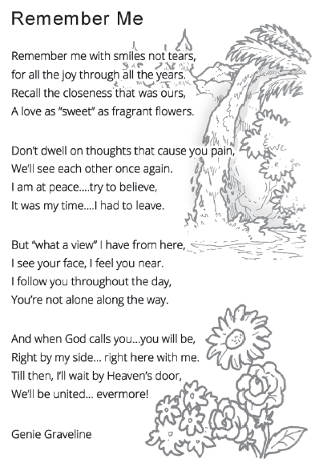
Conveying Meaning through Creative Writing
Literary writing
is used to entertain and give aesthetic pleasure.
the focus is on the words themselves and on a conscious and deliberate arrangement of the words to produce a pleasing or enriching effect
is usually fictional, and it makes use of figurative or symbolic language.

Slide 20
Conveying Meaning through Creative Writing
Literary writing
• Play with language to produce pleasure or emotional release for the
reader.
• Use figurative language and sensory appeals.
• Include some sort of problem or tension, along with a resolution of that
problem.
• Try to give some essential meaning or idea to the reader.

Slide 21
Conveying Meaning through Creative Writing
Convert each inverted sentence into natural or normal order. Then, on the line, give your own example of fronting.
Very good performance we had yesterday.
____________________________________________________________________________
Eccentric and proud people they are!
____________________________________________________________________________

Slide 22
Conveying Meaning through Creative Writing
Determine if the following is INFORMATIVE, JOURNALISTIC, or LITERARY type of text.
________ 1. Government urged to add more work sectors to COVID-19 vaccination list
(from Inquirer)
________ 2. The legend of Mt. Makiling
________ 3. How to cook adobo in fi ve easy steps
________ 4. Under pressure, Biden works for a ceasefi re in Israel-Gaza violence (from
Inquirer)
________ 5. How vaccines work

Slide 23
Conveying Meaning through Creative Writing
ANSWER KEY
Convert each inverted sentence into natural or normal order. Then, on the line, give your own example of fronting.
Very good performance we had yesterday.
____________________________________________________________________________
Answers may vary.
Eccentric and proud people they are!
____________________________________________________________________________
Answers may vary.

Slide 24
Conveying Meaning through Creative Writing
ANSWER KEY
Journalistic 1. Government urged to add more work sectors to COVID-19 vaccination
list (from Inquirer)
Literary 2. The legend of Mt. Makiling
3. How to cook adobo in five easy steps
Informative
Journalistic 4. Under pressure, Biden works for a ceasefire in Israel-Gaza violence
(from Inquirer)
5. How vaccines work
Informative

