Slide 1
Making Inferences

Slide 2
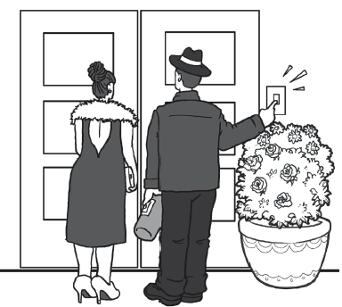
Making Inferences
Look closely at the illustration. What does it want or intend you to believe?
Although it is never stated, you as a reader/ viewer can infer thoughts, feelings, and intentions based on the details of information presented in the text or the material viewed.
You can focus on the lines, angles, colors, or even shapes of the objects/ images presented and relate them to real-life experiences for you to understand their message/ meaning.

Slide 3
Making Inferences
When making inferences you are making a logical guess using evidence from the text, your knowledge, and common sense. It also involves finding deeper meanings in events and situations, and meanings that are not explicit.
Let’s consider this sample text from Kristina Smekens:
Imagine a half a dozen students standing at the end of the street. It’s a dark morning at 7:00 a.m. The students are huddled together. Several are hugging themselves. Others are jumping up and down. And still, others are rubbing their hands together and huffing on them. When the bus arrives, one student hollers, “Bus!” All of the students run to get on the vehicle.

Slide 4
Making Inferences
Using the sample text, let’s apply the five-step process in making an inference.
• Step 1: Read the text carefully. (Refer to the text on the previous page.)
• Step 2: Read and understand what is being asked. For example, what season does
this scene take place in?
• Step 3: List the relevant details. In this example, which details from the text have
anything to do with season, temperature, or weather?
There are other details mentioned in the text, like the fact that there are half a dozen kids and that one kid hollered when the bus was coming.

Slide 5
Making Inferences
Step 4: Look for patterns and relationships among the details—to determine what these details have in common.
Group the following details: jumping up and down, moving around, and rubbing and huffing on their hands. Using background knowledge, predict what the combination of actions might indicate—the kids are trying to generate some heat or keep warm. Add in the other detail about it being a dark morning at 7:00 a.m. The last detail: They ran to the bus. Of course, they ran because they were cold. They had been trying to keep warm, and that’s why they were moving around.
• Step 5: Determine what it means. After putting multiple clues together, it’s finally
time to make an inference.

Slide 6
Making Inferences
Recall the five-step process in making an inference.

Slide 7
Making Inferences
ANSWER KEY
1. Have a careful look at the text.
2. Analyze what is being asked.
3. List the relevant details.
4. Look for patterns and relationships among the details, their commonalities.
5. Look for clues and make your inference.

