Slide 1
A Valuable Life Lesson

Slide 2
A Valuable Life Lesson
Literary Analysis is something we do every day. From talking about our favorite song with a friend to commenting about the latest show we watched, we subconsciously analyze literary texts. In addition, one of the elements of a story we commonly analyze is the theme.
All other elements of a story such as characters, setting, plot, and conflict contribute to a story’s theme and we can identify a story’s theme by understanding how all of these elements fit together.

Slide 3
A Valuable Life Lesson
Theme
The part of the short story that focuses on the higher meaning behind the conflict and interactions between the characters is called the theme. Examples include the sacrifice of
love, truth over falsehood, and bravery.
Setting
The element of the short story that refers to the time and physical space of the story is called the setting. This includes the place, time, weather and social conditions, and mood or atmosphere that affect the events that the characters participate in.

Slide 4
A Valuable Life Lesson
Characters
The characters refer to the people, animals, or inanimate objects that exist in the short story, and they help in the movement of the plot of the story.
Plot
This refers to the events that characters experience throughout the story. The plot includes situations that would help the characters face their hardships or achieve their goals.

Slide 5
A Valuable Life Lesson
Conflict
The conflict is the part of the story that shows tension in different forms:
• Interpersonal conflict – the conflict that occurs between different characters
• External conflict – This occurs between characters and the environment.
• Inner conflict – refers to the inner battles that a character faces
• Philosophical conflict – Some stories include characters who go through conflicts that
reflect different ideologies or values, such as materialism versus spirituality.
Some of the most memorable stories include complex combinations of these different forms of conflicts.

Slide 6
A Valuable Life Lesson
Writer’s Techniques
The tone of a short story or a literary text like a poem or a drama refers to the level or kind of emotions expressed like happiness, excitement, or loneliness.
The mood, on the other hand, is the bigger picture of the author’s or poet’s feelings that are revealed by the words included in a literary piece. These are referred to as the language choices of the author or poet.

Slide 7
A Valuable Life Lesson
Advance Organizers
One tool in learning that illustrates the relationship of what you are about to learn and the information that you have learned already is the advance organizer. It helps you make connections between concepts learned in class in a visual manner.
When you use an advance organizer, you can link the new information to old information, and this makes it easier for you to remember more easily new concepts. The three basic purposes of advance organizers:
1. Direct the students’ attention to what is important in the upcoming lesson.
2. Highlight relationships among ideas that will be presented.
3. Remind the students of relevant information that they already have.

Slide 8
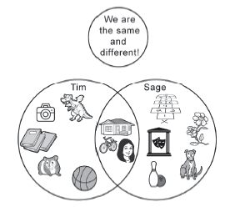
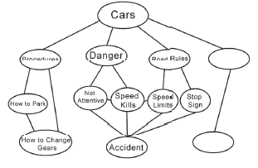
A Valuable Life Lesson
Answer the following questions:
1. What do you call the part of a story that focuses on the higher meaning behind the
conflict and interactions between the characters?
2. How does a theme of a story evolve?
3. Identify each advance organizer below.
________________
________________

Slide 9
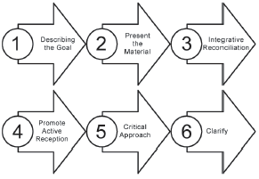
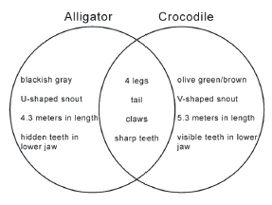
A Valuable Life Lesson
4. How are advance organizers used in analyzing stories?

Slide 10
A Valuable Life Lesson
ANSWER KEY
1. What do you call the part of a story that focuses on the higher meaning behind the
conflict and interactions between the characters? - Theme
2. How does a theme of a story evolve? -All other elements of a story such as characters, setting,
plot, and conflict contribute to a story’s theme and we can identify a story’s theme by
understanding how all of these elements fit together.
Venn diagram
Semantic web

Slide 11
A Valuable Life Lesson
ANSWER KEY
Flowchart
Venn diagram
4. How are advance organizers used in analyzing stories?
-Advance organizers are used to express ideas and the relationships of ideas derived from stories.

