Slide 1
Formal and Informal Language

Slide 2

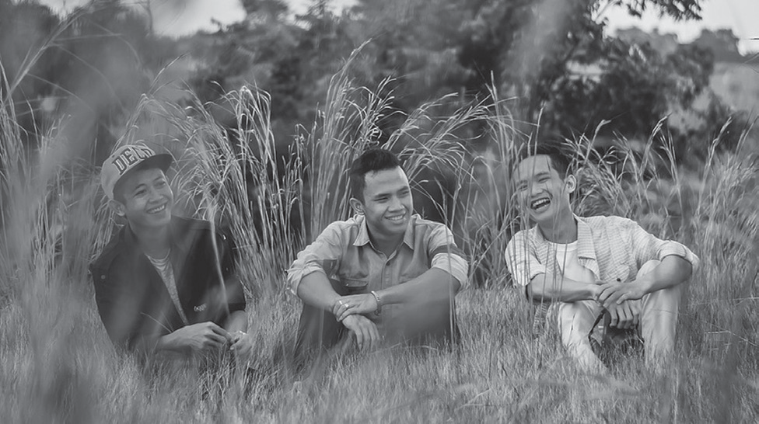
Formal and Informal Language
Informal Contexts
by CaiHuuThanh, CC0 Public Domain via Pixbay
by darwisalwan, CC0 Public Domain via Pixbay
Informal register is the language used by friends, family, and people that you are close with, while formal register is appropriate for professional settings or events like offices, classroom discussions, or professional organization’s events.

Slide 3
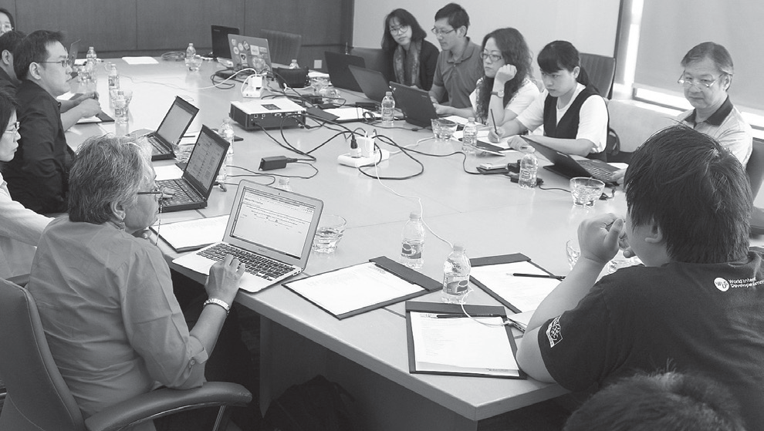
Formal and Informal Language
Formal Contexts
by Nasir Khan Saikat, CC BY-SA 4.0 via Wikimedia Commons
Faculty Meeting

Slide 4
Formal and Informal Language
Formal Contexts
Formal situations: a speech delivery, meetings, or academic forums. Informal situations: a conversation between friends and spontaneous sharing of stories and jokes between family members or close friends.
To know more about the appropriate use of English in formal and informal contexts, it is helpful to learn “register.” Register refers to variation in language or level of usage that is determined by degree of formality and consideration of several factors: the situation or context of use, the purpose, subject-matter and content of message, the standing of the user, and the relationship between the participants.
Source: ROMAINE, 1994 as cited by Jimenez, Ryan. “English Register (English 28).” April 28, 2021.
https:www.slideshare.net/RyanBuer/types-of-language-registers
https://www.lexico.com/defi nition/register

Slide 5
Formal and Informal Language
The Five Levels of Register
1. Frozen – printed, unchanging language, formal, almost scripted phrases that do not vary
Examples:
The Bible Laws • Preamble to the Philippine Constitution
I want to welcome you to the Managers’ Conference, sponsored by Sunny Inc.
Please submit the document at your earliest convenience.

Slide 6
Formal and Informal Language
The Five Levels of Register
2. Formal – characterized by one-way communication, no interruptions
– used in impersonal, formal settings
– follows a commonly accepted format—complete sentences, more complex syntax, and specific word usages
– often used to show respect
Examples:
introductions between strangers • speeches
pronouncements made by judges • announcements
Good afternoon. I’ll inform Dr. Carlos that you have arrived.
Could you possibly monitor the parcel delivery for me by tomorrow?

Slide 7
Formal and Informal Language
The Five Levels of Register
3. Consultative – involves two-way participation, professional setting
– Background information is provided (Prior knowledge is not assumed).
– Interruptions and feedback fillers are allowed (“uh-huh,” “I see”).
– more complex syntax, longer phrases
Examples:
doctor: patient, lawyer: client, lawyer: judge • teacher: student • superior: subordinate
Hello, Ms. Cruz. How are you doing this morning?
Can you do this in the afternoon?

Slide 8
Formal and Informal Language
The Five Levels of Register
4. Casual – uses very informal language; Ellipsis and slang are common.
– no background information provided
– “group” language—must be a member to use
– interruptions common
– context and nonverbal communication important
Examples:
friends and acquaintances • family • teammates • chats and blogs
Hey, Joe. What’s up?
Watch my bag for me, OK?

Slide 9
Formal and Informal Language
The Five Levels of Register
5. Intimate – non-public
– Intonation is as important as wording and grammar.
– often a private vocabulary
Examples:
husband and wife • boyfriend and girlfriend • twins (siblings)
How’s my little lovie today?
Hey, honey, pour me a cuppa Jenny.

Slide 10
Formal and Informal Language
ACTIVITY: Below are words or phrases with similar meanings. One is for formal contexts, while the other is for informal contexts. Choose from the given options to complete the following statements.
Example:
Heaps of packages are placed on the table for delivery.
heaps of / a number of (informal talk between friends)
1. lots of / a lot of / many / much (informal situation)
There’s ___________ food for our friends and relatives.
2. completely / totally (formal situation)
I’m ___________ troubled by the emerging problems of our organization.
3. really / definitely (informal situation)
She’s ___________ excited about the coming birthday celebration.

Slide 11
Formal and Informal Language
ANSWER:
Example:
Heaps of packages are placed on the table for delivery.
heaps of / a number of (informal talk between friends)
1. lots of / a lot of / many / much (informal situation)
There’s a lot of food for our friends and relatives.
2. completely / totally (formal situation)
I’m completely troubled by the emerging problems of our organization.
3. really / definitely (informal situation)
She’s really excited about the coming birthday celebration.

