Slide 1
Literary Style

Slide 2
Literary Style
A literary text is a genre of literature that creatively conveys a message. This genre focuses on both content and form. When you see this kind of text, you will simply notice the use of stylistic language. Each text has its own characteristic to present reality or discuss a phenomenon.

Slide 3
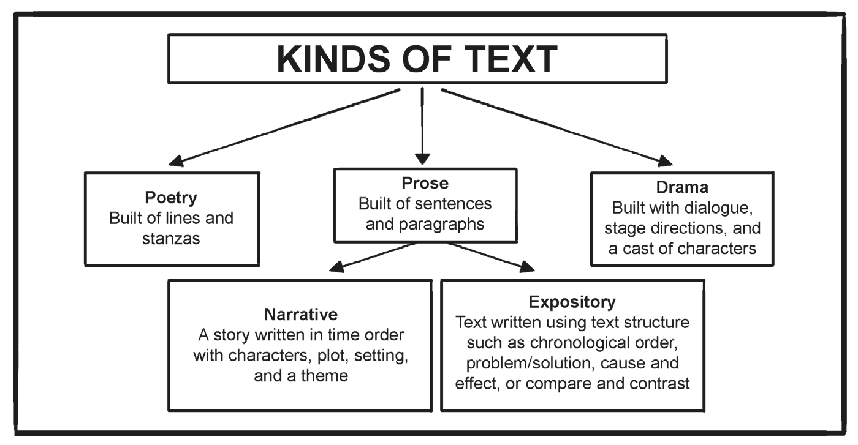
Literary Style
Kissner (2013) - Retrieved from http://emilykissner.blogspot.com/2013/07/kinds-of-text-poetry-drama-and-prose.html

Slide 4
Literary Style
A narrative text is a story creatively written to entertain the reader. It tells stories that use imaginative language and express emotion through the use of literary devices. Fiction and nonfiction stories, fables, folktales, legends, myths, and fairytales are examples of narrative text.
Fictions are popular to learners. Fictions were adapted in movies. Some famous writers contributed to the fiction genre like Edgar Allan Poe, William Shakespeare, and Oscar Wilde.

Slide 5
Literary Style
What Is a Literary Style?
Literary styles are the choice of words, syntax, sentence structure, and language (metaphorical and figurative) that the writers use to express their concept through their work. Literary style can also be described as how a writer express es what he/she wants to say. The writer’s style may be determined through his/her choice of words, the sentence structure, syntax, and language.

Slide 6
Literary Style
There are four types of literary styles. These are expository, descriptive, persuasive, and narrative.
1. Expository style is a subject-oriented type of writing. Its main objective is to tell the reader about a specific subject or topic. Informative essays are examples of writing that use expository style.
Example:
“Drones are considered robots too. They are now used in some foreign countries as tools to do different types of tasks.”

Slide 7
Literary Style
2. Descriptive style specifies a subject or object. It is poetic and usually involves sensory details. Poetic lines use descriptive style to highlight imagery.
Example:
“The clouds cover the entire sky with the peaceful shade of blue, setting the scene with serenity.”

Slide 8
Literary Style
3. Persuasive style gives reasons and justifications to convince the readers. Argumentative essays use persuasive style to persuade the readers.
Example:
“The impact of global aspects easily reaches young minds through television and other multimedia platforms. It is no doubt that one day, our very own language will be swiped off the surface along with the remaining Filipino culture, beliefs, and values.”

Slide 9
Literary Style
4. Narrative style narrates a story, including short stories, novels, poetry, and biographies. Short stories use the narrative style to connect with the readers’ emotions and experiences.
Example:
“Emily closes her eyes as the music in the background continues. Her tears fall down her cheeks , and she knows that they are visible to Robert.”

Slide 10
Literary Style
ACTIVITY: Matching Type. Match the descriptions from Column A with the types of literary texts in Column B. Write the letter only.
COLUMN A
COLUMN B
1. Characters, plot, setting, and theme
2. Text structures
3. Lines, verses, and stanzas
4. Dialogues, stage directions, and characters
5. Type of Prose that tells story
A. Prose
B. Narrative
C. Poetry
D. Expository
E. Drama

Slide 11
Literary Style
ANSWER:
COLUMN A
COLUMN B
1. Characters, plot, setting, and theme A
2. Text structures D
3. Lines, verses, and stanzas C
4. Dialogues, stage directions, and characters E
5. Type of Prose that tells story B
A. Prose
B. Narrative
C. Poetry
D. Expository
E. Drama

