Slide 1
Communication Skills for Life

Slide 2
Communication Skills for Life
Here are some gestures from Heather Yamada-Hosley who cites few gestures from Vanessa Van Edwards’s video.
• When you say a number, show that number with your fingers. For example, “You
need to follow two basic rules to join the club and be a member.” When you say the
word “two,” you should be able to show that number with your fingers as well.
• Use your hands to underscore the importance of an issue. If you say, “This is a big
problem,” you would hold your hands wider apart to give your words visual impact.
However, if you say, “That is a small issue,” your thumb and pointer finger must be
a little apart to show how small the problem is.

Slide 3
Communication Skills for Life
• Emphasize emotional topics by placing a hand over your heart. An example is when
you say something like, “This vital issue means a lot to me.”
• Help others keep track of your explanation of two diff erent groups by representing
one group with each hand. When comparing two proposals, you use your left hand to
refer to proposal one and your right hand for proposal two. Be consistent when you
mention proposal one; raise your left hand a little higher and vice versa. This way, your
audience doesn’t get confused.
• Show two things being brought together by bringing your hands together. An example
from the video: “I see children like babes in the woods.” As you say “children,” you
raise one hand; as you say “babes” you raise the other, and at the end of your
sentence, bring your hands together, “woods.” There is a visual emphasis that helps a lot.

Slide 4
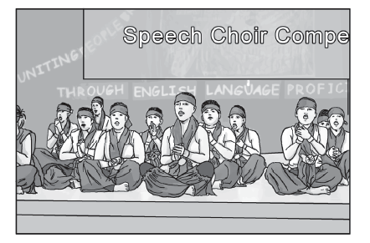
Communication Skills for Life
This is a speech choir that is like a choir of singers who get together to perform. While a choir sings, a speech choir performs a special speech instead of singing a song. The members of a speech choir chant every part of the speech in perfect unison. They perform a speech choir piece, often a poem, that is spoken or delivered with a theatrical effect.

Slide 5
Communication Skills for Life
The other conventions of the speech choir that are related to voice are the following:
• voice quality (light, medium, and dark)
• number of voices (maybe solo speaker, small group, or whole choir)
• pitch or inflection
• power (using volume, force, or loudness for emphasis)
• phrasing and rhythm
• tempo or the rate of speech that relates to the beat of the poem or the piece

Slide 6
Communication Skills for Life
Summarizing
Pointers in summarizing texts that you listened to:
1. Carefully listen to or view the material to be summarized.
2. Jot down the main ideas and major details.
3. Remember that the main idea of the material is the most important idea of your
summary.
4. Show the connections between the facts and ideas when you summarize.
5. Leave out unnecessary details.
6. Make sure that you present the ideas and information in an organized way that
reflects the message or meaning of the text you listened to or viewed.

Slide 7
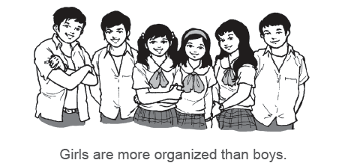
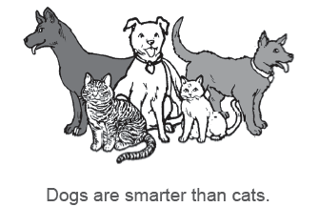
Communication Skills for Life
Making Generalizations and Conclusions
Are the above statements conclusions or generalizations?

Slide 8
Communication Skills for Life
Generalizing and concluding are important skills that are taught in school. They are also important in life.
Conclusion
How to Draw Conclusions:
1. You must know the main idea of the selection or the material you are viewing or listening.
2. You have to understand the facts and details about the main ideas and the subpoints.
3. As you listen to the material or as you view the material, ask yourself, “What will happen as a result of these actions or events?”

Slide 9
Communication Skills for Life
How to Draw Conclusions:
4. Build your conclusion on pieces of evidence you can find in what you have listened to or what you have watched. Sometimes you have to rely on or use your own experience for you to figure out how things may happen, but you have to ensure that you base your conclusions on what you have listened to or what you have watched.
Example:
How can we beat COVID-19?
In summary, our society would have fewer COVID-19 new cases if more people practiced the basic health protocols. We should continue to cooperate with the government’s policies on public health and the local government units’ quarantine policies and guidelines.

Slide 10
Communication Skills for Life
Generalization
One way to interpret the information from what you have listened to or viewed is to develop skills in generalizing. A generalization is a broad statement or an idea that is applied to a group of people or things. It is often true but not completely true in all cases or not entirely true because there are usually examples of individuals or situations in which the generalization does not apply.
How to Generalize:
1. It is important that you understand the main idea and key details of what you have listened to or viewed.
2. When you draw conclusions or make a prediction of outcomes, you must base them on the information that you have listed or viewed.
3. Think about how you will apply the writer’s ideas in different situations.

Slide 11
Communication Skills for Life
4. When you make a generalization, be aware of words that do not allow exceptions like “always, never, must, certainly, definitely, and absolutely.”
5. Remember that the main idea statement is often a generalization.

Slide 12
Communication Skills for Life
Identify whether the statements is TRUE or FALSE.
1. Communication skills include reading, listening, speaking, writing, and viewing.
2. Hand gestures are used to communicate.
3. There are no speech conventions for speech choir or poem recital.
4. Listening skills plays an important role in drawing generalizations and conclusions from
any material viewed.
5. We use listening skills in summarizing information from the text.

Slide 13
Communication Skills for Life
ANSWER KEY
True or False.
True 1. Communication skills include reading, listening, speaking, writing, and viewing.
True 2. Hand gestures are used in communication.
False 3. There are no speech conventions for speech choir or poem recital.
True 4. Listening skills plays an important role in drawing generalizations and conclusions
from any material viewed.
True 5. We use listening skills in summarizing information from the text.

