Slide 1
Using the Right Subordinating and Coordinating Conjunctions to Compose Clear Sentences

Slide 2
Using the Right Subordinating and Coordinating Conjunctions to Compose Clear Sentences
Sentences are also called clauses which can express several relationships to show their
context and meaning. The variety and flow of sentences can be achieved when conjunctions are
used. Conjunctions are the words or groups of words that connect or link groups of words in a
sentence and establish relationships between or among your sentences.
Sentences are composed of dependent and independent clauses which are joined by
conjunctions, namely, coordinating and subordinating. Coordinating conjunctions combine ideas
that are of equal rank and importance. Subordinating conjunctions join both independent and
dependent clauses.

Slide 3
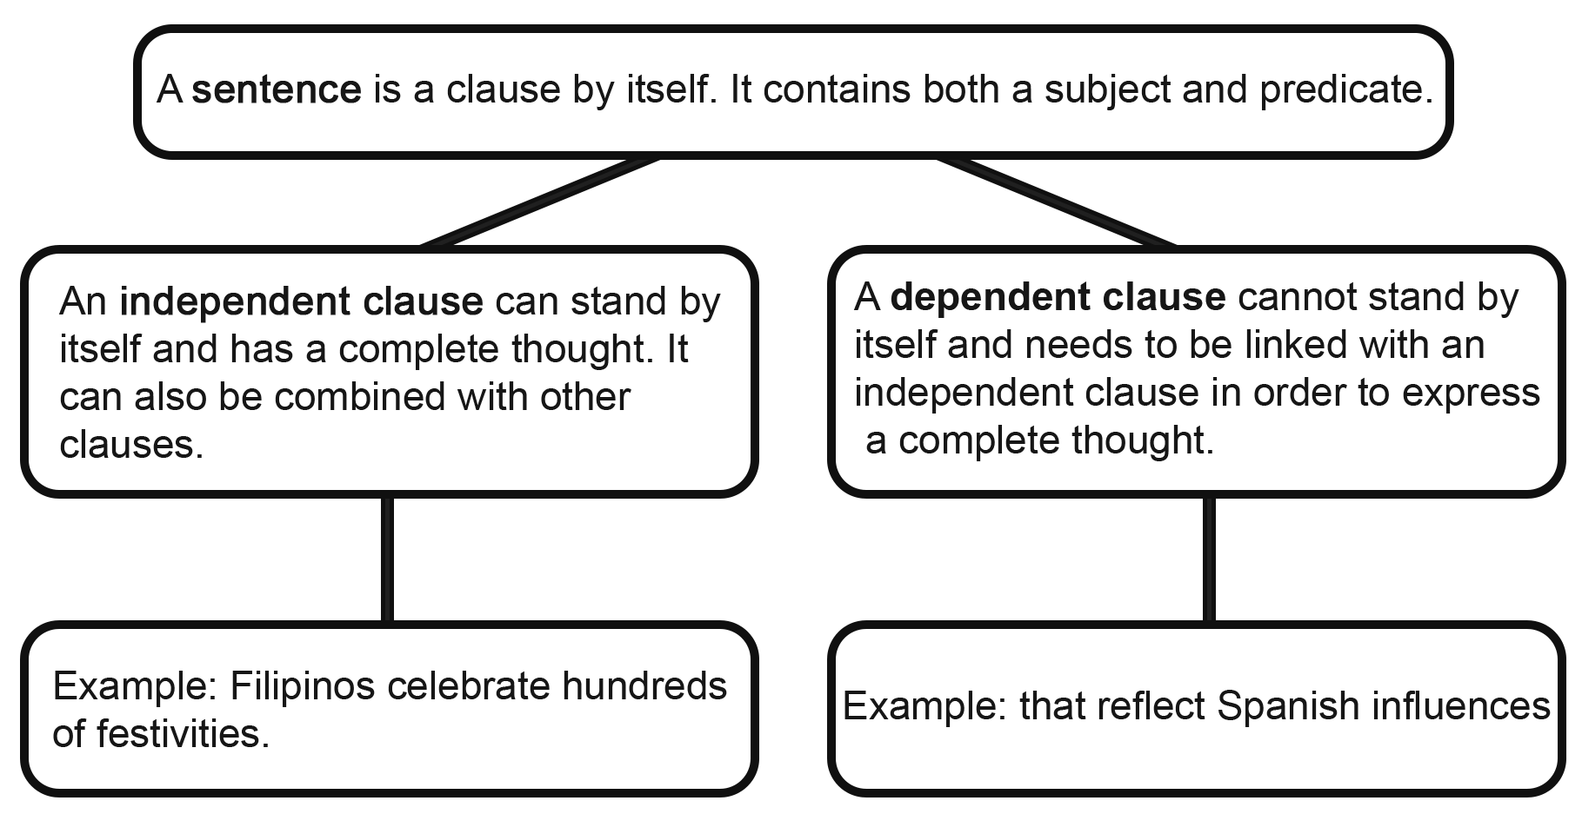
Using the Right Subordinating and Coordinating Conjunctions to Compose Clear Sentences
Structure of Sentence

Slide 4
Using the Right Subordinating and Coordinating Conjunctions to Compose Clear Sentences
Conjunctions
1. Coordinating Conjunctions are more popularly known as the FANBOYS which stands for: for, and, nor, but, or, yet, and so. These words join clauses that are of equal rank and importance. Coordinating conjunctions put together two independent clauses and form a compound sentence.
A. The Spanish missionaries did not only convert Filipinos to Christianity, but they also taught them good behavior, trading, language, tradition, and habits, among others.
B. Eighty percent of the Filipinos are Catholics, and they take pride in being the only Christian nation in Asia.

Slide 5
Using the Right Subordinating and Coordinating Conjunctions to Compose Clear Sentences
Conjunctions
2. Subordinating Conjunctions not only join independent clauses and dependent clauses, but they also reflect the kind of relationship these clauses have. There are different types of subordinating conjunctions according to their use, which can be: comparison, condition, cause, concession, time, and manner.

Slide 6
Using the Right Subordinating and Coordinating Conjunctions to Compose Clear Sentences
Kinds of Subordinating Conjunction
A. Comparison: These words join independent and dependent clauses by comparing the two clauses.
Examples: whereas, whether, rather, as much as, than, rather than
○ The Filipinos wanted equal treatment as much as they wanted their independence from colonial rule.
B. Condition: These words connect clauses while revealing that one action is dependent on another
action.
Examples: if, as long as, unless, in case, provided that, assuming that
○ In case you want to know which aspect of our Filipino identity shows Spanish origins, check the family name that we carry.

Slide 7
Using the Right Subordinating and Coordinating Conjunctions to Compose Clear Sentences
Kinds of Subordinating Conjunction
C. Cause: These words state the reasons or causes why something happened.
Examples: because, so that, since, as, in order to
○ Since churches were built near towns and villages, church bells were used to rouse Filipinos and enjoined them to attend masses each day during the Spanish era.
D. Concession: These words feature an action that takes place despite difficulties or challenges.
Examples: though, although, even though
○ Although the Spanish occupation ended a century ago, their influence is deeply ingrained in the way of life of Filipinos from birth to death.

Slide 8
Using the Right Subordinating and Coordinating Conjunctions to Compose Clear Sentences
Kinds of Subordinating Conjunction
E. Time: These words indicate when something takes place.
Examples: until, whenever, after, as soon as
○ Before the Spanish era ended, Filipinos learned better farming techniques, trading, baking, and painting, among others.
F. Manner: While combining clauses, these words tell us how things are done.
Examples: as though, as if, how
○ Most Filipinos defend their faith as though it is a matter of life and death.

Slide 9
Using the Right Subordinating and Coordinating Conjunctions to Compose Clear Sentences
Choose a proper conjunction from the given word bank to complete each of the following sentences.
1. Marie was packing her Lola’s lunch _____ her parents start the car.
2. _____ her illness, Lola Imelda did not have a chance to tend her garden.
3. Marie knew _______________________ Lola Imelda was happy.
Answer:
1. while
2. Since
3. why
why since where while

