Slide 1
Filling Out Forms

Slide 2
Filling Out Forms
Forms are printed or typed documents with blank spaces for the insertion of the required information. Filling out forms accurately is a skill. A person filling out a form should know its type to be able to fill it out. In addition, reading the instructions and the needed information before filling out any form is important.
Why is filling out forms important?
Filling out forms is an important skill that needs to be learned because, for one, they are important documents, and they often require a lot of important information related to you. Forms must be accomplished correctly and honestly.
It is important to be honest when filling out forms because they represent your identity and give correct information about you.

Slide 3
Filling Out Forms
The following basic information is usually asked in various forms.
Name | This refers to your first name, middle name, and family/last name/surname.
Address | This refers to where you live. Make sure to include your complete address.
Date of Birth | This refers to the date when you were born. Make sure to include the month, day, and year of your birth.
Age | This refers to how old you are.
Telephone Number/Contact Number | This refers to the number where you can be contacted. It can be a landline or mobile/cell phone number.
Gender | This refers to whether you are male or female.
Nationality | This refers to the country where you were born.

Slide 4
Filling Out Forms
Father’s Name | This refers to your father’s complete name.
Father’s Occupation | This refers to your father’s job or what he does for a living.
Father’s Age | This refers to how old your father is.
Mother’s Name | This refers to your mother’s complete name.
Mother’s Occupation | This refers to your mother’s job or what she does for a living.
Mother’s Age | This refers to how old your mother is.
Guardian’s Name (if any) | This refers to the name of another person caring for you other than your parents or in the absence of your parents.
Religion | This refers to your religious beliefs.
Siblings | This refer to your brother(s) or sister(s), if any.

Slide 5
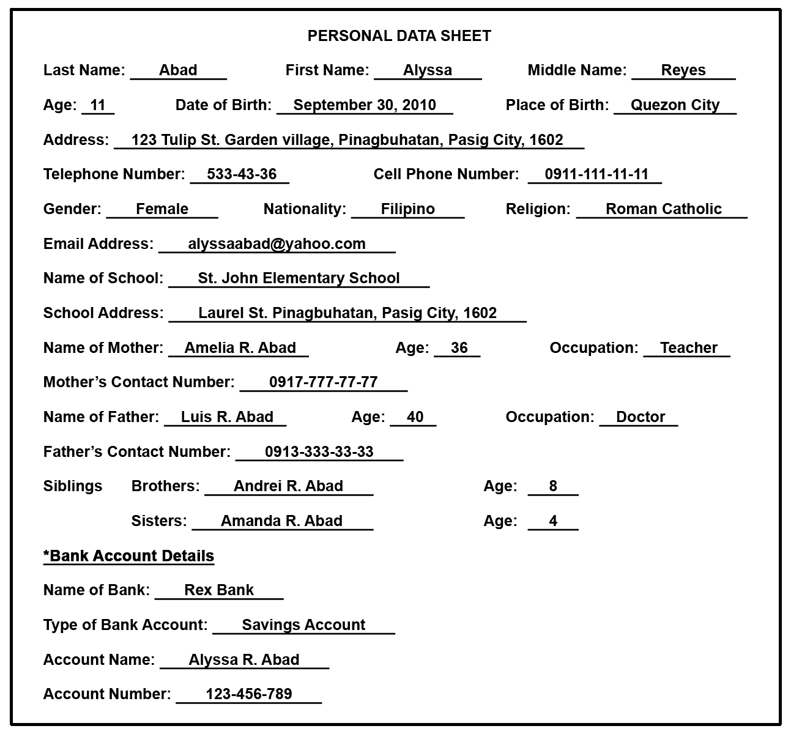
Example:
Filling Out Forms

Slide 6
Filling Out Forms
Bank Form
There are various types of forms used in a bank for every kind of bank transaction. The following pieces of information are commonly present and asked in bank forms.
♦ Name of Bank refers to the bank where you have opened a bank account.
Example: Rex Bank
♦ Type of Account refers to the account you have in the bank (savings account or checking account).
Example: Savings Account
♦ Account Name refers to the name of the bank account holder.
Example: Alyssa R. Abad
♦ Account Number refers to the set of numbers specific to your bank account.
Example: 123-456-789

Slide 7
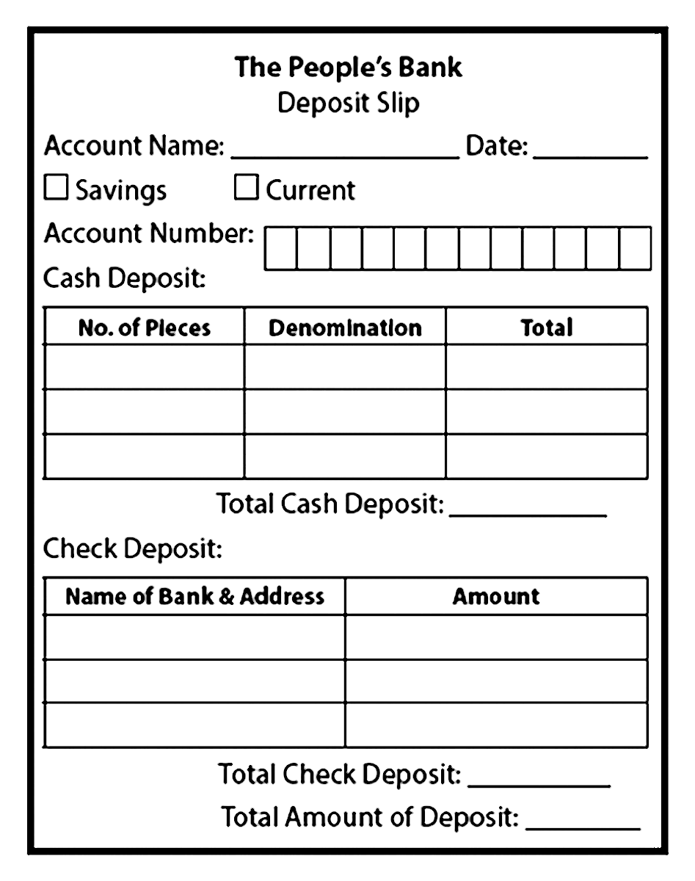
Filling Out Forms
Bank Form
Types of Bank Forms
1. Deposit Slip: This is commonly found inside a bank and is used when you want to add money to your bank account. Notice that it asks for your account name, date, account number, and account type (e.g., savings account or current account). You also need to give the amount (e.g., P550), denomination (P100, P20, P50, P1, P5, etc.), and number of pieces of denomination (2 pcs of P100, 4 pcs of P50, 8 pcs of P20, etc.).

Slide 8
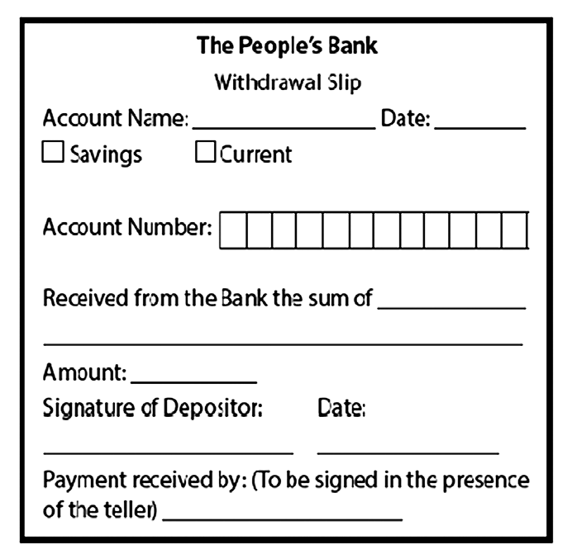
Filling Out Forms
Bank Form
Types of Bank Forms
2. Withdrawal Slip: This can also be found inside a bank. It is used when you want to get money from your bank account. The withdrawal slip also asks for your account name, date, account number, and account type (e.g., savings account or current account). You also need to give the amount you want to get from the bank and sign the deposit slip.

Slide 9
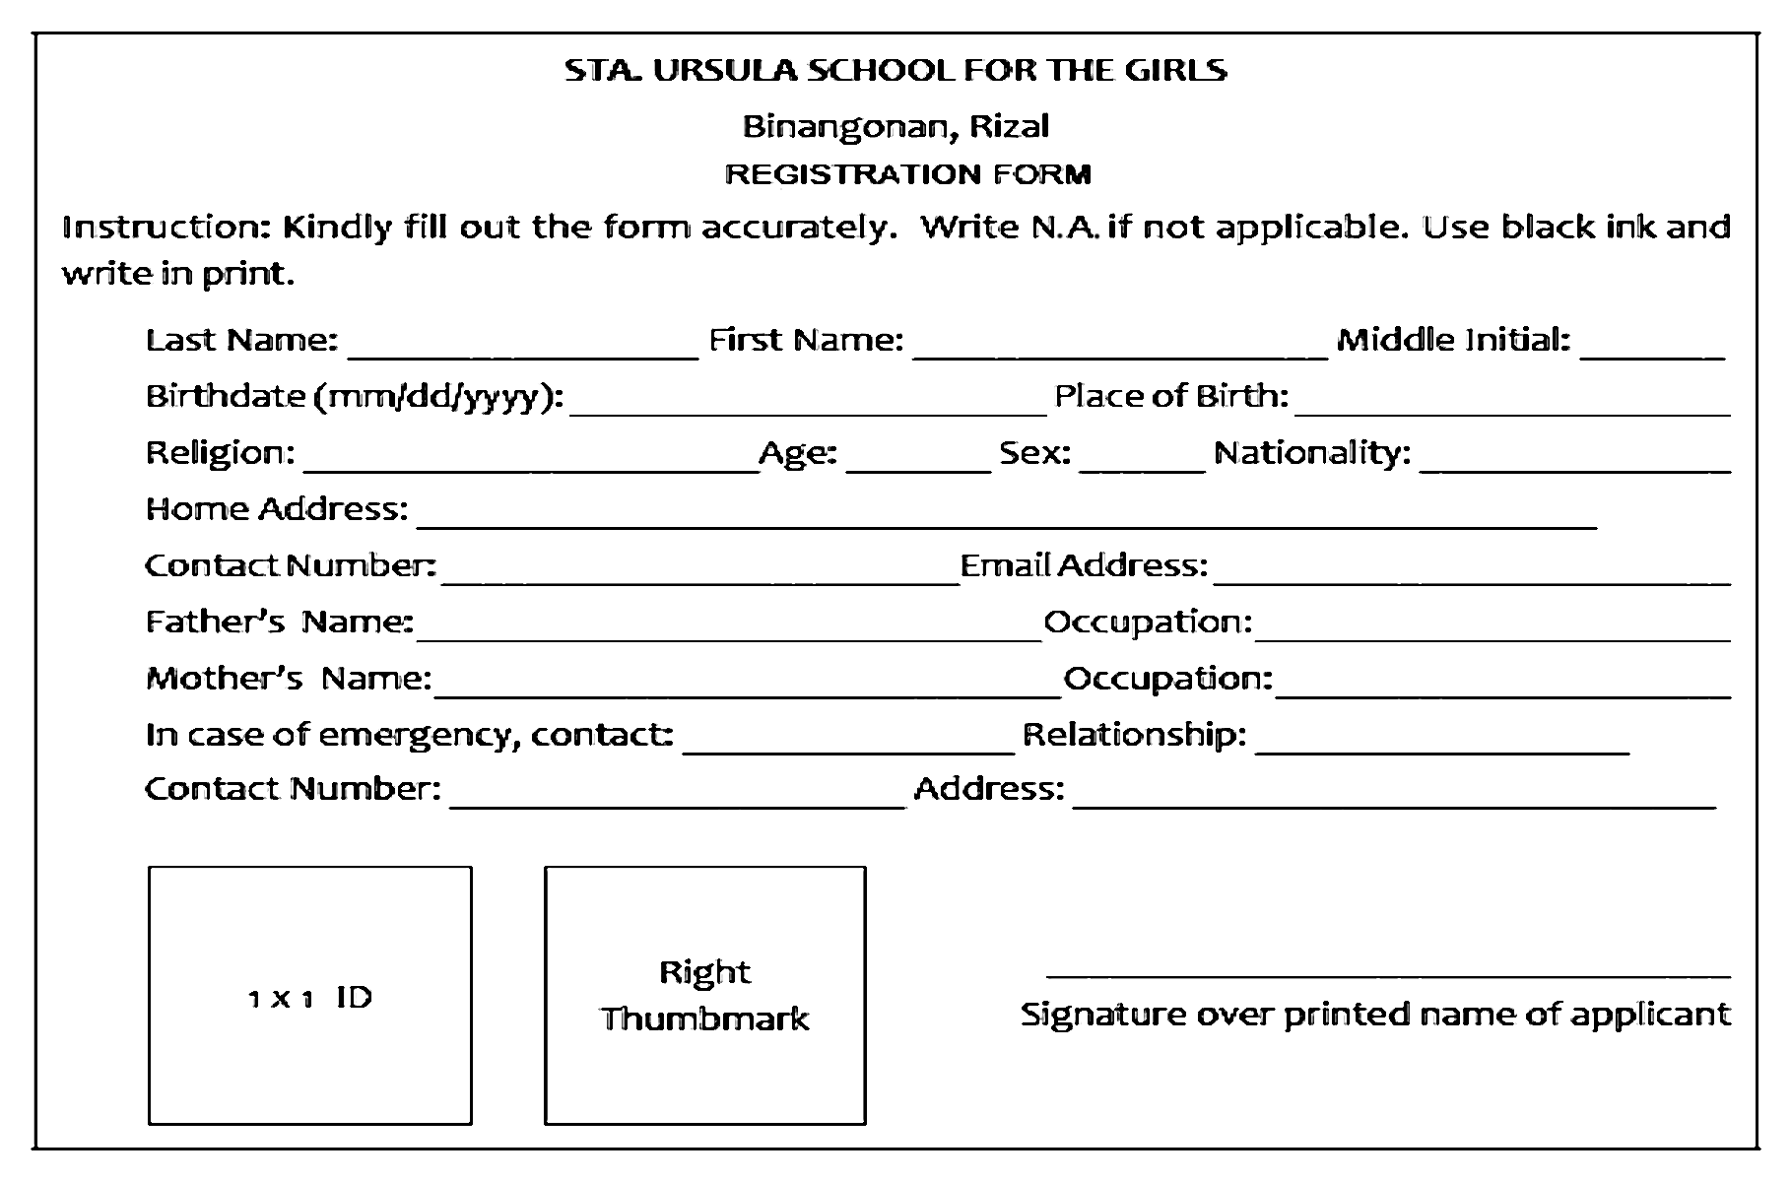
Filling Out Forms
School Form
This is an information sheet used in schools. It is filled out when you want to enroll in a certain school.

Slide 10
Filling Out Forms
Here are some important things to remember when filling out forms:
1. Read the instructions carefully.
2. Pay attention to the details so that you can provide the correct information in the correct
space/blank or box.
3. Use black ink as often as possible. Do not use a pencil. But also check the instructions if there is a
specific color of ink required for the form.
4. Write legibly in print.
5. Avoid erasures
6. Make sure to supply all the needed information. Ask a parent/teacher/guardian if you do not know what information is being asked from you.
7. Write N.A. for “not applicable” in the blanks which do not apply to you.
8. Observe honesty in filling out forms.
9. Give accurate details when filling out forms.
10. Review the entries you filled out on the forms before submitting them.

Slide 11
Filling Out Forms
Read aloud the selection below. Afterward, copy the given Enrollment Form. Fill it out with the information needed.
ENROLLMENT FORM
Name (Last Name, First Name, Middle Initial) | (1)
Age | (2)
Gender | (3)
Date of Birth | (4)
Place of Birth | (5)
Contact Number | (6)
Email Address | (7)
Grade Level | (8)
Name of Mother | (9)
Name of Father | (10)
Angelica Mercado Reyes is going to enroll in a school as a Grade 5 learner. She was asked to fill out an enrollment form. She was born on September 28, 2010, in Pasig City. Her parents are Alma Reyes and Rodel Reyes. She can be reached at 0918-444-44-44 or through amreyes@gmail.com. She was asked to use black ink and to make sure that the pieces of information she will give are accurate. She was also informed to keep the form clean and to avoid erasures.

Slide 12
Filling Out Forms
Answers:
1. Reyes, Angelica M.
2. 11
3. Female
4. September 28, 2010
5. Pasig City
6. 0918-444-44-44
7. amreyes@gmail.com
8. Grade 5
9. Alma Reyes
10. Rodel Reyes

