Slide 1
Identifying a Paragraph and Its Parts

Slide 2
Identifying a Paragraph and Its Parts
Let us liken the ham sandwich to a paragraph. Just like the ham sandwich that is made up of different ingredients, a paragraph is made up of different parts that when put together express one whole idea.
A paragraph is a group of related sentences that present one idea or topic. Since it is made up of related sentences, the sentences are divided into three parts. You have the beginning or the introduction, the middle or the body of the paragraph, and the ending or the conclusion.

Slide 3
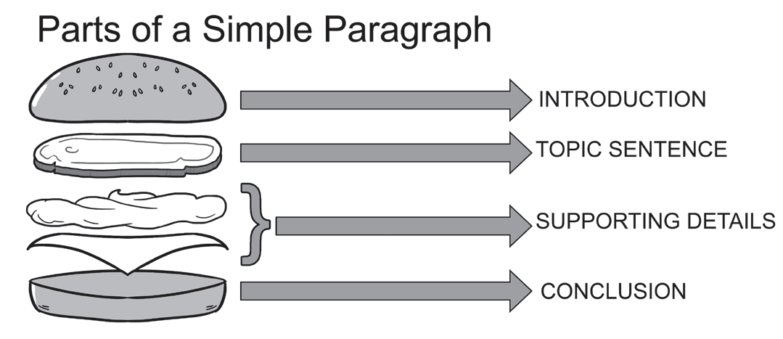
Identifying a Paragraph and Its Parts
Like the ham sandwich, the first bread is the introduction of a paragraph. It gives readers an idea of what will be talked about in a paragraph.
The ham serves as the topic sentence or the main topic, which gives readers an idea of what the paragraph is all about. The topic sentence of a paragraph can be found in any of its three parts: introduction, body, or conclusion.
To make the whole sandwich even more delicious, other ingredients are added like mayonnaise and cheese. We can liken the other ingredients to supporting details because they elaborate or tell us more about the topic sentence.
Finally, you need to add another bread to put all the ingredients together. The second bread is the ending or conclusion, which gives a summary or closure of what was talked about in the paragraph.

Slide 4
Identifying a Paragraph and Its Parts
Example:
Being an honor pupil takes a lot of hard work. Christina is a consistent honor pupil. She reads her lessons in advance and studies them even if there is no test. She keeps her notes neat and organized, so if she needs them, they can be easily accessed. She always submits her homework on time, and she produces projects with quality. Indeed, she deserves to be an honor pupil because she works really hard.
INTRODUCTION
TOPIC SENTENCE
SUPPORTING DETAILS
CONCLUSION

Slide 5
Identifying a Paragraph and Its Parts
The sentences in the given paragraph are numbered. Read and identify its topic sentence and concluding sentence.
1Bayanihan is a common Filipino practice. 2It is reflected when one says, 3“Our house did not really get burned because our neighbors came to help put out the fire.” 4This practice of the Filipinos to immediately respond to the needs of the neighbors is very evident, especially in the provinces where government assistance cannot immediately reach those who are in need because of the distance and accessibility problems. 5Indeed, the spirit of helping each other in a community is shown through Bayanihan.
Which sentence shows the topic sentence and conclusion of the given paragraph?

Slide 6
Identifying a Paragraph and Its Parts
ANSWER KEY
1Bayanihan is a common Filipino practice. 2It is reflected when one says, 3“Our house did not really get burned because our neighbors came to help put out the fire.” 4This practice of the Filipinos to immediately respond to the needs of the neighbors is very evident, especially in the provinces where government assistance cannot immediately reach those who are in need because of the distance and accessibility problems. 5Indeed, the spirit of helping each other in a community is shown through Bayanihan.
Sentence 1: Topic sentence
Sentence 5: Conclusion

