Slide 1
Using Word Association and Classification to Get the Meaning of Words

Slide 2
Using Word Association and Classification to Get the Meaning of Words
Words are related to each other in some ways.
Word association
  is a technique you can use not only to arrive at the meaning of an unfamiliar word but also to expand your vocabulary.
  refers to free association in which a given word serves as the “cause” for you to think of more words related to the given word.

Slide 3
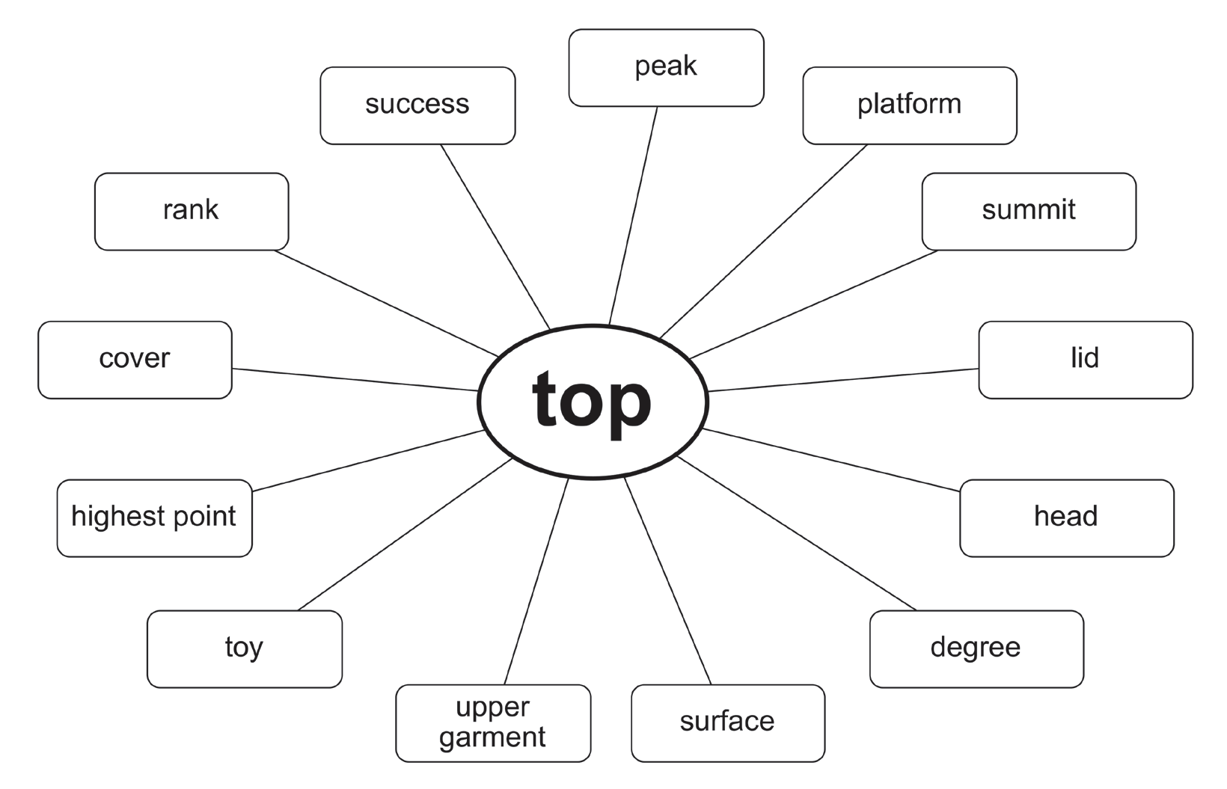
Using Word Association and Classification to Get the Meaning of Words

Slide 4
Using Word Association and Classification to Get the Meaning of Words
Top is to highest point as summit is to peak.
What do you think is the relationship of the words top, highest point, summit, and peak?
All have the same meaning, or they are all synonyms of each other.

Slide 5
Using Word Association and Classification to Get the Meaning of Words
Word analogy is the comparison of words that show similarities with each other. It explains how one word is in terms of another in order to emphasize the characteristics that make the words alike.
Example: Summit is to bottom as peak is to base.
Summit is the opposite of bottom, and peak is the opposite of base.
The given example shows that each pair is an antonym.

Slide 6
Using Word Association and Classification to Get the Meaning of Words
Word classification is simply grouping words together that have similarities or relations to one another.
Example:
Monday, Tuesday, and Wednesday - days of the week.
shirt, blouse, and polo - clothes.

Slide 7
Using Word Association and Classification to Get the Meaning of Words
Directions: Read each sentence. Choose the letter of the correct answer.
1.Which among the groups do the instruments violin, viola, and cello belong to?
A. brass C. string
B. percussion D. woodwind

Slide 8
Using Word Association and Classification to Get the Meaning of Words
2. Which among the groups do the words always, often, and requently belong to?
A. adjectives C. nouns
B. adverbs D. verbs
3. Which of the following does not belong to the group?
A. soap C. shampoo
B. lipstick D. toothpaste

Slide 9
Using Word Association and Classification to Get the Meaning of Words
ANSWER KEY
Directions: Read each sentence. Choose the letter of the correct answer.
1.Which among the groups do the instruments violin, viola, and cello belong to?
A. brass C. string
B. percussion D. woodwind

Slide 10
Using Word Association and Classification to Get the Meaning of Words
ANSWER KEY
2. Which among the groups do the words always, often, and requently belong to?
A. adjectives C. nouns
B. adverbs D. verbs
3. Which of the following does not belong to the group?
A. soap C. shampoo
B. lipstick D. toothpaste

