Slide 1
Using the Dictionary, Thesaurus, and Online Resources to Get the Meaning of Words

Slide 2
Using the Dictionary, Thesaurus, and Online Resources to Get the Meaning of Words
When you use the dictionary to look for the meaning of a word, it gives you an exact definition of the word and some other important details such as its part of speech, its pronunciation, and how you can use it in a sentence.
A dictionary uses guide words that help learners see right away what words are defined on a given page. You will see those guide words at the top or bottom of the page. The first guide word is the first word you will see on that page, while the second guide word is the word that is defined last on that page. Other words between the guide words are arranged alphabetically.
A dictionary uses guide words that help learners see right away what words are defined on a given page. You will see those guide words at the top or bottom of the page. The first guide word is the first word you will see on that page, while the second guide word is the word that is defined last on that page. Other words between the guide words are arranged alphabetically.

Slide 3
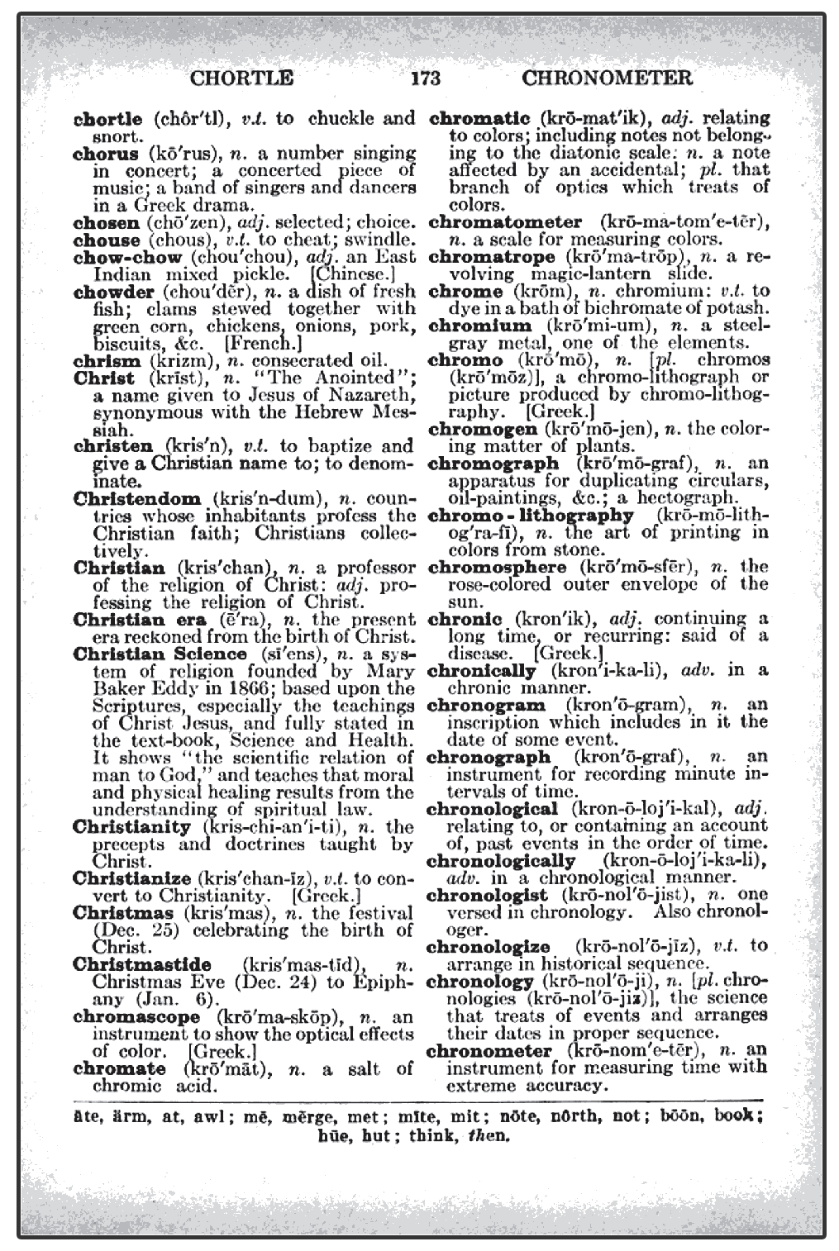
Using the Dictionary, Thesaurus, and Online Resources to Get the Meaning of Words
Let us pretend that we are looking for the meaning of the word chrome. As you can see, the first guide word is chortle because it is the first word on the page. Chronometer is the last word on the page; that is why it is also the second guide word. Chrome appears in between these two guide words: chortle and chronometer. The guide words help speed up your word search in this manner.

Slide 4
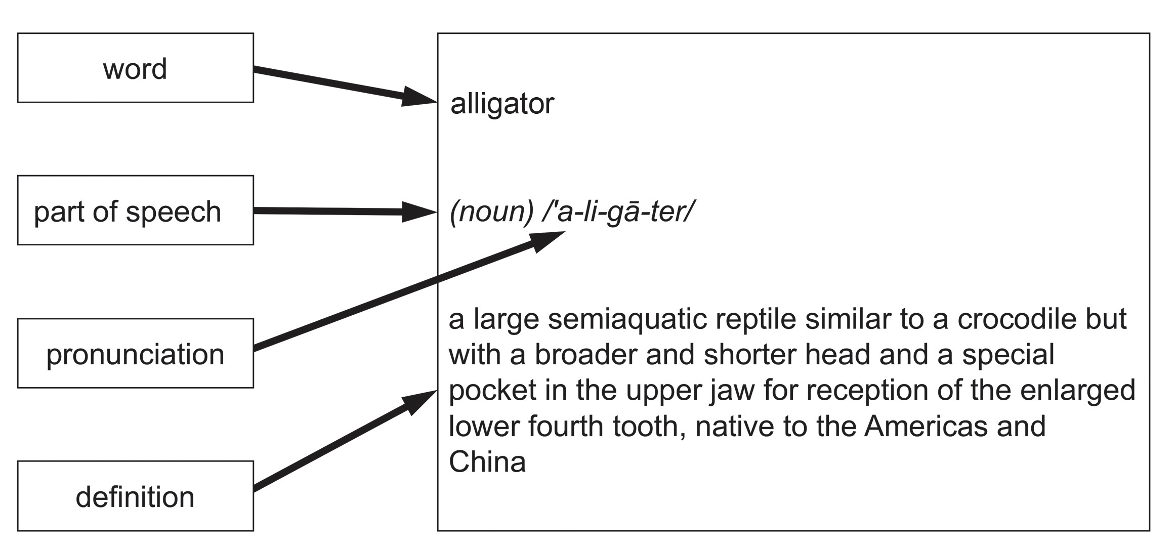
Using the Dictionary, Thesaurus, and Online Resources to Get the Meaning of Words
This is a word entry from a dictionary.
Each part tells you how the word is spelled correctly, which part of speech the word belongs to, how the word is pronounced correctly, and the definition of the word.

Slide 5
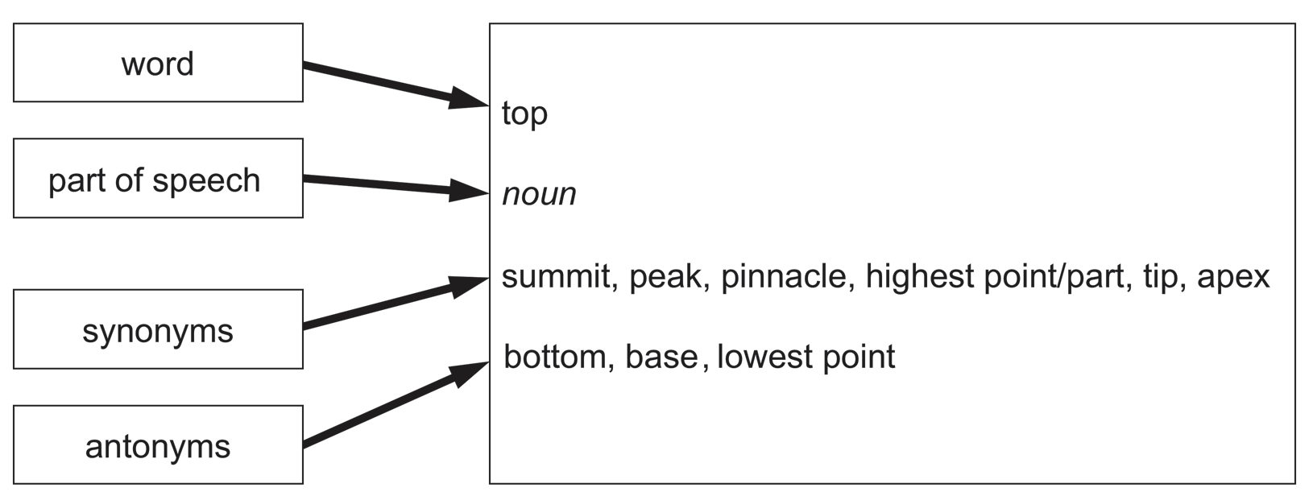
Using the Dictionary, Thesaurus, and Online Resources to Get the Meaning of Words
The thesaurus can help you find a similar word of a word you are looking for or the opposite word of a word you are looking for.
The parts of a thesaurus are a bit different because they no longer give you the definition of a word. Instead, they give you the synonyms and antonyms of a word as well as a sample sentence to give you a clue on how to use the word. Like a dictionary, a thesaurus will also show the spelling of a word and what part of speech it belongs to.

Slide 6
Using the Dictionary, Thesaurus, and Online Resources to Get the Meaning of Words
In today’s generation, we have a third source of information, which is the Internet.
Internet
  has sites where you can easily type in an unfamiliar word, and a search engine will pull up a handful of digital dictionaries and thesauruses that can help you find the meaning of the word.
Merriam-Webster: merriam-webster.com (m-w.com)
  is designed to be just like a real dictionary, but it is digital. This means you can also do word searches on this site.

Slide 7
Using the Dictionary, Thesaurus, and Online Resources to Get the Meaning of Words
You can say that a digital dictionary and a digital thesaurus are almost similar to physical ones since they give you the definition of a word, its spelling, pronunciation, and synonyms and antonyms, as well as a sample sentence. The only difference is that you can access this information through any smart device with an Internet connection. But not all information on the Internet is correct, so there is always a need to verify the information.

Slide 8
Using the Dictionary, Thesaurus, and Online Resources to Get the Meaning of Words
Read the given words. Use a thesaurus to look for two synonyms of each word. Make a sentence using each of the given words. The first one is done for you as an example.
1. brave
2. quick
3. kind
4. silent
5. warm
1. brave―bold, courageous
Sentence: Our frontliners are brave individuals who serve the country amid the pandemic.

Slide 9
Using the Dictionary, Thesaurus, and Online Resources to Get the Meaning of Words
ANSWER KEY
Answers may vary. These are the sample answers:
1. Given
2. quick―alert, immediate
Sentence: He was quick to run out of the building when he saw a fire.
3. kind―considerate, good
Sentence: We all need to have a kind heart.
4. silent―quiet, hushed
Sentence: The library is a silent place.
5. warm―toasty, lukewarm
Sentence: We experience warm weather every summer.

