Slide 1
Composing Clear and Coherent Sentences with Mass and Count Nouns

Slide 2
Composing Clear and Coherent Sentences with Mass and Count Nouns
Nouns are name words. Nouns can either be count nouns or mass nouns.
Count nouns are nouns that we can count. That means there can be more than one of them, so they have plural forms. We can use numbers to count them.

Slide 3
Composing Clear and Coherent Sentences with Mass and Count Nouns
Look at the examples:
one heart
two eyes
three fingers
Hearts, eyes, and fingers are examples of count nouns because you can count them. Aside from numbers, you can also use articles and determiners such as a, an, the, some, many, and few to quantify or count them. You can say: a hat, an ear, many cans, or few bags.

Slide 4
Composing Clear and Coherent Sentences with Mass and Count Nouns
Example:
Mass nouns, on the other hand, are nouns that cannot be counted, like the sand and water. They are always treated as mass, quantity, or volume. Generally, they do not have plural forms. We do not use numbers to count them. Rather, we use quantifiers or counters to count them.
What do you think is the meaning of the word specimens? It is a small quantity of something, which can be used for testing.

Slide 5
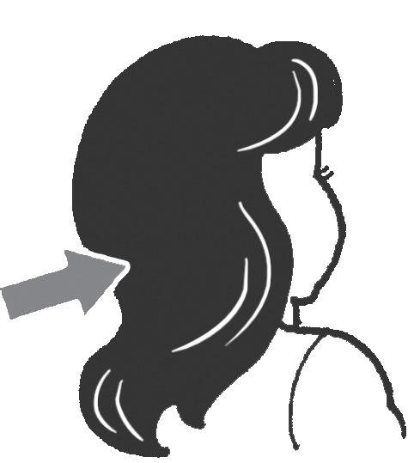
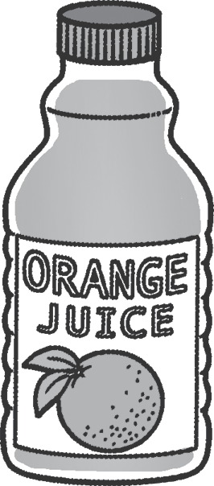
Composing Clear and Coherent Sentences with Mass and Count Nouns
Study the examples of mass nouns.
bottle of juice
counter mass noun
strands of hair
counter mass noun

Slide 6
Composing Clear and Coherent Sentences with Mass and Count Nouns
A lot of mass nouns come in liquid forms, like soup, clay, and tea.
Here are some common mass nouns:
liquids: gasoline, vinegar, shampoo, oil
food: butter, bread, cheese
materials: iron, wood, steel
Remember to use appropriate counters or quantifiers for mass nouns. We cannot say a strand of milk. Instead, we can say a carton of milk.

Slide 7
Composing Clear and Coherent Sentences with Mass and Count Nouns
Here are other examples of counters for mass nouns: bar of, bowl of, box of, cup of, dash of, heap of, pinch of, kilo of, pack of, pail of, piece of, slice of, teaspoon of. You can also use the, some, much, and little.
Example:
Nanay bought a sack of rice from the market.
Tatay added a pinch of salt to the dish he is cooking right now.
My ate adds a teaspoon of sugar to her drink.

Slide 8

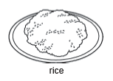


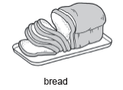
Composing Clear and Coherent Sentences with Mass and Count Nouns
Activity 1
Give the counters/quantifiers of the following mass nouns.
1.
2.
3.
4.
5.

Slide 9
Composing Clear and Coherent Sentences with Mass and Count Nouns
Activity 2
Choose the letter of the noun that best completes each sentence.
1. She drinks _____ every night.
A. a milk C. milks
B. milk D. many milks
2. She needs to buy new _____.
A. furniture C. little furniture
B. furnitures D. a lot of furniture
3. The store has run out of _____.
A. bread C. breads
B. a bread D. more bread
4. We need five _____ to bake cookies.
A. an egg C. many eggs
B. eggs D. some eggs

Slide 10
Composing Clear and Coherent Sentences with Mass and Count Nouns
Activity 1 Answer Key
1. cup of coffee
2. bowl of rice
3. glass of water
4. slices of bread
5. bottle of oil
Activity 2 Answer Key
1. B
2. A
3. A
4. B

