Slide 1
Using Correct Aspects of Verbs to Compose Clear Sentences

Slide 2
Using Correct Aspects of Verbs to Compose Clear Sentences
Verb Tense and Aspect
Tense tells when something happens or when a situation occurs. It has three elements placed under the time column: present, past, and future. These three time periods run through all the aspect components: simple, progressive, and perfect. The verb below differentiates tense from aspect as to form.
While tense indicates when a situation happens, aspect tells how an action happens, how a speaker views an action, how frequent an action happens, and how long (duration) an action is. While the simple aspect is part of the aspect of verbs, this lesson will center only on the perfect aspect and progressive aspect.

Slide 3
Using Correct Aspects of Verbs to Compose Clear Sentences
ASPECT
Time | Simple | Simple Progressive (be + ing) | Perfect (has/ have/had+ participle) | Perfect Progressive (have + been + ing)
Present | [word-s/es form (if singular)] writes (singular) write (plural) | am writing is writing are writing | has written have written | has/have been writing
Past | [regular-d/ed] [irregular - wrote] | was writing were writing | had written | had been writing
Future | [will + base form] will write | will be writing | will have written | will have been writing
T
E
N
S
E

Slide 4
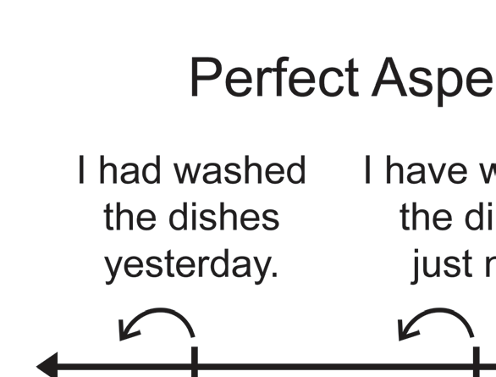
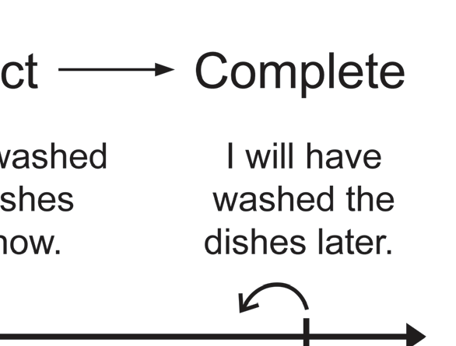

Using Correct Aspects of Verbs to Compose Clear Sentences
Perfect Aspect
There are three major components of perfect aspect: present perfect aspect, past perfect aspect, and future perfect aspect. Each is explained with sample sentences and meaningful practices.The list of past participles of irregular verbs is needed in constructing the perfect aspect.
The regular verbs simply need an -ed or -d endings for their past participles. To better understand the perfect aspect, refer to the given timeline presented in each perfect aspect.

Slide 5
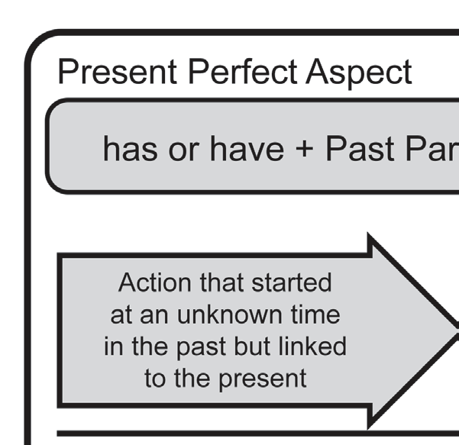
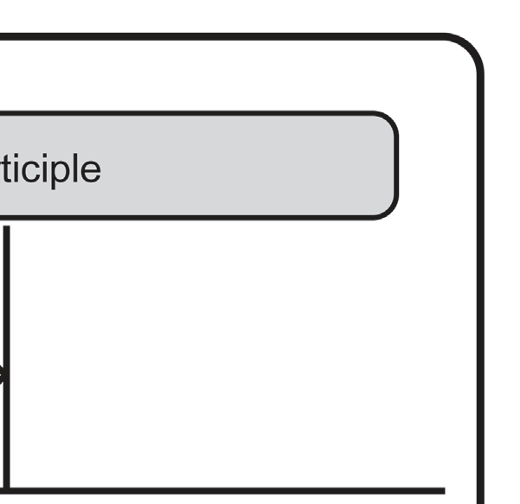

Using Correct Aspects of Verbs to Compose Clear Sentences
Perfect Aspect
Present Perfect Aspect
The present perfect aspect with the structure has +
past participle for the singular subject and have + past
participle for the plural subject has several core meanings. In general, the present perfect aspect refers to actions or
events that started at an unknown time in the past but
linked to a later time, which is usually the present.

Slide 6
Using Correct Aspects of Verbs to Compose Clear Sentences
Perfect Aspect
Uses of the Present Perfect Aspect
1. It indicates continuous time from an unknown time in the past to the present.
The emphasis is on the present meaning.
a. Daisy has finished cooking.
b. I have already written the letter.
The first speaker wishes to include a little of the present action, whereas the second decides to end it at a definite past.
2. It may indicate continuous action from some time in the past to the present. The emphasis is on the length of time introduced by for or since.
a. Wesley has not seen her for a year now.
b. Gizmo and Makoy have played football since they were five years old.
3. It expresses recent events with the help of the word just or recently.
a. The speaker has just arrived in the auditorium.
b. Have you seen our English teacher recently?

Slide 7
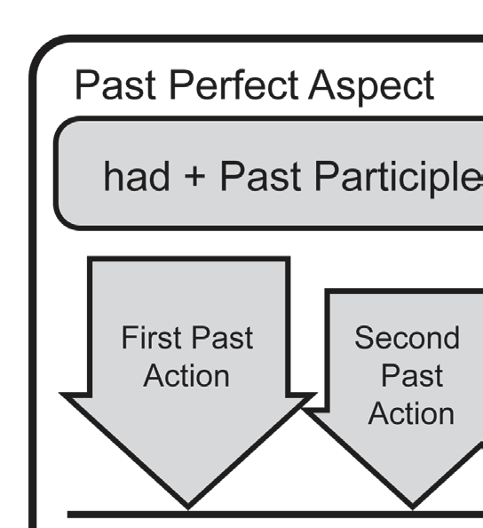
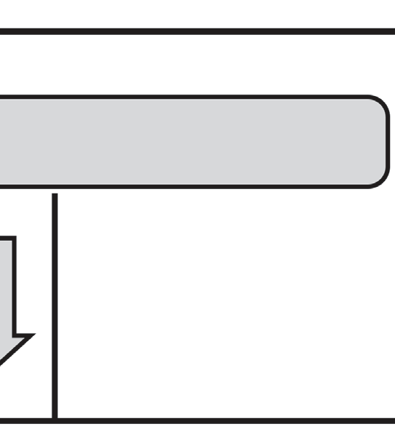

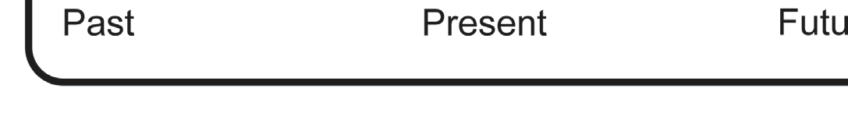
Using Correct Aspects of Verbs to Compose Clear Sentences
Perfect Aspect
Past Perfect Aspect
The structure of the past perfect aspect is almost the same as the present perfect except that have becomes had. The past perfect aspect indicates two actions that both happened in the past. However, the fi rst past action or the earlier action is expressed in the past perfect aspect. The second past action is expressed in the simple past aspect. We use the same time expressions as the simple past aspect such as yesterday, last week, last month, two weeks ago, three months ago, and the like.
Example:
a. When we had reached the house, we noticed the front door was unlocked.
b. We had decided to go inside and found a pair of old and muddy slippers someone left near the corner sofa bed.

Slide 8
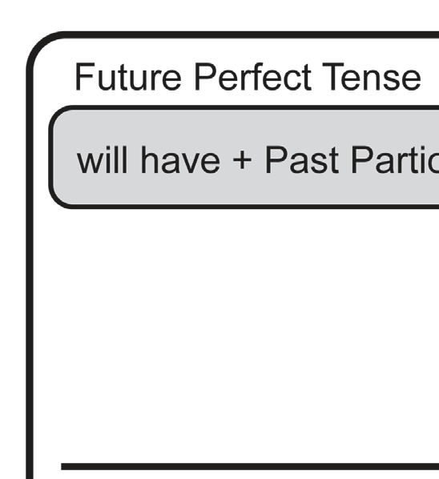
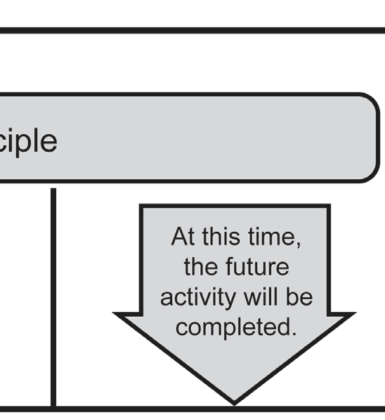

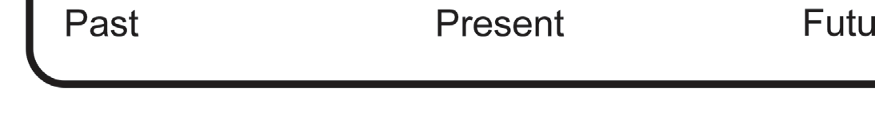
Using Correct Aspects of Verbs to Compose Clear Sentences
Perfect Aspect
Future Perfect Aspect
The future perfect aspect indicates an action that will be completed at some point in the future. We use the same time expressions for the simple future aspect for the future perfect aspect such as later, tomorrow, next week, next month, and the like.
Example:
a. Lucy will have finished the project before the teacher collects it tomorrow.
b. The report says people will have undergone vaccination in two years.
The sentence examples show how the future perfect aspect works with the help of will have + past participle of a regular or irregular verb.

Slide 9
Using Correct Aspects of Verbs to Compose Clear Sentences
Progressive Aspect
The progressive aspect indicates actions that are continuous but not completed.
Are you going to sleep right now, Lucy?
Example:

Slide 10
Using Correct Aspects of Verbs to Compose Clear Sentences
Progressive Aspect
Present Progressive Aspect
The present progressive aspect indicates a continuing action that is happening now. It consists of the be-verb (am, is, are) plus the -ing form of the main verb. We use the time expressions now, at the moment, currently, and the like.
Example:
Tatay is cooking adobo in the kitchen right now.

Slide 11
Using Correct Aspects of Verbs to Compose Clear Sentences
Progressive Aspect
Past Progressive Aspect
Have you ever experienced doing something in the past that was interrupted? For sure, you have had. It is the past progressive aspect that can best express the mentioned situation. The past progressive aspect uses the same time expressions as the simple past aspect of the verb, such as yesterday, last week, last month, two weeks ago, three months ago, and the like. The past progressive aspect indicates an action that was in progress in the past when it was interrupted by a shorter past action. This aspect is formed by using was (singular subject)/were (plural subject) + -ing form of the verb. Usually, the longer past action is signaled by the word while. The interrupting action is signaled by the word when.
Example:
I was working on my modules when my brother called me.
In the given example, was working is the action that was in progress in the past, and called is the interrupting action.

Slide 12
Using Correct Aspects of Verbs to Compose Clear Sentences
Progressive Aspect
Future Progressive Aspect
The future progressive aspect indicates an action that will last for a duration of time at some point in the future. This aspect is formed by using will + be + -ing form of the verb. We use the same time expressions for the simple future aspect of the verb like later, tomorrow, next week, next month, and the like.
Example:
I will be attending another school next year.
In the given example, the action that will be in progress at some point next year is will be attending.

Slide 13
Using Correct Aspects of Verbs to Compose Clear Sentences
Perfect Progressive Aspect
The perfect progressive aspect, shows both continuous and completed actions.
The medical workers are tired now because they have been working since last night.
Example:

Slide 14
Using Correct Aspects of Verbs to Compose Clear Sentences
Perfect Progressive Aspect
Present Perfect Progressive Aspect
In contrast to the present progressive aspect, the present perfect progressive aspect indicates an action, which has a connection with the present or now. The present perfect progressive aspect is formed by using has (singular subject)/have (plural subject) + been + the -ing form of the verb.
The present perfect progressive aspect has the following uses:
1. It indicates an action that began in the past and stopped recently. There is usually a result in the “now” or present time.
a. I am tired now because I have been exercising.
b. The ground is wet now because it has been raining.
2. It indicates an action that started in the past and is continuing up to now. We use the time modifiers for or since.
a. I have been studying this module for an hour now.
b. My kuya has been cleaning the whole house since this morning.

Slide 15
Using Correct Aspects of Verbs to Compose Clear Sentences
Perfect Progressive Aspect
Past Perfect Progressive Aspect
The past perfect progressive aspect is similar to the past perfect aspect except that it indicates a longer first past action before another past action. This aspect is formed by using had + been + -ing form of the verb. The second past action uses the simple past aspect of the verb.
Example:
The dam overflowed with water because it had been raining all night.
In the given example, the longer first past action, which was in progress, is had been raining. The second past action is overflowed.

Slide 16
Using Correct Aspects of Verbs to Compose Clear Sentences
Perfect Progressive Aspect
Future Perfect Progressive Aspect
The future perfect progressive aspect indicates an action that will start in the future and will last within a set amount of time. This aspect is formed by using will + have + been + -ing form of the verb
Example:
I will have been studying this module for three hours by 3:00 p.m.
In the given example, the action will have been studying will be finished at 3:00 p.m.

Slide 17
Using Correct Aspects of Verbs to Compose Clear Sentences
Write the correct aspect of the verb inside the parenthesis
to complete each sentence. Time expressions are given in each sentence to serve as your clues.
1. My ate and I (play) the guitar since we were six years old.
2. Last night, while my family and I (celebrate), we (hear) a loud crashing sound outside our house.
3. It is fortunate that the residents (evacuate) the area before the water level in the river (rise) yesterday.
4. The volunteers (clean) the whole shore before the day ends tomorrow.
5. Right now, the medical workers (administer) vaccines at the health centers.
Answers:
1. have played/have been playing
2. were celebrating, heard
3. had evacuated, rose
4. will have cleaned
5. are administering

