Slide 1
Using the Simple Present Tense of the Verbs in Sentences

Slide 2
Using the Simple Present Tense of the Verbs in Sentences
The Verb and Its Features
A verb can either be a state or an action. It usually functions as the predicate of a sentence. It has several features or characteristics, including form, tense, and number.

Slide 3
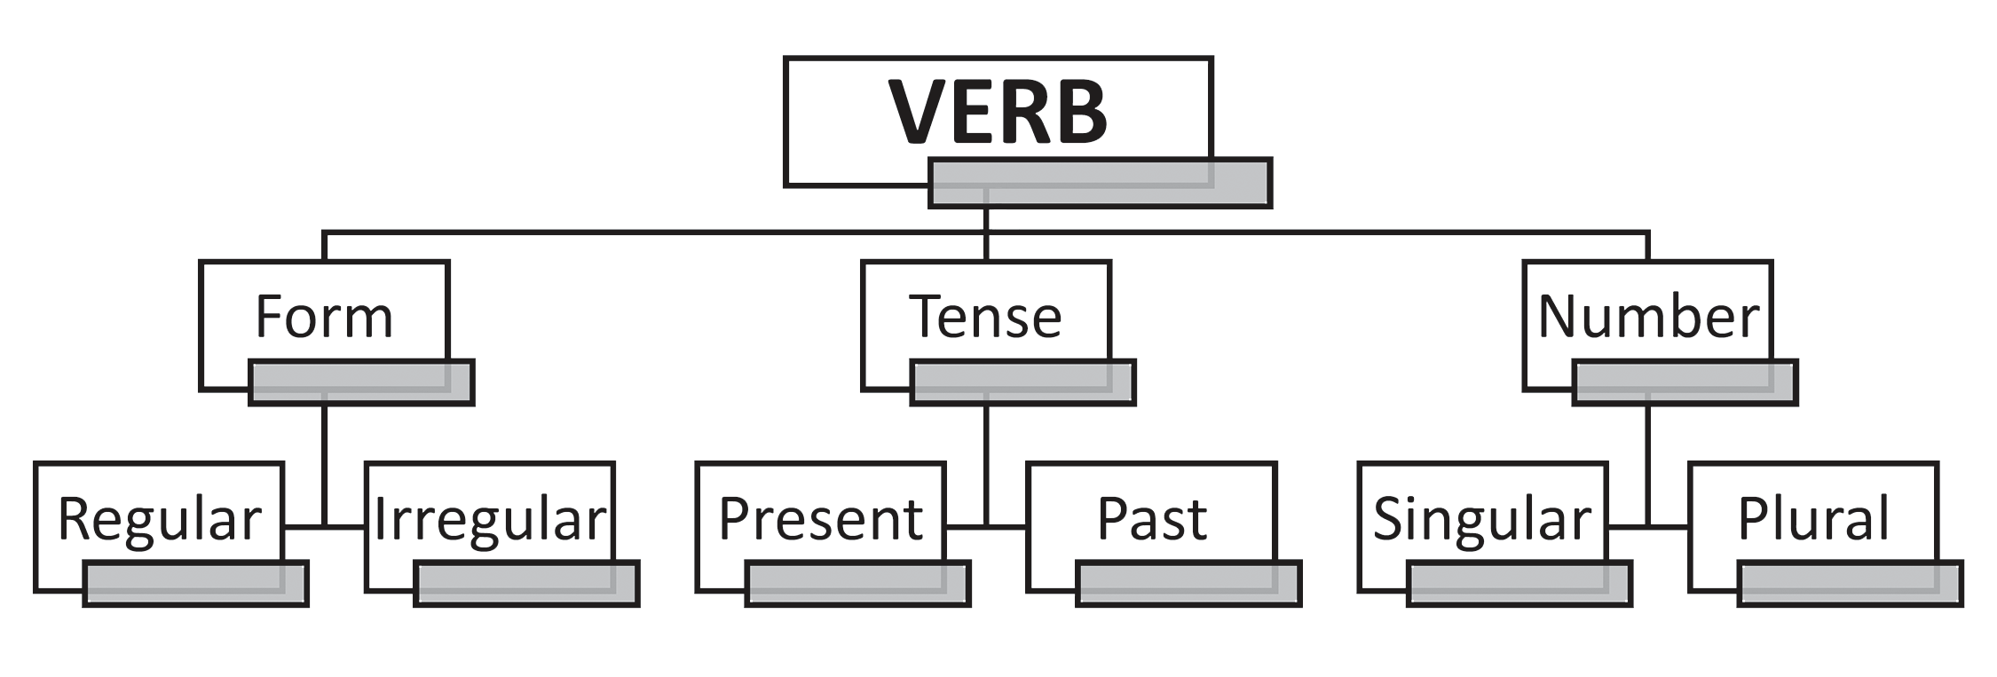
Using the Simple Present Tense of the Verbs in Sentences
As the diagram shows, the verb is either regular or irregular in its form. It can be singular or plural in number.

Slide 4
Using the Simple Present Tense of the Verbs in Sentences
Verb in the Present Tense
The simple present tense form of the verb expresses actions that happen habitually, frequently, or regularly. It is also used to express facts and universal truths.
Examples:
The earth revolves around the sun. (Universal truth)
I am a human being. (Fact)
Mark and Maria go to school every day. (Habitual action)

Slide 5
Using the Simple Present Tense of the Verbs in Sentences
Examples:
The earth revolves around the sun. (Universal truth)
I am a human being. (Fact)
Mark and Maria go to school every day. (Habitual action)
The present tense of the verb has two forms. The first one carries an -s/-es/i + -es ending; whereas the second one is on its base form (no -s/-es/i + es ending). These two forms depend on the subject of a sentence.

Slide 6
Using the Simple Present Tense of the Verbs in Sentences
Spelling rules to follow on when to add -s/-es/i + -es to the base form of a verb for the simple present tense:
1. Add -es to verbs that end in o, ch, sh, ss, x, and z.
Examples: go – goes
catch – catches
wash – washes
kiss – kisses
fix – fixes
buzz – buzzes

Slide 7
Using the Simple Present Tense of the Verbs in Sentences
2. For verbs that end in y but are preceded by a consonant, drop the y and change it to i then add -es.
Examples: study – studies
fry – fries
cry – cries

Slide 8
Using the Simple Present Tense of the Verbs in Sentences
3. For verbs that end in y but are preceded by a vowel, simply add -s.
Examples: play – plays
enjoy – enjoys
say – says

Slide 9
Using the Simple Present Tense of the Verbs in Sentences
A verb in the present tense must agree with its subject in number. Noun and pronoun as subject of a sentence can be singular or plural. If the subject means one, it is singular in number. If it is more than one, it becomes plural (e.g., boys, girls, students, phones).

Slide 10
Using the Simple Present Tense of the Verbs in Sentences
Verbs can also be singular or plural depending on their agreement with the number of the subject in the sentence.
Add -s/-es/i + -es to the base form of the verb in the simple present tense when the subject is singular. | Use the base form of the verb when the subject is plural and when the pronoun used is I or You.
1. The short vacation ends tomorrow. | 1. I also know where it is.
2. Lolo cooks food for us. | 2. You better say it tonight.

Slide 11
Using the Simple Present Tense of the Verbs in Sentences
The Verb “be”
Other than action, a verb may also express a state of being, which shows no action at all. The verb be, sometimes called be verb, falls into this kind, which states when and where someone or something exists.
The be-verb comprises am, is, and are for the present tense.

Slide 12
Using the Simple Present Tense of the Verbs in Sentences
The general subject-verb agreement rule for be-verbs is that we use is for singular noun subjects and are for plural noun subjects.
But the pronouns used as subjects need a clear guide for subject-verb agreement. Read the table that follows.
Personal Pronouns as Subjects
Singular Pronouns | Be-verb | Plural Pronouns | Be-verb
I | am | we | are
he, she, it | is | they | are

Slide 13
Using the Simple Present Tense of the Verbs in Sentences
Other Subject-Verb Agreement Rules
Indefinite Pronoun as Subject
Indefinite pronouns like each, either, every, everyone/everybody, someone/somebody, anyone/anybody, no one/nobody, neither, and one use verbs in the -s/-es/i + -es form.
Examples:
• One of the winners is a student from the South.
• Every individual speaks freely for his or her rights.
• Nobody stops him from doing such.

Slide 14
Using the Simple Present Tense of the Verbs in Sentences
Other Subject-Verb Agreement Rules
Collective Noun as Subject
When a collective noun functions as a singular unit, use verbs in the -s/ es/i + -es form. When the parts of the collective noun function separately, use the base form of the verb.
Examples of Collective Nouns:
People: team, panel, staff, family, group, committee, class, group, band, battalion, choir, jury, board
Animals: flock, herd, swarm, cattle, school
Things: bunch, fleet, pack, set

Slide 15
Using the Simple Present Tense of the Verbs in Sentences
Collective Noun as Subject
• The class agrees that the new policy must take effect now.
(As one deciding body)
• The class have opposing views on the proposed policy.
(As individual members)
• The band wear their uniforms.
(As individual members; Their is a clue.)
• The band performs its masterpiece. (As one group performing)

Slide 16
Using the Simple Present Tense of the Verbs in Sentences
Compound Subjects
Compound subjects, nouns, or pronouns, joined by “and” are plural in number. Use the verb are or the base form of the verb.
• Daisy and Jill are best friends.
• Annie and Marie sing and dance in the program.
• The teacher and the adviser work hard on the project.

Slide 17
Using the Simple Present Tense of the Verbs in Sentences
Compound Subjects
Except for one instance when the compound subject refers to one person, concept, or idea, the singular number of the subject retains. Use the verb is or the -s/-es/i + -es form.
• Rice and fish is my favorite meal.
• The teacher and adviser leads the class in the program.

Slide 18
Using the Simple Present Tense of the Verbs in Sentences
Activity 1
Analyze each sentence. Choose the letter of the correct verb that will complete each sentence.
1. Ate Sheena _____ fast.
a. run b. runs c. ran
2. Every Saturday, our mother _____ us to the volleyball practice.
a. escorts b. escorted c. escort

Slide 19
Using the Simple Present Tense of the Verbs in Sentences
3. My brother and my cousin _______ me to join the pageant because I am
hesitant.
a. encourage b. encourages c. encouraged
4. Everyone _____ losing in the contest.
a. am b. are c. is
5. The government officials always ______ their best efforts to keep us safe
and sound.
a. exerts b. exerted c. exert

Slide 20
Using the Simple Present Tense of the Verbs in Sentences
ANSWER KEY
Analyze each sentence. Choose the letter of the correct verb that will complete each sentence.
1. Ate Sheena _____ fast.
a. run b. runs c. ran
2. Every Saturday, our mother _____ us to the volleyball practice.
a. escorts b. escorted c. escort

Slide 21
Using the Simple Present Tense of the Verbs in Sentences
3. My brother and my cousin _______ me to join the pageant because I am
hesitant.
a. encourage b. encourages c. encouraged
4. Everyone _____ losing in the contest.
a. am b. are c. is
5. The government officials always ______ their best efforts to keep us safe
and sound.
a. exerts b. exerted c. exert

