Slide 1
Distinguishing Various Types of Viewing Materials

Slide 2
Distinguishing Various Types of Viewing Materials
Viewing is the ability to understand different concepts from images and presentations seen. In addition, viewing also includes interpreting these images and presentations with words that have been read.
Using viewing materials helps the audience clearly understand what a speaker or presenter say. On the other hand, as a viewer, these also help find new ways of learning and appreciate what is being presented.

Slide 3
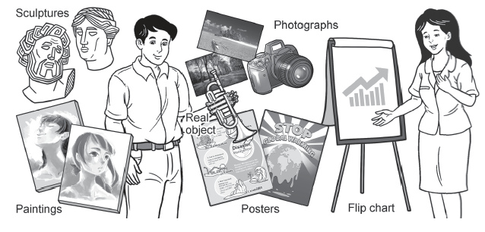
Distinguishing Various Types of Viewing Materials
Viewing Materials
Viewing materials can be visual aids like real objects, models, photographs, paintings and sculptures, charts, posters, as well as the use of blackboards and whiteboards. These materials help the audience see the topics being discussed. For example, using blackboards and whiteboards in presenting solutions in Math and Science classes.

Slide 4
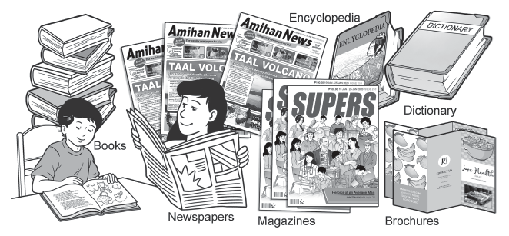
Distinguishing Various Types of Viewing Materials
Viewing Materials
Viewing materials can also be printed materials like brochures, newspapers, paper handouts, books, magazines, dictionaries, and encyclopedias. These materials serve as references to get a specific information.

Slide 5
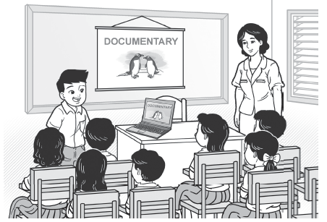
Distinguishing Various Types of Viewing Materials
Viewing Materials
Moreover, viewing materials called audio-visual materials can be used in both viewing and listening activities. These include movies, documentaries, videos, slide presentations, as well as the use of television. Sometimes, these audio-visual materials become digital and interactive materials if viewed using gadgets with an internet connection. These materials allow an audience to interact with information using the senses of hearing and sight.

Slide 6
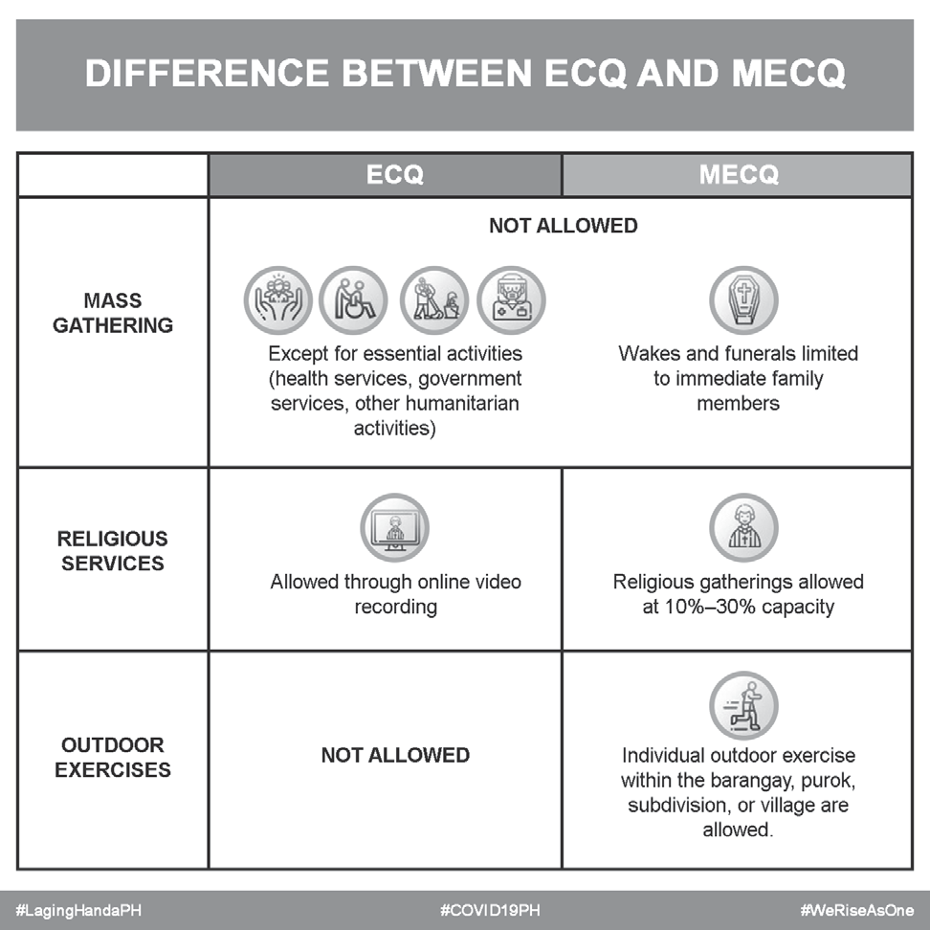
Distinguishing Various Types of Viewing Materials
Viewing Materials
Another viewing material is an infographic. An infographic is a viewing material that combines charts, images, and a minimal number of words to give an easy-tounderstand overview of a topic.

Slide 7
Distinguishing Various Types of Viewing Materials
Getting Information from Viewing Materials
After learning the different types of viewing materials, try to make the most of this skill by learning how to get information from these materials.
Whenever we view a material, we can ask ourselves the following questions to better understand a material’s content and make our viewing more meaningful.
1. What is the material about?
2. What further details does the material give me?

Slide 8
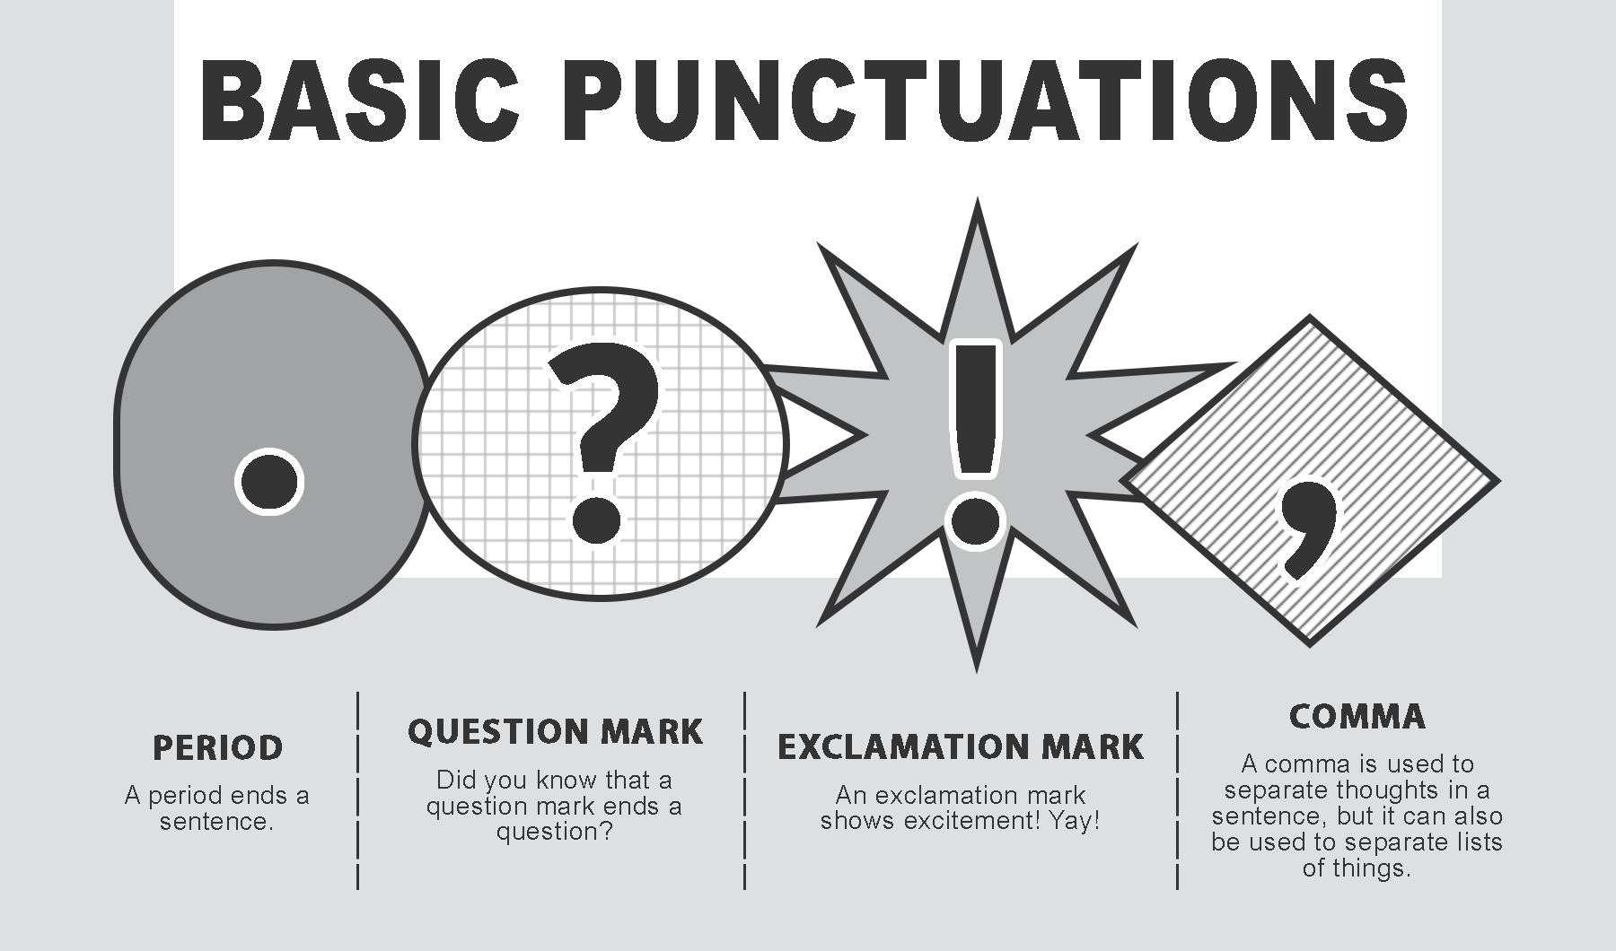
Distinguishing Various Types of Viewing Materials
Getting Information from Viewing Materials
View and analyze the details given in the poster.
To answer the first question, we can say that the poster talks about basic punctuations, such as period, question mark, exclamation mark, and comma.
Answering the next question will tell us that the poster also includes the functions of
these punctuation marks. It also includes the actual symbols of punctuation marks
when they are used.
1. What is the material about?
2. What further details does the material give me?

Slide 9

Distinguishing Various Types of Viewing Materials
Getting Information from Viewing Materials
View and analyze another viewing material – an infographic
1. What is the material about?
2. What further details does the material give me?
To answer question 1, we can tell that the infographic is about “Heart for Kids,” a charitable organization that supports children’s education.
Next, to answer question 2, we can say that the infographic presents the organization’s achievements. The infographic combines numbers, minimal words, and images to further
present the information about the organization.

Slide 10
Distinguishing Various Types of Viewing Materials
Complete the following table below by supplying the most appropriate viewing material to use. The first item serves as your guide.
Situation | I will use…
1. You will report in class about healthy foods without having to use a laptop or computer. | I will use real objects. I will bring examples of healthy foods as part of my report.
2. You plan to promote your local community to tourists.
3. You will talk about the life cycle of a mosquito.
4. You are assigned to report about the different products of each region in the Philippines.

Slide 11
Distinguishing Various Types of Viewing Materials
Answer:
1. I will use real objects. I will bring examples of healthy foods as part of my report.
2. I will use brochures.
3. I will use a diagram or slide presentation.
4. I will use pictures or slide presentation

