Slide 1
Point of View in Images Used in Texts

Slide 2
Point of View in Images Used in Texts
Your point of view is influenced by what you see, hear, or experience. It is based on what you observe. Point of view is your opinion on a certain topic, situation, or event.
A stereotype is a belief about a particular person or group of people or places based on race, age, gender, culture, and/or religion. Stereotyping can be positive or negative. However, these labels can result to unfair judgments about an individual.
Stereotyping can affect our points of view or the way we see a person or a group of people. So, the best way we can avoid this is by getting to know the people and their stories.

Slide 3
Point of View in Images Used in Texts
Stereotyping
Stereotyping can be positive or negative. However, these labels can result in unfair judgments about an individual.
Example:
a. All women are the same—they are all weak.
-This statement is stereotyping because every woman has her strength.
b. Older adults (aged 56 and above) will never learn how to use gadgets.
-The statement is unfair to them because we cannot say the capacity and strength of each individual just because of his/her age.
Note: We must understand that by stereotyping, we assume or conclude that the abilities and characteristics of all the members of the group are the same. So to be fair and avoid wrong judgment, we must go back to the basics; we must be polite in expressing points of view.

Slide 4
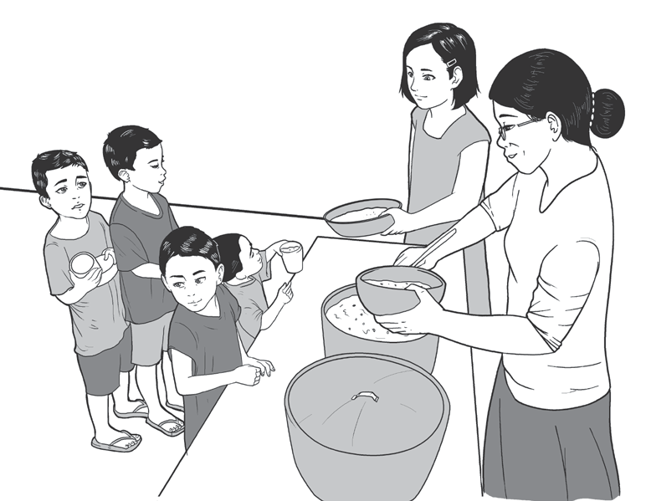
Point of View in Images Used in Texts
Analyze the given example to find out how stereotypes affect a person’s point of view of another person
Dear Diary,
Today, I saw Ms. Luzviminda, our school
librarian, in a feeding program when I passed
by our barangay hall. She was so happy while
giving food to those street children.
I always thought Ms. Luzviminda is very
strict and mean to children. Having seen her
now volunteering for a feeding program makes me think that she is a kind and caring person.
Markie
To see beyond the image, we can ask ourselves these two guide questions:
1. How do you see the stereotypical image?
2. How does the diary entry affect your point of view?

Slide 5
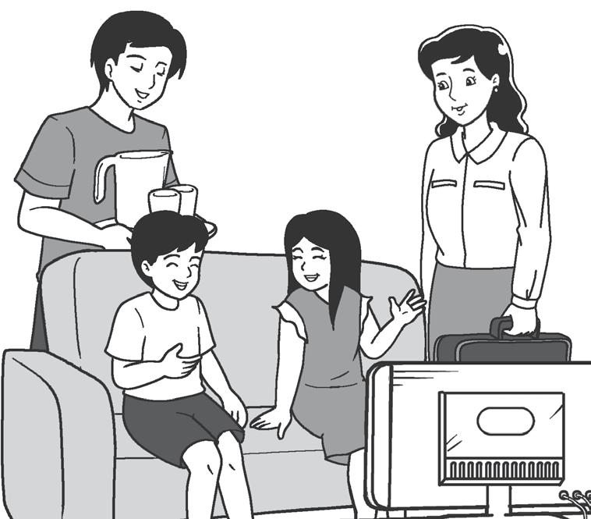
Point of View in Images Used in Texts
Dear Diary,
Today, I visited my classmate, Luna. I found out that her father manages the house and her mother works for the family.
I’m surprised that fathers can do
housework, and mothers can be breadwinners.
Wesley
In the given examples, it shows that stereotyping can affect one’s points of view or how to see a person or a group of people. So, the best way this avoid this is by getting to know the people and their stories.

Slide 6
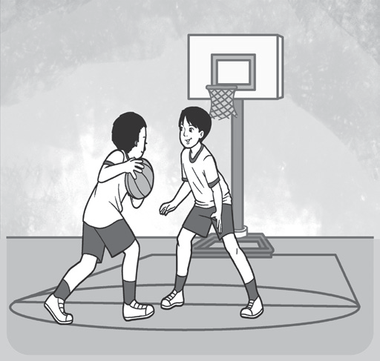
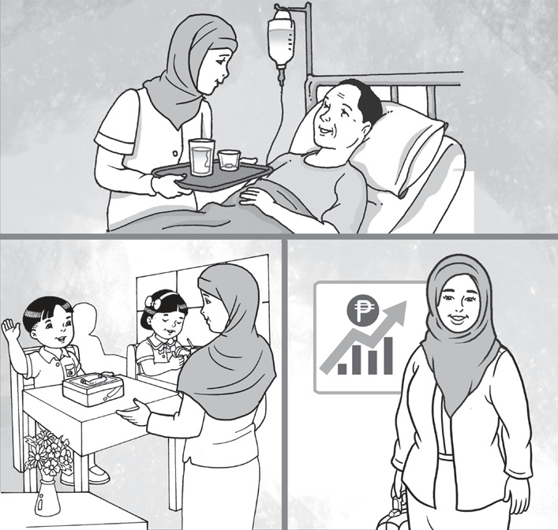
Point of View in Images Used in Texts
Analyze the following images and complete the table. The first one is done for you as your guide.
Example: | Stereotype: If you are tall, you can play basketball well. | My point of view: I think that anyone can play basketball, even if you are tall or not.
1.)

Slide 7
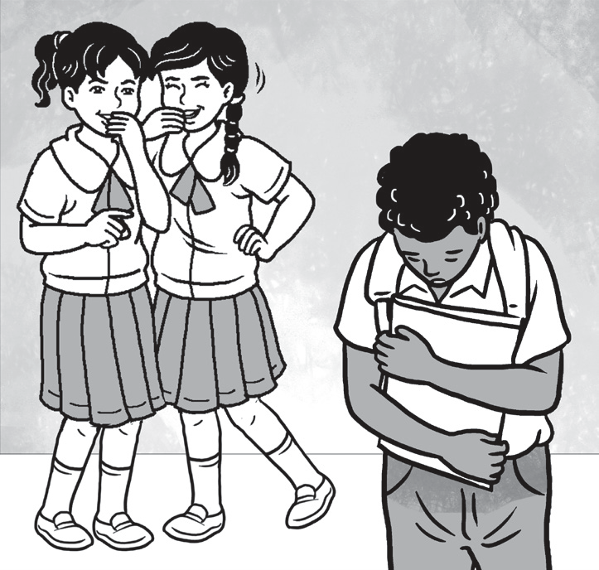
Point of View in Images Used in Texts
2.)
Possible answers:
1. Stereotype: Muslim women are not allowed to work.
My point of view: Any woman, regardless of religious belief, can work and have a career of her own.
2. Stereotype: People with curly hair and dark skin are more likely to be disrespected.
My point of view: No one deserves to be made fun of.

