Slide 1
The Story Elements and Theme

Slide 2
The Story Elements and Theme
One of the ways we can understand and appreciate literature is by expanding our vocabulary. Before we digest a story or a poem, we first unlock difficult words so that we will be able to understand better the literary piece. Knowing how to use technical and operation definitions will give us an edge in understanding a text.
Expanding Your Vocabulary
A. Technical Definition
A technical definition is a detailed description of a specialized term, process, or phenomenon.

Slide 3
The Story Elements and Theme
A. Technical Definition
When preparing a document, the writer often has to use some terms that might be unknown to the audience but are essential in understanding the author’s idea. The length of the definition depends on the complexity of the term and the intended readers.
There are two types of definitions: parenthetical and sentence.
1. Parenthetical Definition
A term is defined with a short description enclosed in parentheses
immediately after the term.

Slide 4
The Story Elements and Theme
1. Parenthetical Definition
Example:
The redundancy (repetitiveness) will be increased as sentences of roughly the same topic are put together in a paragraph.
A parenthetical definition may also be a longer phrase or clause.
Example:
Revenue bonds (bonds issued to finance projects that will eventually generate their own revenues, such as a toll bridge) are sold by his uncle.

Slide 5
The Story Elements and Theme
2. Sentence Definition
It features an explanation of a word or phrase using one sentence. A sentence definition usually follows a standard pattern.
• The item being defined is placed in a class or category of similar items.
• The item being defined is distinguished from similar items.
Examples:
1. Aluminum is a metallic element with the symbol Al.
2. Lithium is a metallic element with Li symbol.

Slide 6
The Story Elements and Theme
B. Operational Definition
An operational definition describes exactly what the variables are and how they are measured within the context of your study. For example, if you were doing a study on the effects of online activities on students’ academic performance, you would need to state what you mean by online activities and academic performance.
In this example, you might define online activities as follows:
⇒ Individual computer tasks like engagement in social media
⇒ Computer tasks done inside the school computer laboratory

Slide 7
The Story Elements and Theme
You define academic performance as how well a student performed in classes through an investigation of his/her written performance (quizzes, long tests, essays, online printouts) and oral performance (recitation, speech, role-play).

Slide 8
The Story Elements and Theme
Other than unlocking unfamiliar terms to better understand a literary piece, we can also use nonlinear texts. Below are some examples of nonlinear texts.
Types of Nonlinear Texts | Description
Graphs/Charts | Show a relationship between two or more measurements
Line Graphs | Show trends
Bar Graphs | Show comparisons between variables
Pie Graphs | Show information on parts or segments as a whole proportion, percentage, or fraction of the whole
Tables | Show a summary of complicated facts and figures

Slide 9
The Story Elements and Theme
Organizers are also nonlinear texts.
What is an advance organizer?
• It is a cognitive strategy you can use to learn new information and retain
them in your memory.
• It consists of information that is presented before you learn something, and
you can use it to organize and interpret new information.
• It is not an overview but rather a presentation of information (either verbal or
visual) that are “umbrellas” for the new material to be learned.

Slide 10
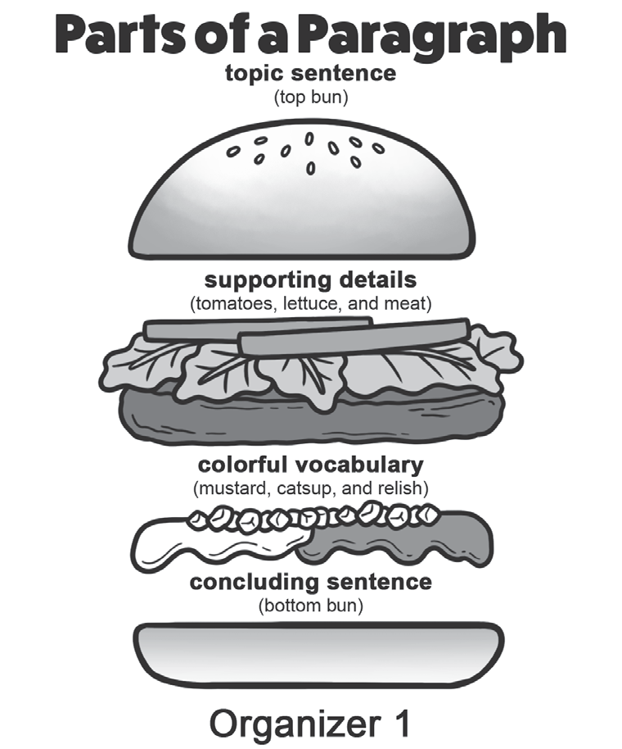
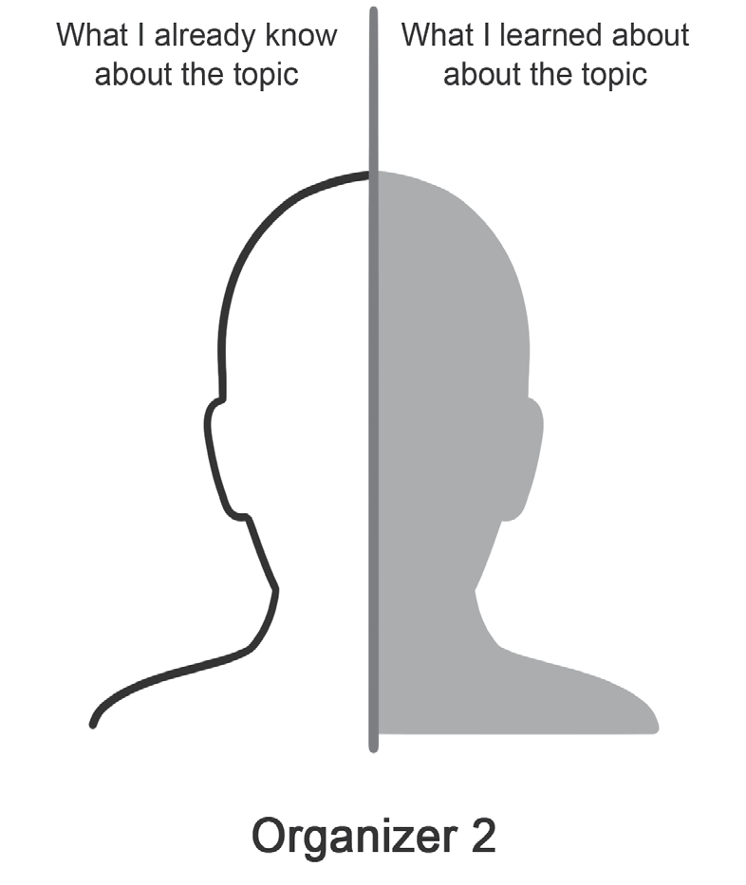
The Story Elements and Theme
One example of advance organizers is the analogy graphic organizer. The analogy graphic organizer uses analogies to help the students understand a new concept that is being introduced by comparing it with a familiar concept.

Slide 11
The Story Elements and Theme
Theme of a Story
The theme tells the author’s view about life as reflected by the characters’ behavior and the setting that make up the story. This is the lesson or the message of the story.
Some important concepts that are used to explain how the elements of a story build its theme are as follows:
Characterization
Symbolism
Setting
Conflict

Slide 12
The Story Elements and Theme
Characterization refers to how a character behaves in a certain situation. His/Her actions will be determined by his/her motivation, which shapes his/her personality.
Symbolism is when a concrete thing represents abstract ideas. What colors, shapes, and objects have been presented? What ideas are presented?
Setting describes the time and place when and where the story happened.
Conflict is a clash between opposing forces.

Slide 13
The Story Elements and Theme
Conflict
A conflict may be external, a struggle between the character and outside forces. An outside force may be another character, the society or community, forces of nature, or even technology. An internal conflict is a struggle within the character’s mind, feelings, or emotions.
There are two kinds of conflict:
a. internal conflict or man vs. himself – pertains to a character’s struggle with
feelings of guilt, fear, indecision, pride, etc.
b. external conflict or man vs. others – pertains to a character’s struggle with
another person, a group, a society, or the environment

Slide 14
The Story Elements and Theme
Choose the letter of the correct answer.
1. Which of the following presents a theme of a story?
A. Love
B. What is love?
C. The types of love
D. Love is blind and unconditional.
2. Which of the following is a nonlinear text?
A. Chart
B. Paragraph
C. Short story
D. Lyrics of a song

Slide 15
The Story Elements and Theme
Choose the letter of the correct answer.
3. Which of the following statements is NOT true about conflict?
A. A conflict may be external, a struggle between the character and outside forces.
B. A conflict is a clash between two opposing forces.
C. It is the part of the story where the reader or audience feels the most intense
emotions.
D. A conflict may be internal, a struggle within the character’s mind, feelings, or
emotions.

Slide 16
The Story Elements and Theme
Choose the letter of the correct answer.
4. Which among the following statements indicates a direct characterization?
A. “Ben was a quiet and serious boy.”
B. It is a characterization that relies on the reader.
C. The narrator or author does not tell what the character is like.
D. The narrator or author shows the reader or audience what the character is
through the character’s looks and what the character does, says, and thinks;
the character affects the other characters.

Slide 17
The Story Elements and Theme
Choose the letter of the correct answer.
5. Which of the following is NOT an operational definition?
A. Motor activity is described as the student’s movements from his or her seat.
B. A modem that is attached to a telephone handset to transmit computer
information over telephone lines is an acoustic coupler.
C. Fear can be described as a situation when a person is subjected to objects, persons, or places that that person wants to avoid.
D. Introversion is described as a characteristic of an individual choosing and engaging in solitary rather than group activities.

Slide 18
The Story Elements and Theme
ANSWER KEY
1. Which of the following presents a theme of a story?
A. Love
B. What is love?
C. The types of love
D. Love is blind and unconditional.
2. Which of the following is a nonlinear text?
A. Chart
B. Paragraph
C. Short story
D. Lyrics of a song

Slide 19
The Story Elements and Theme
ANSWER KEY
3. Which of the following statements is NOT true about conflict?
A. A conflict may be external, a struggle between the character and outside forces.
B. A conflict is a clash between two opposing forces.
C. It is the part of the story where the reader or audience feels the most intense
emotions.
D. A conflict may be internal, a struggle within the character’s mind, feelings, or
emotions.

Slide 20
The Story Elements and Theme
ANSWER KEY
4. Which among the following statements indicates a direct characterization?
A. “Ben was a quiet and serious boy.”
B. It is a characterization that relies on the reader.
C. The narrator or author does not tell what the character is like.
D. The narrator or author shows the reader or audience what the character is
through the character’s looks and what the character does, says, and thinks;
the character affects the other characters.

Slide 21
The Story Elements and Theme
ANSWER KEY
5. Which of the following is NOT an operational definition?
A. Motor activity is described as the student’s movements from his or her seat.
B. A modem that is attached to a telephone handset to transmit computer
information over telephone lines is an acoustic coupler.
C. Fear can be described as a situation when a person is subjected to objects, persons, or places that that person wants to avoid.
D. Introversion is described as a characteristic of an individual choosing and engaging in solitary rather than group activities.

