Slide 1
Basic Features of Text Genres: Informational & Narrative

Slide 2
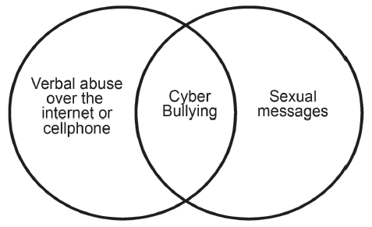
Basic Features of Text Genres: Informational & Narrative
Understanding Nonlinear Texts
A. Venn diagram – shows comparison and contrast
What message does the diagram convey?

Slide 3
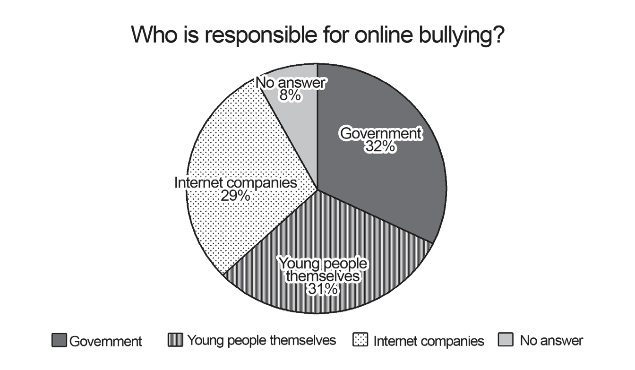
Basic Features of Text Genres: Informational & Narrative
B. Pie chart – shows the information on parts or segments as a fraction of the
whole
Who is believed by the majority to be responsible for online bullying?

Slide 4
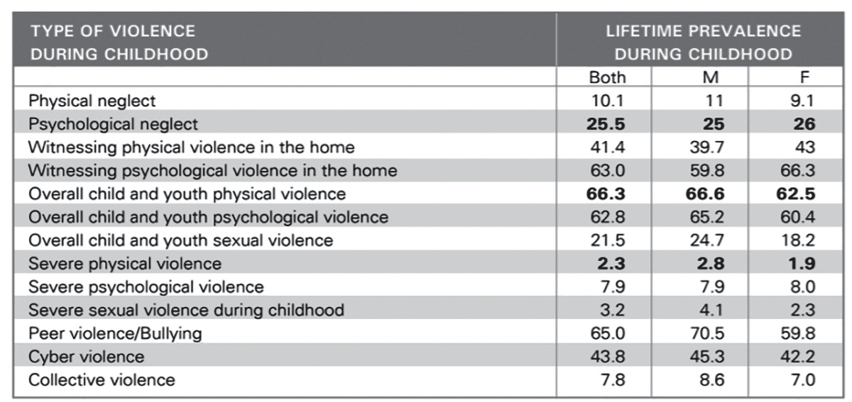
Basic Features of Text Genres: Informational & Narrative
C. Table – shows a summary of complicated facts and figures
Gleaning from the table, identify the rank of cyberbullying as the type of violence experienced by children, with 1 as the highest and 13 as the lowest.
Answer: _____________________________

Slide 5
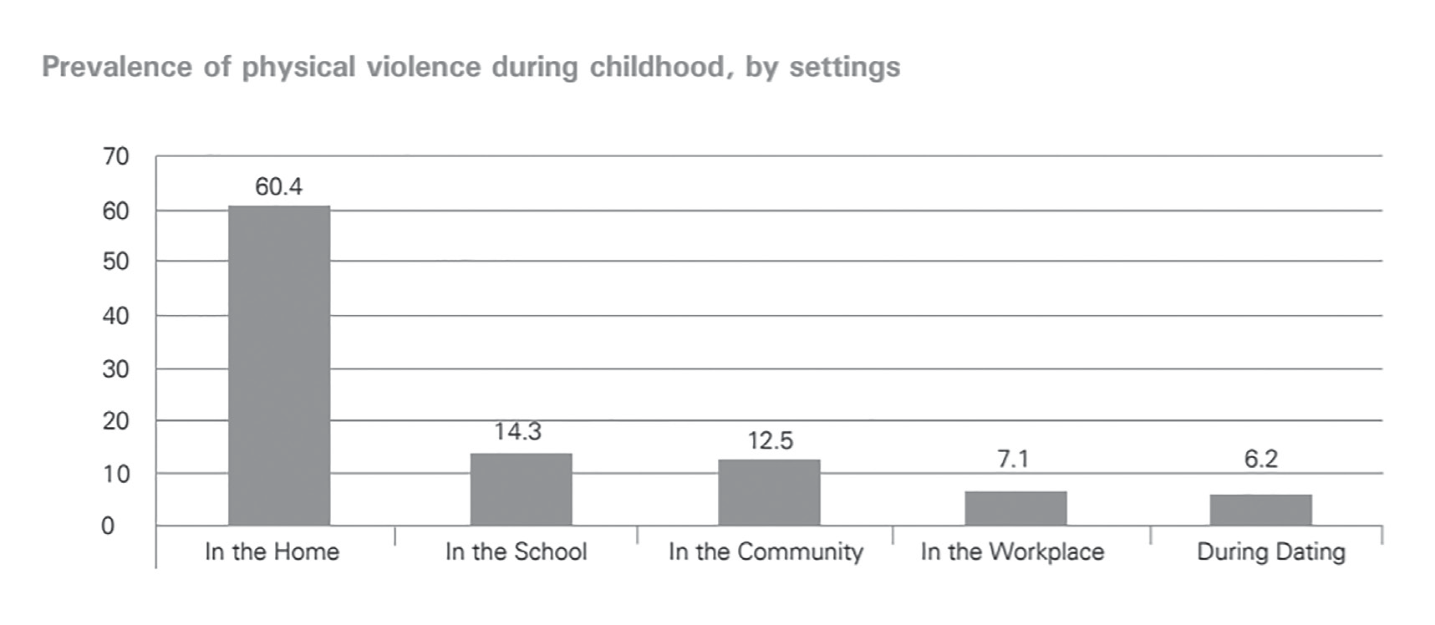
Basic Features of Text Genres: Informational & Narrative
D. Bar graph – shows comparisons between variables
Identify the place where physical violence is at: (1) most and (2) least.
Answer:
1. _________________________________________________________________
2. _________________________________________________________________

Slide 6
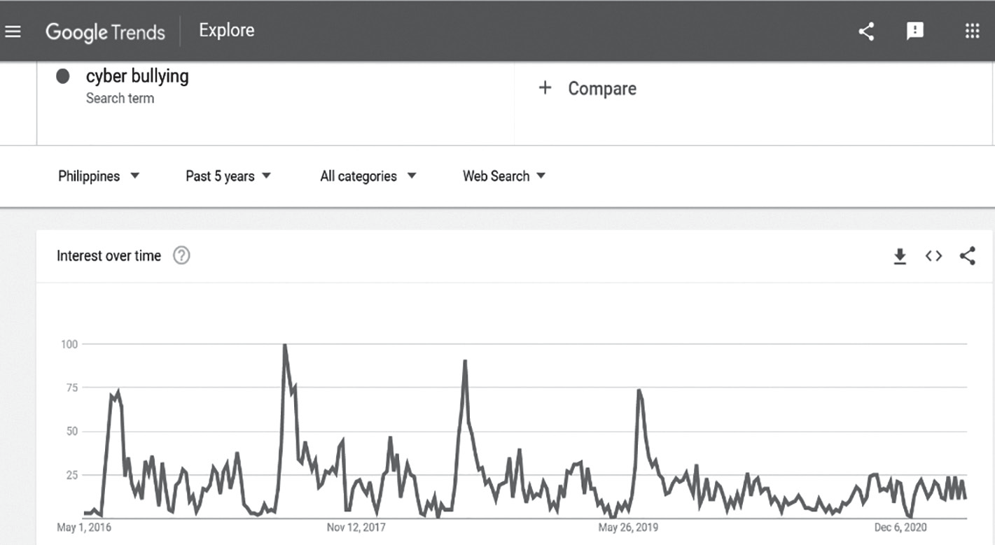
Basic Features of Text Genres: Informational & Narrative
E. Line graph – shows trends
Following the live data on the web, when is the highest incident of cyberbullying in the Philippines?

Slide 7

Basic Features of Text Genres: Informational & Narrative
F. Word chart/Chart – shows the relationship between two or more sets of
information or measurements
Which goal of UNICEF is achieved as shown on the statistical figures and proof listed on the chart?

Slide 8
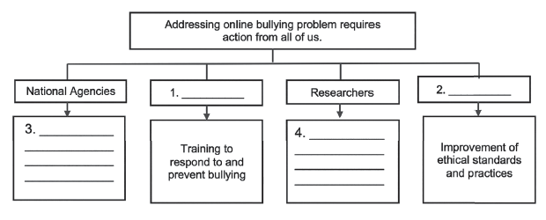
Basic Features of Text Genres: Informational & Narrative
G. Tree diagram – shows classifications, hierarchy, and organizational
relationships

Slide 9
Basic Features of Text Genres: Informational & Narrative
Vocabulary: Technical and Operational Definitions
A technical definition refers to the meaning of words related to science, technology, commerce, and other specialized fields. These words or terms require operational definition.
An operational definition is the specific meaning of a word or a phrase given to it by a group of communicators who use it in a specific context. This definition describes exactly what the idea is and how it is used in a particular field. Operational definitions are usually used in research, in which a term has to be given meaning according to how it is used (or operationalized) in the study.

Slide 10
Basic Features of Text Genres: Informational & Narrative
1. hungry
Ordinary Definition | A discomforting feeling brought about by the need for food or nourishment
Operational Definition | Absence of food intake for 16 hours
2. academic achievement
Ordinary Definition | The ability to gain success in one’s studies
Operational Definition | Human intelligence measured in high stakes examination, GPA or grade point average

Slide 11
Basic Features of Text Genres: Informational & Narrative
In writing a definition, do not forget its specific parts or elements. It is comprised of the term, which is the idea that needs to be clarified, described, or explained; the class or the general class, where the item can be grouped or categorized; and the specific or distinguishing characteristics that make the term different from the rest of its class. The verb used in formal definitions is in the simple present tense, usually a be-verb (is or are), because you are stating a fact or a general truth. The formula is as follows:
Article + term + verb (is/are) + class + relative pronoun (who/whom/which/that) + specific characteristics

Slide 12
Basic Features of Text Genres: Informational & Narrative
Literature
A story is another text genre that has different elements not found in informational texts. The major elements exclusive to narratives are the plot or the series of events in the story, characters, tone, and conflict that contribute to the theme of the text. A theme has the following characteristics:
1. It is the central idea of the story.
2. It sums up the story’s view of the world or a revelation about human nature or
condition.
3. It is expressed in a complete sentence (with subject and verb) and not in a
single word.
4. It is not a moral. It is just a statement.

Slide 13
Basic Features of Text Genres: Informational & Narrative
Another powerful tool of the narrative is sensory images. Aside from a story’s theme, sensory images also drives the story to life. It further creates an emotional effect on a reader.

Slide 14
Basic Features of Text Genres: Informational & Narrative
Choose the letter of the correct answer.
1. What nonlinear text is most effective in showing how a student spends his 24 hours
for personal and academic activities?
A. pie chart C. tree diagram
B. bar graph D. venn diagram
2. Which of the following is an example of a linear text?
A. grid C. flow chart
B. story D. tree diagram

Slide 15
Basic Features of Text Genres: Informational & Narrative
3. Which refers to an operational definition?
A. the general meaning of a term
B. the specific meaning of the term
C. the extended definition of the term
D. the distinguishing quality of a term
4. The following descriptions point to a technical or operational definition. Choose
which does not.
A. It gives a specialized definition.
B. It is the general definition of a term.
C. It is the specific meaning of a word or phrase.
D. It is given by a group of people who use the word in a particular context.

Slide 16
Basic Features of Text Genres: Informational & Narrative
ANSWER KEY
1. What nonlinear text is most eff ective in showing how a student spends his 24 hours
for personal and academic activities?
A. pie chart C. tree diagram
B. bar graph D. venn diagram
2. Which of the following is an example of a linear text?
A. grid C. flow chart
B. story D. tree diagram

Slide 17
Basic Features of Text Genres: Informational & Narrative
ANSWER KEY
3. Which refers to an operational definition?
A. the general meaning of a term
B. the specific meaning of the term
C. the extended definition of the term
D. the distinguishing quality of a term
4. The following descriptions point to a technical or operational definition. Choose
which does not.
A. It gives a specialized definition.
B. It is the general definition of a term.
C. It is the specific meaning of a word or phrase.
D. It is given by a group of people who use the word in a particular context.

