Slide 1
Listening Strategies and Prosodic Features of Speech

Slide 2
Listening Strategies and Prosodic Features of Speech
Listening requires processing the concepts received from the source. The following are some listening strategies that we can use:
1. Listening for the Gist
When your purpose is to know the main idea of the material you will listen to, do not focus on the specific details. You have to focus on the main points presented. You are expected to express the general idea concisely and not deliver lines about names, dates, places, or specific details.

Slide 3
Listening Strategies and Prosodic Features of Speech
2. Listening for Specific Details
When you listen to get specific important information, focus on time, hours, dates, names, places, or the answers to the when, where, what, how types of questions. Hence, before listening, you may prepare questions that fall under these types.

Slide 4
Listening Strategies and Prosodic Features of Speech
3. Listening for a Sequence
When you listen to grasp steps or orders, focus on getting the steps, orders, or the series of events right. Make sure to understand the correct order or steps. You may do this by preparing graphic organizers or a timeline to guide you while listening.
One way of evaluating if the audio/material is eff ective is by determining the speaker’s purpose and by checking if that purpose has been achieved. We can determine the speaker’s purpose by researching the speaker’s background and why the speech, song, or audio material was written or produced.

Slide 5
Listening Strategies and Prosodic Features of Speech
3. Listening for a Sequence
For materials that we view, we can start by observing what can literally be seen in the image. We can note down the details and then later reflect on what these details mean separately and as a whole. We can also look into the materials used (if applicable), the angling, lighting, and other technicalities, as can be applied. We can further dig into the meaning of the image and what it conveys.

Slide 6
Listening Strategies and Prosodic Features of Speech
The prosodic features of speech are the suprasegmental that include stress, pitch, intonation, tone, juncture, rhythm, etc.
Pitch is the highness or lowness of a tone. The highness or lowness of a tone is applied when reading stressed and unstressed syllables or words.
Tone is the sound of a definite pitch and vibration.
Stress is how we emphasize a syllable or a word. Stressing means making certain syllables and words louder, longer, and higher in pitch.

Slide 7
Listening Strategies and Prosodic Features of Speech
Every word in English has just one syllable with primary stress or emphasis, but you also have to remember that it is not only important to stress or emphasize certain syllables and words, but you must also de-stress other syllables and words.
De-stressing means that speakers of English make certain syllables and words more relaxed and weaker. For instance, the word is imagination. We produce imagi- and -tion faster, lower in pitch, and softer because they are unstressed, while we produce NA longer, higher in pitch, and louder.

Slide 8
Listening Strategies and Prosodic Features of Speech
In stressing phrases and sentences, remember that we have to stress the content words (nouns, main verbs, adjectives, adverbs), the demonstratives, and the question words because they carry the meaning of the sentence. On the other hand, determiners, personal pronouns, prepositions, conjunctions, and auxiliary verbs are usually unstressed. In the following sentence, let us first determine the words that need to be stressed.

Slide 9
Listening Strategies and Prosodic Features of Speech
He looked unhappy to me.
Following the rule on stressing, the words looked (verb) and unhappy (adjective) should be stressed. So, when reading the sentence, the words he, to, and me should be read faster, lower in pitch, and softer. The words looked and unhappy are to be produced slower, higher in pitch, and louder.

Slide 10
Listening Strategies and Prosodic Features of Speech
Rhythm is another important concept in speaking. Rhythm is the beat or pattern of movement based on the stressed and unstressed words.
To experience rhythm in the sentence, “He looked unhappy to me.”:
    Tap your table faster and softer while reading the unstressed words and louder and slower for the stressed words looked and unhappy.

Slide 11
Listening Strategies and Prosodic Features of Speech
Intonation is the way of producing tones that concerns the accuracy of pitch. Four tones are used in speaking: low, normal, high, and extra high.
The first three most commonly used tones are the intonation patterns of standard American English. Extra high (4) tone expresses an extreme emotion like extreme fear, extreme anger, extreme surprise, or extreme excitement. There are also three basic intonation patterns. These are:
2-3-1 or the rising-falling intonation
2-3-3 or the rising intonation
2-3-2 or the non-final intonation

Slide 12
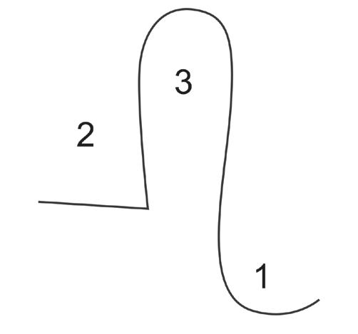
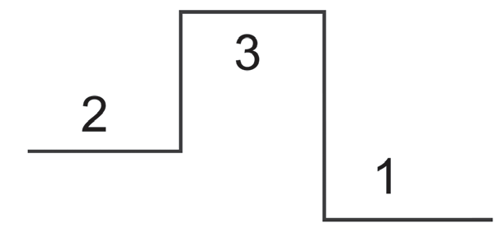
Listening Strategies and Prosodic Features of Speech
Intonation Patterns
1. The 2-3-1 Intonation Pattern
The 2-3-1 pattern has these structures:
a. b.

Slide 13
Listening Strategies and Prosodic Features of Speech
The first structure is used when the last word of the sentence is made up of two or more syllables.
Example: Ben did well in his examination.
The second structure is used when the last word of the sentence is a monosyllabic or one-syllable word. This structure requires your voice to glide down.
Example: That is great!

Slide 14

Listening Strategies and Prosodic Features of Speech
2. The 2-3-3 Intonation Pattern
This pattern entails your voice to go up at the last syllable of the last word of the sentence, hence the mark after 3 in 2-3-3.
Read the following sentences using the 2-3-3 or rising intonation.
• Shall we go?
• Have you seen Bryan?

Slide 15
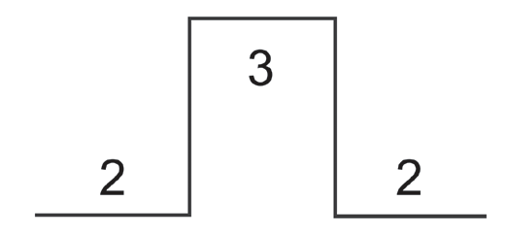
Listening Strategies and Prosodic Features of Speech
3. The 2-3-2 Intonation Pattern
This has this structure:
This is used if the last word of the sentence has two or more syllables. As seen in the 2-3-1 pattern, the glide is also used in the 2-3-2 pattern if the last word is monosyllabic. Only that for 2-3-2, the intonation stops at level 2.

Slide 16
Listening Strategies and Prosodic Features of Speech
Juncture is another important concept in speaking. Juncture refers to the proper pausing in between words or thought units. Juncture is represented by // for a long pause and / for a short pause. An incorrect pause may affect the intended meaning of a speech or a poem. Read the following lines, observing correct juncture:
It works with me like madness/ dear/ to bid me say good-bye.//

Slide 17
Listening Strategies and Prosodic Features of Speech
Choose the letter of the correct answer.
1. Which word in the sentence, “I believe in you,” should be stressed?
A. I C. in
B. believe D. you
2. Which of the following is not a basic intonation pattern?
A. 2-3-1 C. 2-3-3
B. 2-2-3 D. 2-3-2

Slide 18
Listening Strategies and Prosodic Features of Speech
3. Which of the following is NOT TRUE about juncture?
A. Juncture is the proper pausing in between words or thoughts of words.
B. Juncture is represented by / for a long pause and // for a short pause.
C. An incorrect pause may affect the intended meaning of a speech or a poem.
D. Juncture enables the listener to determine a word, phrase, or unit of thought.

Slide 19
Listening Strategies and Prosodic Features of Speech
4. Which of the following statements has an appropriate juncture?
A. Juncture is the proper pausing// in between words or thoughts of words.//
B. Juncture/ is the proper pausing// in between words or thoughts of words.//
C. Juncture/ is the proper pausing in between words// or thoughts of words.//
D. Juncture/ is the proper pausing/ in between words/ or thoughts of words.//

Slide 20
Listening Strategies and Prosodic Features of Speech
5. Which of the following statements on stressing words is NOT TRUE?
A. The determiners, personal pronouns, prepositions, conjunctions, and
auxiliary verbs are usually unstressed.
B. Nouns, main verbs, adjectives, adverbs, demonstratives, and question
words are stressed.
C. Nouns, main verbs, adjectives, adverbs, demonstratives, and question
words are emphasized because they give meaning to the sentence.
D. The stressed words or syllables are not necessarily delivered louder,
higher in pitch, and longer.

Slide 21
Listening Strategies and Prosodic Features of Speech
ANSWER KEY
Choose the letter of the correct answer.
1. Which word in the sentence, “I believe in you,” should be stressed?
A. I C. in
B. believe D. you
2. Which of the following is not a basic intonation pattern?
A. 2-3-1 C. 2-3-3
B. 2-2-3 D. 2-3-2

Slide 22
Listening Strategies and Prosodic Features of Speech
ANSWER KEY
3. Which of the following is NOT TRUE about juncture?
A. Juncture is the proper pausing in between words or thoughts of words.
B. Juncture is represented by / for a long pause and // for a short pause.
C. An incorrect pause may affect the intended meaning of a speech or a poem.
D. Juncture enables the listener to determine a word, phrase, or unit of thought.

Slide 23
Listening Strategies and Prosodic Features of Speech
ANSWER KEY
4. Which of the following statements has an appropriate juncture?
A. Juncture is the proper pausing// in between words or thoughts of words.//
B. Juncture/ is the proper pausing// in between words or thoughts of words.//
C. Juncture/ is the proper pausing in between words// or thoughts of words.//
D. Juncture/ is the proper pausing/ in between words/ or thoughts of words.//

Slide 24
Listening Strategies and Prosodic Features of Speech
ANSWER KEY
5. Which of the following statements on stressing words is NOT TRUE?
A. The determiners, personal pronouns, prepositions, conjunctions, and
auxiliary verbs are usually unstressed.
B. Nouns, main verbs, adjectives, adverbs, demonstratives, and question
words are stressed.
C. Nouns, main verbs, adjectives, adverbs, demonstratives, and question
words are emphasized because they give meaning to the sentence.
D. The stressed words or syllables are not necessarily delivered louder,
higher in pitch, and longer.

