Slide 1
What Affects Growth of Children

Slide 2
What Affects Growth of Children
Growing children need food to grow big and strong. Eating the right kind of food is important to keep children healthy.
Your body is like a machine. Machines need fuel to make them work. Your body needs fuel, too. Your body needs food that contains vitamins and minerals for energy. The right food helps your body do different activities everyday.
Right Food to Eat

Slide 3
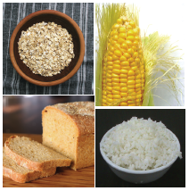
Carbohydrates and Fats
You need food for energy. Energy keeps your muscles working.
Carbohydrates and fats are energy foods. They are called Go foods. Go foods serve as fuel for the body because they give the energy your body needs.
Examples of food rich in carbohydrates are bread, rice, noodles, potatoes, and corn. When you eat food rich in carbohydrates, you are giving your body a lot of energy.
Bananas and potatoes are high energy foods. Fatty food includes butter, margarine, and vegetable oil.
When you eat too much fatty food, you store extra fats in your body. Too much fat is not good for the body because it can cause different heart diseases.
Foods rich in carbohydrates

Slide 4
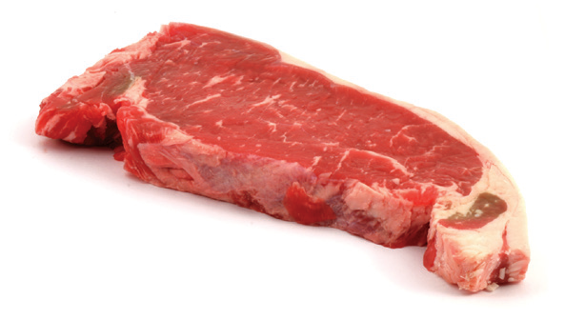
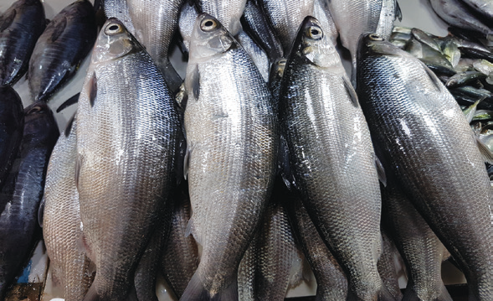
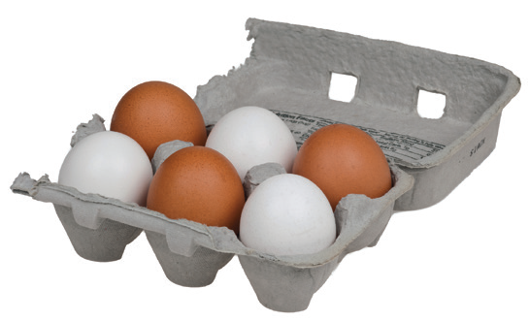
Protein
Proteins are food materials that build and repair body tissues. Food rich in proteins include meat, fish, milk, beans, and eggs. They make your muscles strong.
Affordable food rich in protein are eggs, edible seeds, peas, and beans. They are examples of Grow foods. Grow foods are necessary for growing children.
Foods rich in protein

Slide 5

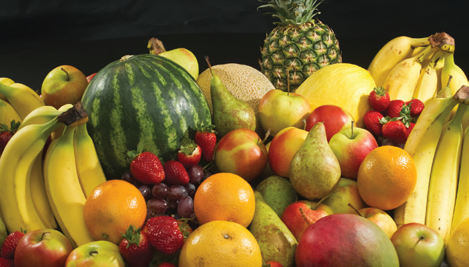
Vitamins
Vitamins help your body work well. Some vitamins are good for the eyes. Some are good for the teeth and bones. Others are good for the skin and for the healing of wounds.
Food that are rich in vitamins are called Glow foods. Glow foods include fresh fruits and vegetables.
Foods rich in vitamins and minerals

Slide 6
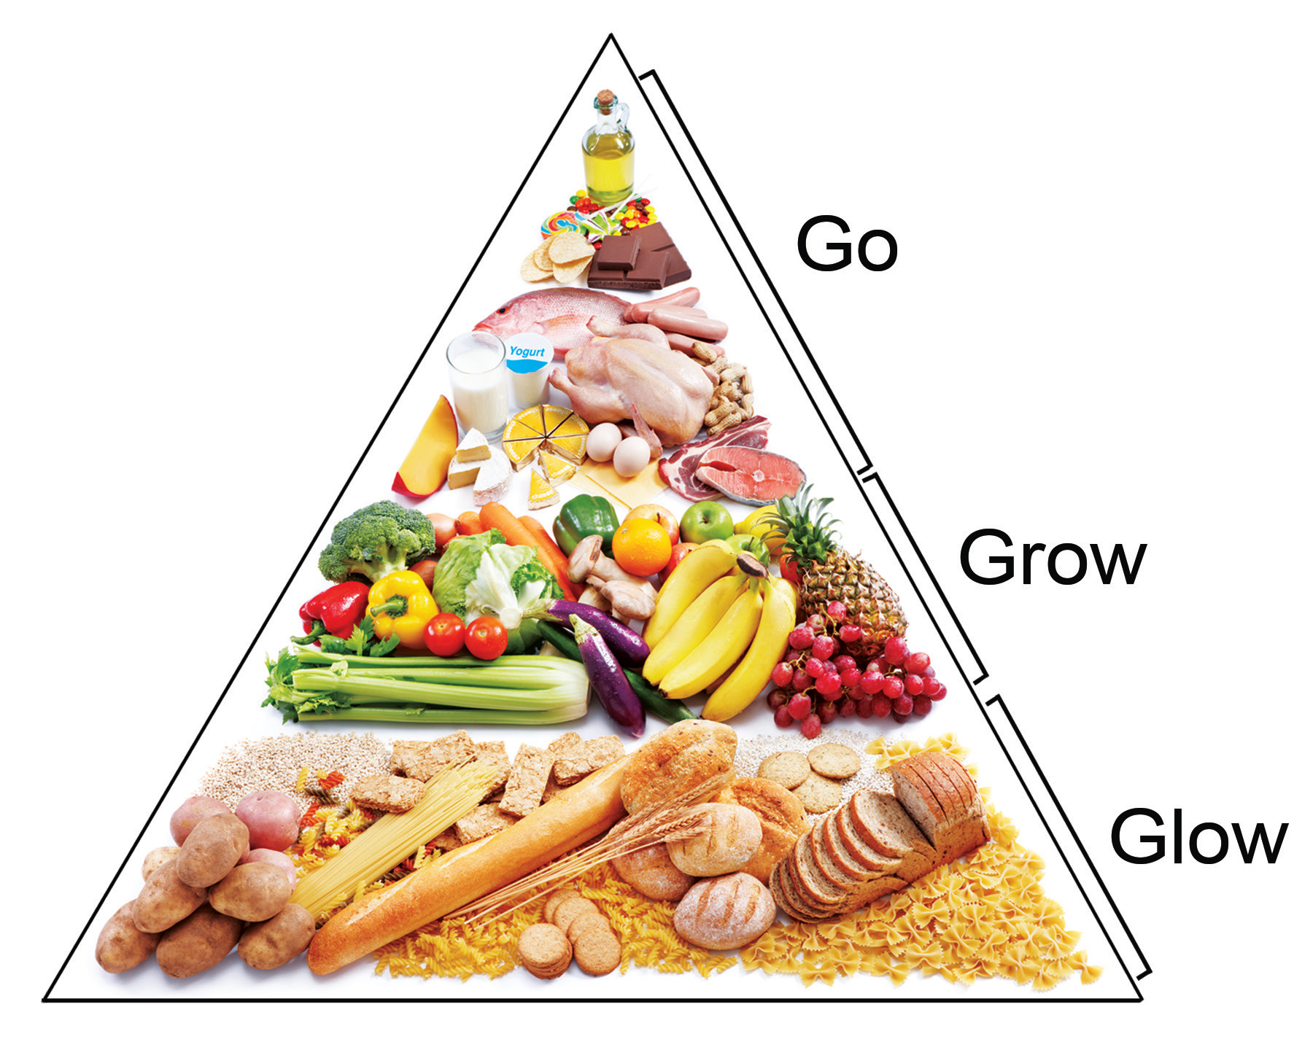
Minerals
Minerals are also needed by the body. Milk, eggs, liver, and some green vegetables are some food rich in minerals.
Calcium is a mineral. It is used for building bones and teeth. Iron is also a mineral. It helps the blood carry oxygen to different parts of the body. Iodine is another mineral. It is good for the thyroid gland.
Selenium from onions and garlic is good for fighting diseases and infections.
We can group foods according to their function. Here are the three food groups: Go, Grow, and Glow foods.
Food Groups

Slide 7
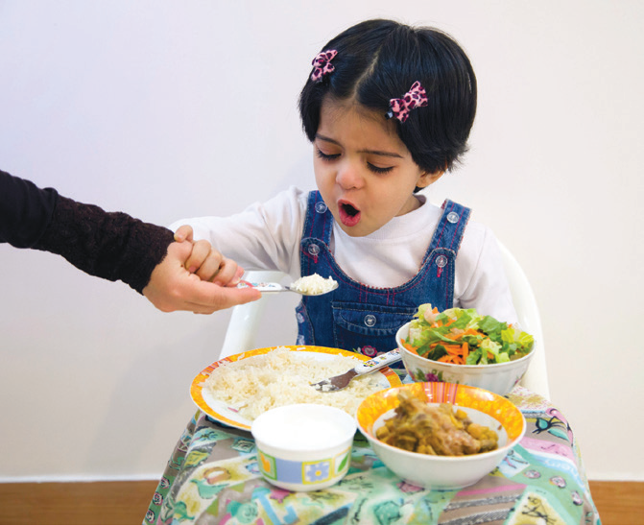
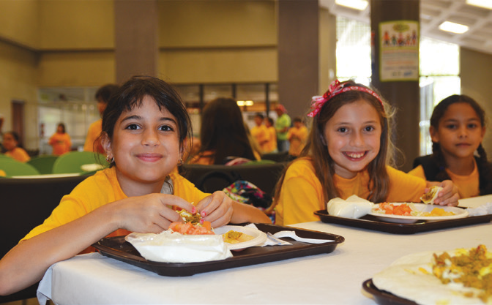
Good Eating Habits
A habit is something you do regularly. A good eating habit helps make your body strong and healthy. Growing children should practice good eating habits that will help them grow strong and healthy.
1. Eat a balanced diet.
A balanced diet is a meal that contains foods from all of the basic food groups. You also need to drink plenty of water and fruit juice.
2. Eat three meals a day.
Eat breakfast, lunch, and dinner everyday. Eat light snacks in between meals so that you will not lose appetite for the next meal. Do not skip meals even when you are in a hurry to do or finish an activity. Skipping meals can make you very hungry and this is not good for the body.
A child eating
breakfast
Children eating
well

Slide 8

Good Eating Habits
3. Avoid eating junk foods.
These foods are not good for your body. They can make you sick if you eat them too much.
Junk foods

Slide 9
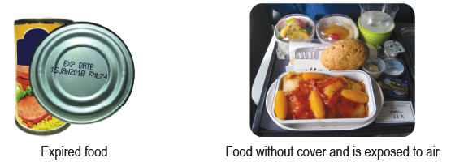
Foods that are Not Safe to Eat
Foods that are not safe to eat
What are the kinds of food that are not safe to eat? Why are they not safe to eat? What might happen if you eat food that is not safe and is exposed to germs?

Slide 10
Good Health Habits and Personal Hygiene
These are some ways to have good health habits:
1. Take a bath regularly. Shampoo your hair properly.
2. Wash your hands with soap and water all the time. Wash your hands each time you use the toilet and after you blow your nose and hold dirty things.
3. Dry your hands thoroughly after washing them. Using sanitizers can kill germs that cause illnesses.
4. Brush your teeth after every meal and floss your teeth at least two times a day.

Slide 11
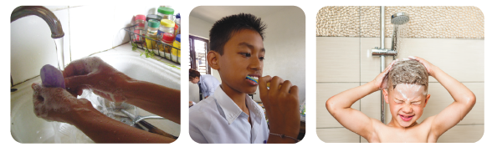
Good Health Habits and Personal Hygiene
These are some ways to have good health habits:
5. Always wear clean clothes and slippers.
6. Use clean tissues and/or handkerchief to cover the mouth when coughing or sneezing. Throw your used tissues in a trash can.
7. Do not share combs, toothbrushes, hats, or other personal belongings with other children.
8. Visit your doctor and dentist regularly.
Good health habits

Slide 12
Good Health Habits and Personal Hygiene
Always clean your body and surroundings to prevent parasitic worm infestation like hookworm and pinworm that can enter your body. This will also prevent pediculosis, which is an infestation of body lice on your scalp.
If you will not practice good health habits and personal hygiene, germs will enter your body. Germs are organisms that can cause diseases or illnesses. Illnesses can affect one’s growth and development.

Slide 13
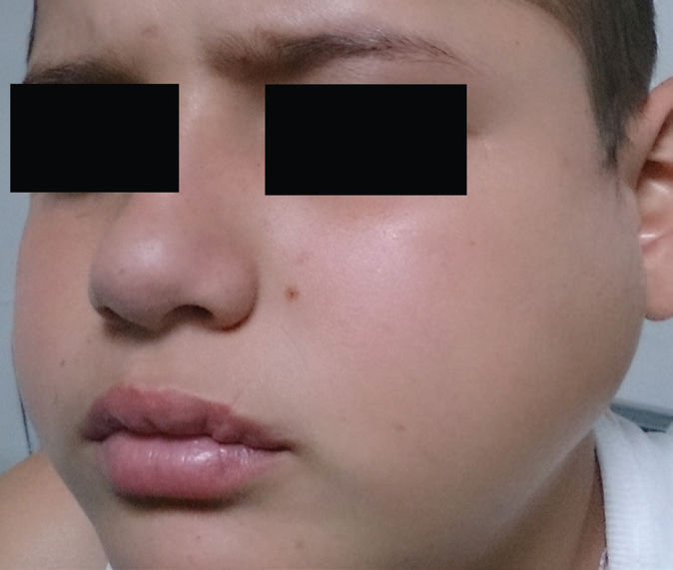
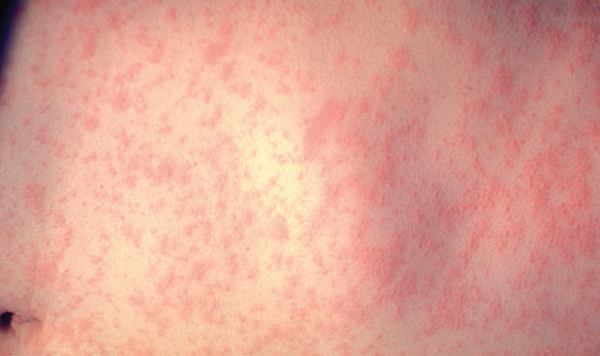
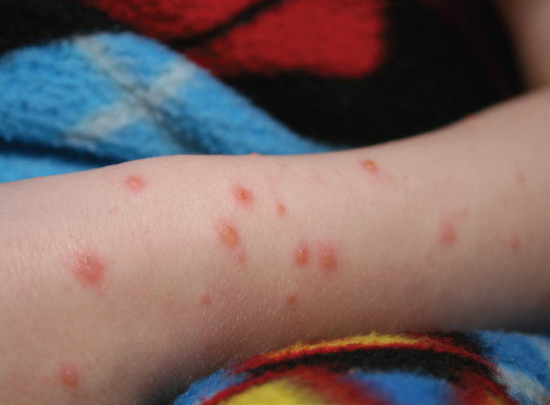
Common Childhood Diseases
Here are some common childhood diseases:
1. Mumps is an infection of the salivary glands. It can cause fever, headache, and swelling of the cheeks and jaw. Mumps can cause deafness in some people.
2. Measles causes high fever, cough, rash, runny nose, and watery eyes. It is a serious infection that can lead to ear infections or pneumonia.
3. Chicken pox is a disease that causes a blister-like rash, itching, fatigue, and fever. The rash pops up first on the face and trunk, and can spread all over the whole body.
A boy with mumps
A girl with measles
A child with
chicken pox

Slide 14

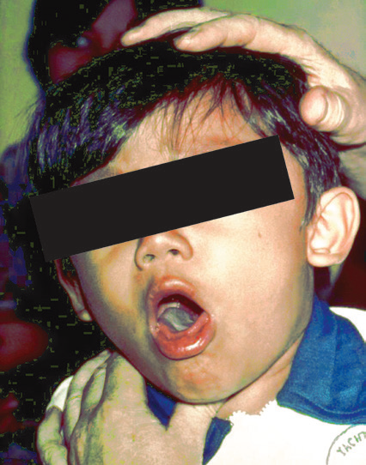
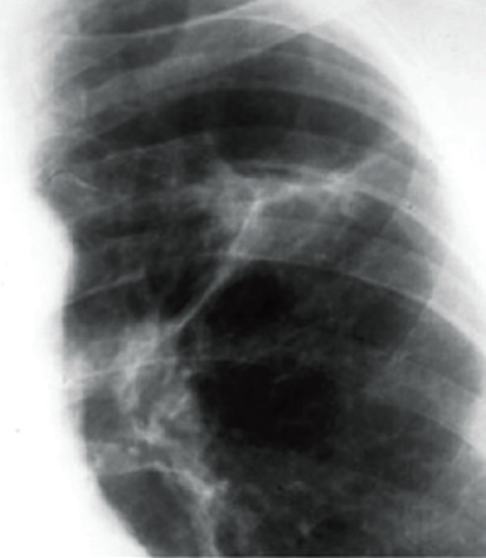
Common Childhood Diseases
4. Tetanus is a serious disease that can kill you if not treated early. It may happen when the tetanus germ gets into a cut in the skin or wound. It does not spread from person to person. You need to be vaccinated against tetanus.
5. Diphtheria is a serious disease of the nose, throat, and skin. It causes sore throat, fever, and chills.
A girl being vaccinated against tetanus
6. Primary complex is a type of tuberculosis that most often occurs in children. It is an infection in a small area in the lungs and lymph nodes.
X-ray of
a child with
primary
complex
A boy
with diphtheria

Slide 15
Common Childhood Diseases
These diseases except for tetanus can spread easily from person to person. This can happen when an infected person coughs, sneezes, or even talks near you. Sharing beverage containers and utensils is another example of how diseases can be spread. People who are infected with these diseases should stay at home so that they do not spread the infection to others.
To prevent mumps, measles, chickenpox, diphtheria, and tuberculosis, a child must be vaccinated against these diseases.

Slide 16
Prevention and Control of Childhood Diseases
To protect yourself and your family from diseases, you should practice the following:
1. Good eating habits
2. Good health habits/personal hygiene
3. Proper exercise and play
4. Enough sleep and rest
5. Clean surroundings
6. Regular vaccination

Slide 17
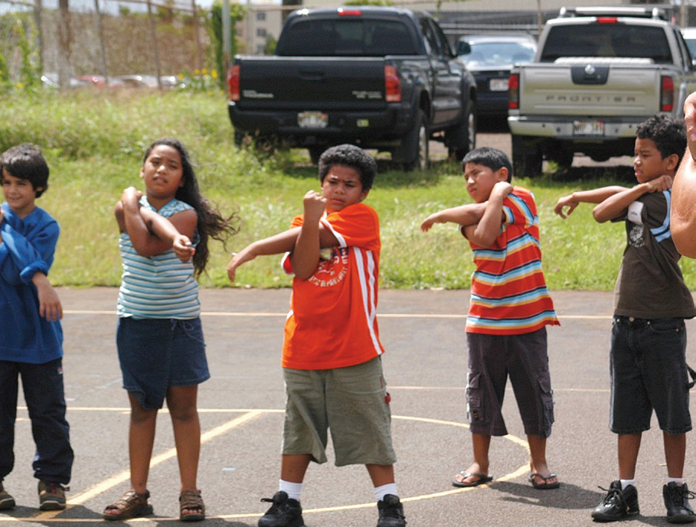
Other Body Needs for Growth and Health
Exercise and Play
Children need exercise. Playing is a form of exercise. It makes you strong and healthy. It makes you sleep well at night. But playing too much can make you sick. Do you play too much?
Exercise and play are good for your body. They help make your muscles strong and healthy. They also help your heart work well.
Exercising regularly also improves your body posture. Having good posture makes us look good and gives us confidence to join different activities in school.
Children exercising

Slide 18

Rest and Sleep
Children need rest after playing or after studying.
You need to go to bed early and sleep well at night in order to become physically fit. This will prepare you for the next day’s activities. Children need 10 to 11 hours of sleep every day.
Children sleeping

Slide 19
Keeping the Surroundings Clean
In order to have healthful surroundings, you should help keep your community clean.
Here are some ways to keep your surroundings clean:
1. Trash cans where wastes are thrown should be covered so they will not attract harmful insects.
2. Canals should be cleaned so they will not become breeding places of mosquitoes.
3. Take care of the plants around your house. They make the surroundings cool and fresh.

Slide 20
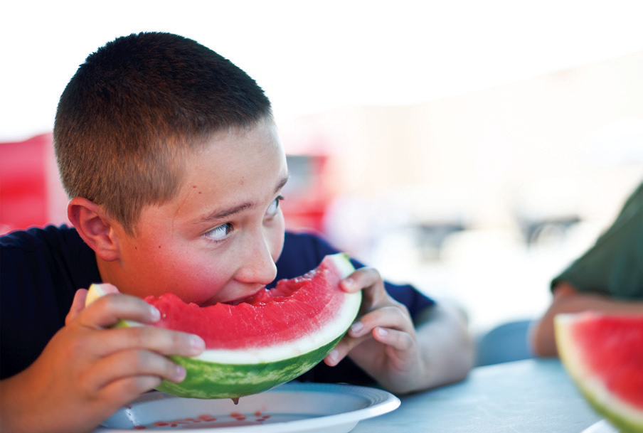
Becoming a Healthy Child
A child who practices good health habits becomes fit and healthy. A healthy child:
has good posture
has strong body
can play and study well
is friendly to everyone
has a positive attitude
A healthy child

