Slide 1
I Am What I Eat

Slide 2
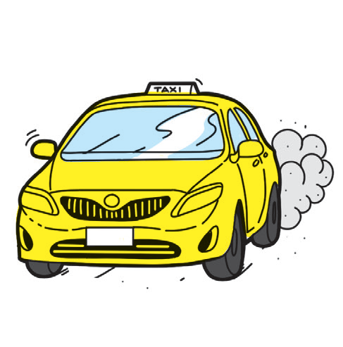
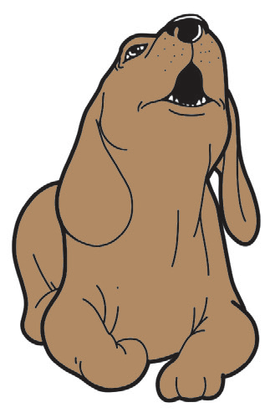

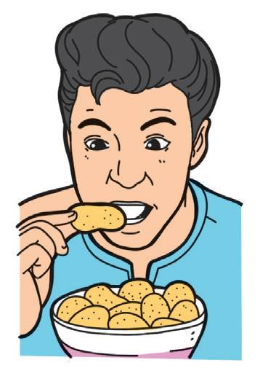

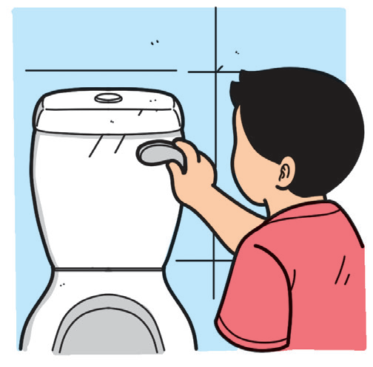
Listening
Pretend that you are about to eat a juicy red apple. Bite into it. How does it sound? Now, sit comfortably. Close your eyes. Pay attention to the sounds that your teacher will play.
Open your eyes. Choose the pictures that match the sounds you heard.

Slide 3

Phonological Awareness
Do you know that sounds can also be heard in letters? How many letters of the alphabet do you know?
There are 26 letters in the alphabet. Each letter has its own sound. Knowing the letter sounds will help you read better.

Slide 4
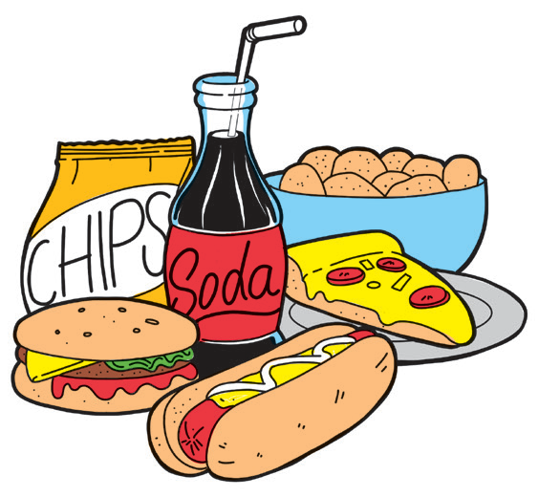
Fluency
I Am What I Eat
Donuts, chips, hotdogs, soda–yummy! I eat them every chance I get–while watching my favorite TV show, while studying, while riding in the car, especially when my parents are not around.
One day, I had a tummy ache. Ouch, I could not sleep! Dad and Mom had to bring me to the hospital.
Doc May asked, “What did you eat?”
I said, “Donuts, chips, hotdogs, soda–all of my favorite food!”
Doc May shook her head and said, “Now we know why. You are what
you eat. If you fi ll your body with junk, it becomes dirty and you get sick.”

Slide 5
Vocabulary Development
Can you recall the words from the story? Look at the list below. Do you know what they mean? Can you use them in sentences?
yummy not around tummy
hospital favorite junk

Slide 6

Reading Comprehension
Form four groups. Each group will go to one corner of the room where a question about the story is posted. All the members of the group have to share their answers. When the teacher rings the bell, the group has to move to another corner to answer the next question.
How do you think the story will end? Why do you say so?
How should you
act when your
parents are not
around?
What did the child in the story do?
Why do you think is the story titled “I Am What
I Eat”?

Slide 7
Oral Language
With a partner, talk about the following:
• We show respect to our body by taking care of it.
• We show respect to others through our words.
Greetings are words of welcome and respect.
Leave-takings are words used to say goodbye or end a conversation.

Slide 8
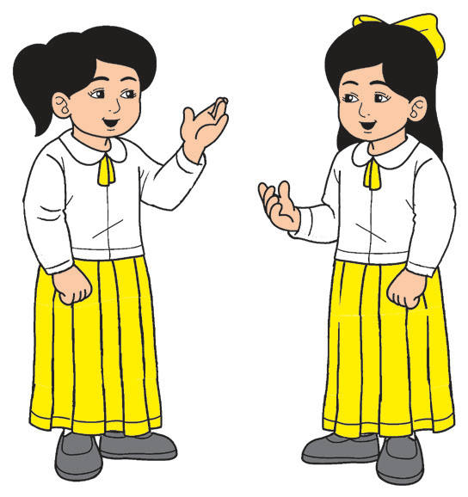
Good morning.
Good afternoon.
Good evening.
A. Practice saying these greetings with a partner.
Hello! Hi! .
How are you?
What’s your name?
It’s nice to see you again.

Slide 9
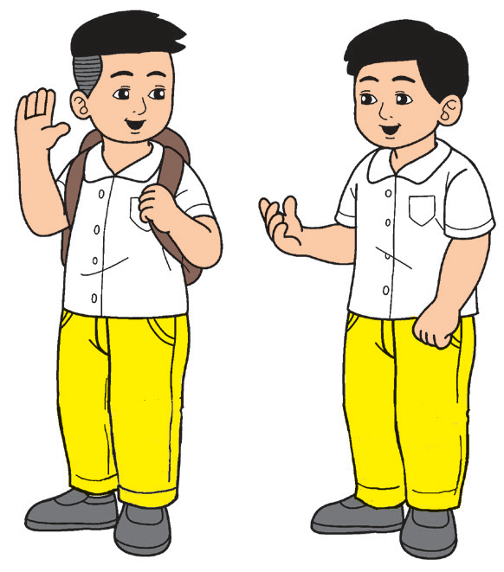
B. Practice these leave-takings with a partner.
Goodbye. See you on Monday.
See you later. Take care.
See you next ti me. Good night.

Slide 10
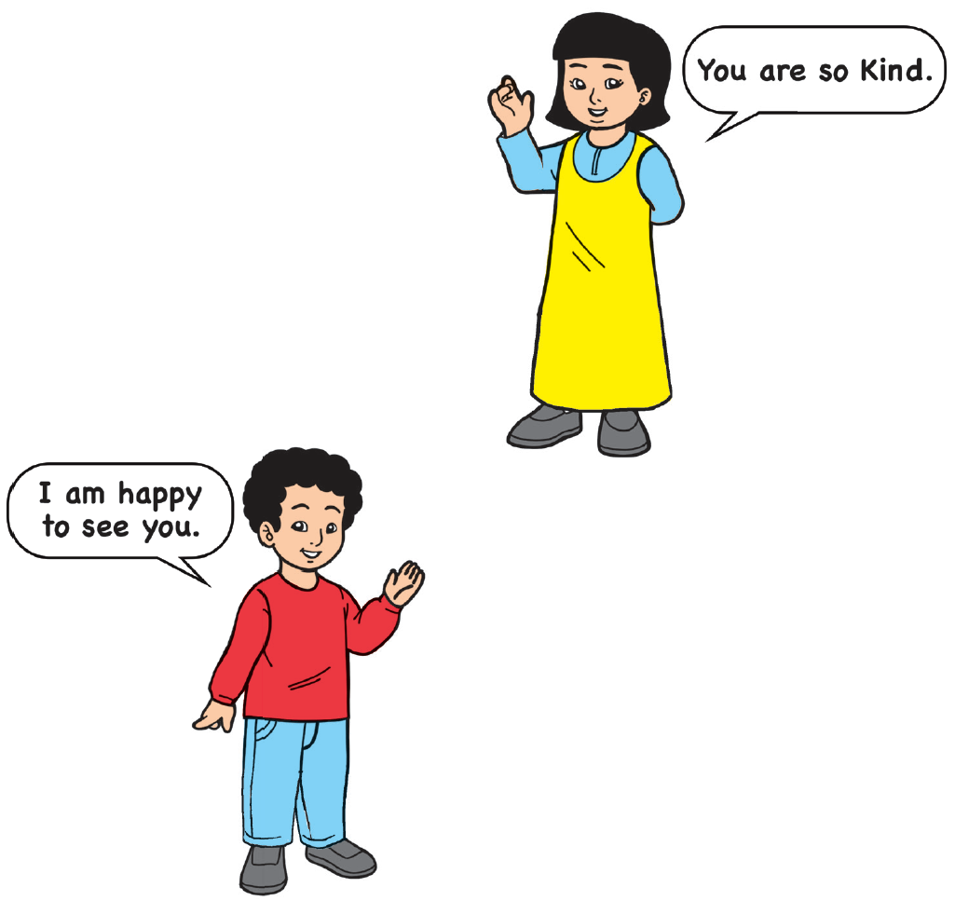
C. Work with a group. Imagine yourselves as superheroes with words as your secret power. What power words will you say to each friend? Act out your answers.

Slide 11

Grammar
All persons have names.
Sometimes, we use the same name for different persons.
With two classmates, list all the names of persons that you know. You will be given two minutes to do this. When the ti me is up, compare your list with another group.

Slide 12

Complete the organizer below with the names of persons related to food. Use the clues in the boxes.
PEOPLE AND FOOD
Sells fruits and vegetables
v e ___ d ___ r
Prepares meals at home
______________________________
Serves food in a restaurant
w a i ___ ___ ___

Slide 13
Writing
Can you think of a food that looks like a line?
Lines are everywhere. Can you look for them in your classroom?
Horizontal lines are also called sleeping lines.
They go from left to right.
Vertical lines are also called standing lines.
They go from top to bottom.
Slanting lines do not go straight across or straight up.
They look like the sides or slopes of a mountain.

