Slide 1
Our Toys

Slide 2
What do the underlined words mean?
1. Toy cars are aplenty in the store.
2. The baby shakes his rattle.
3. The pupils pack away their things before leaving the room.
4. The driver will take charge of the school bus.
• put away
• many
• be responsible for
• a toy for babies

Slide 3
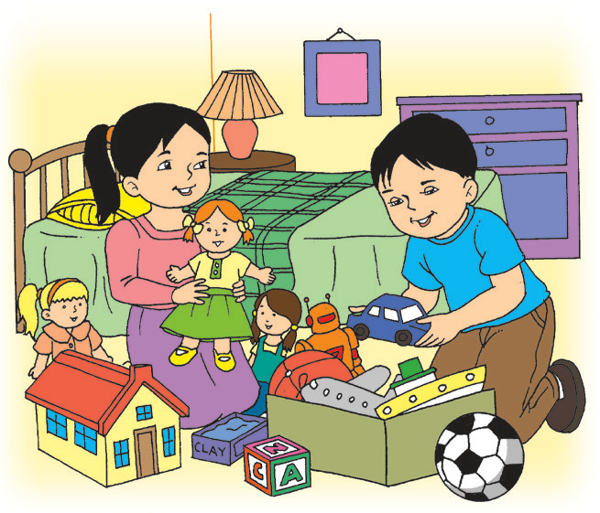
Our Toys
Many toys to choose from, Kit and I.
Kit’s trains, cars, planes, and balls are aplenty,
While mine are boxes of clay and dolls that cry,
And Baby Mina’s rattle looking like a bag of tea.
We share and have fun,
We play all day,
But when the day is done,
It’s ti me to pack away.
Wipe the toys, put some in boxes,
Pick them up or they get stepped on.
Mom is happy, her children take charge
But of course, because the toys are ours!

Slide 4

Think about and answer these questions:
What toys do the children have?
How do they take care of their toys?
How do they feel when they clean and put away the toys properly? How about their mom?
Is putting away toys important? Why or why not?

Slide 5
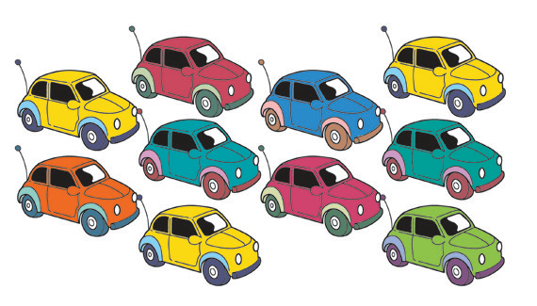
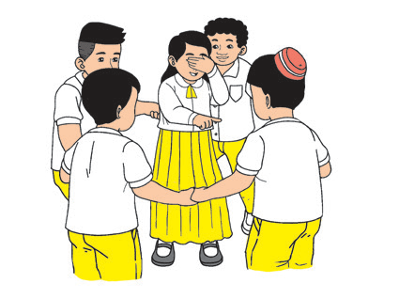
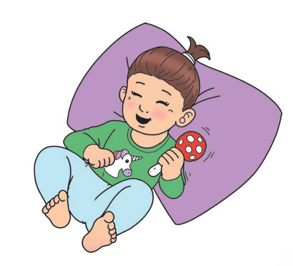
ten toy cars
five friends
one rattle

Slide 6

one
five
ten
Words that tell about numbers
Some words tell about numbers. They tell how many people, animals, and objects there are. They are called number words.

Slide 7
1 | One | 11 | Eleven
2 | Two | 12 | Twelve
3 | Three | 13 | Thirteen
4 | Four | 14 | Fourteen
5 | Five | 15 | Fifteen
6 | Six | 16 | Sixteen
7 | Seven | 17 | Seventeen
8 | Eight | 18 | Eighteen
9 | Nine | 19 | Nineteen
10 | Ten | 20 | Twenty

Slide 8
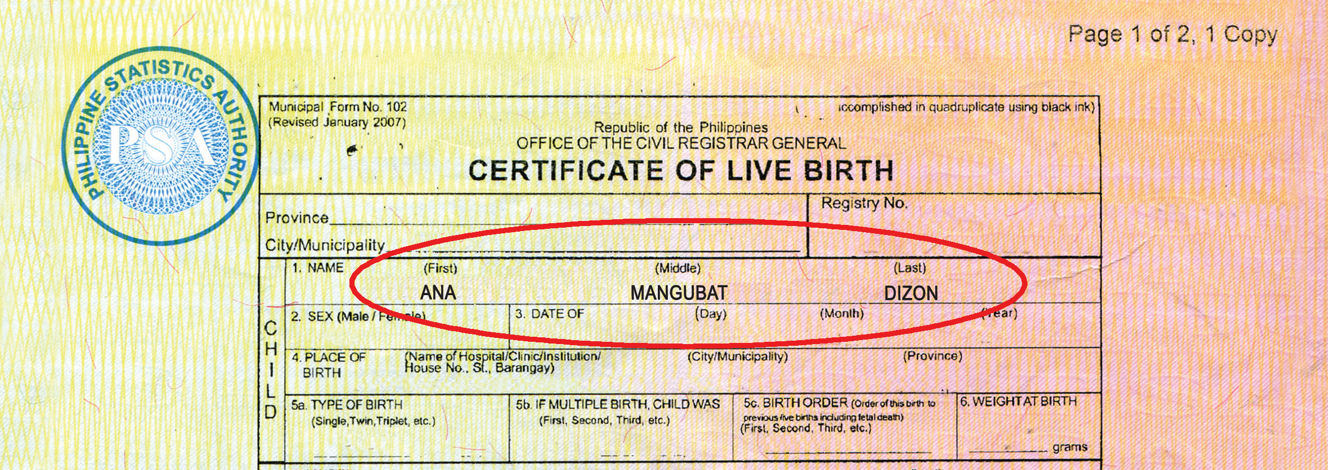
What is a birth certificate?
When you were born, your name was entered into a birth certificate.
You can find your full name here. You can also find it in your school ID and in your passport, if you have one.

Slide 9
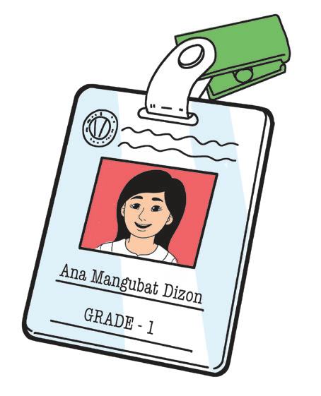
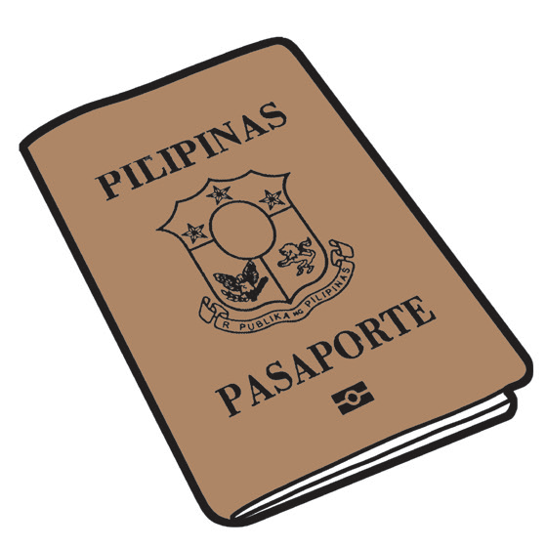
Ana Mangubat Dizon
or
Ana M. Dizon
Ana is my first name or given name. It is found at the beginning of my full name. It is how I am usually called.
Dizon is my last name, surname, or family name. My family has the same surname.
Mangubat is my middle name. It is found in between my first and last names. Most of the time, I just write M., short for Mangubat.

