Slide 1
I Can Grow My Brain

Slide 2
Phonological Awareness
Consonant letters are usually found at the beginning and end of a word.
Take note of the following ending consonant letters and their sounds.
bed
room
rest
sleep
cob
log
man
box
roof
dark

Slide 3
Vocabulary Development
Use these words in sentences.
grow brain burst worry
store memory concentration
laugh exercise sleep listen

Slide 4
I Can Grow My Brain
In school today, we talked about how we can grow our brain. We may imagine my brain getting bigger and bigger–until it burst! But we should not worry–our brain can hold and store much information without breaking or bursting.

Slide 5

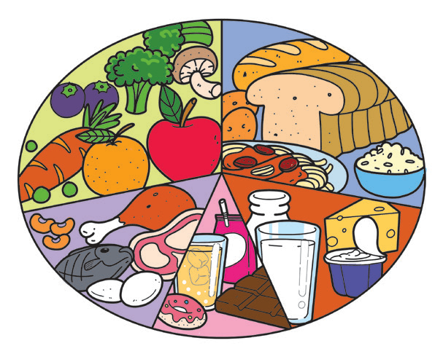

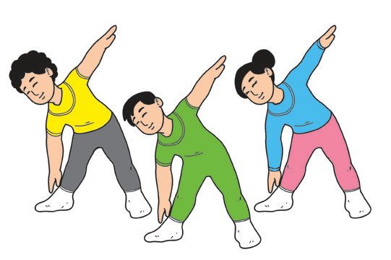

Eat the right food. It improves brain function and concentration.
Exercise daily. The brain works better after you exercise.
Laugh more often. It
Improves memory.
I CAN GROW
MY BRAIN
Enough sleep improves
memory. It helps your brain solve problems.
Listen to good music. It boosts learning.

Slide 6
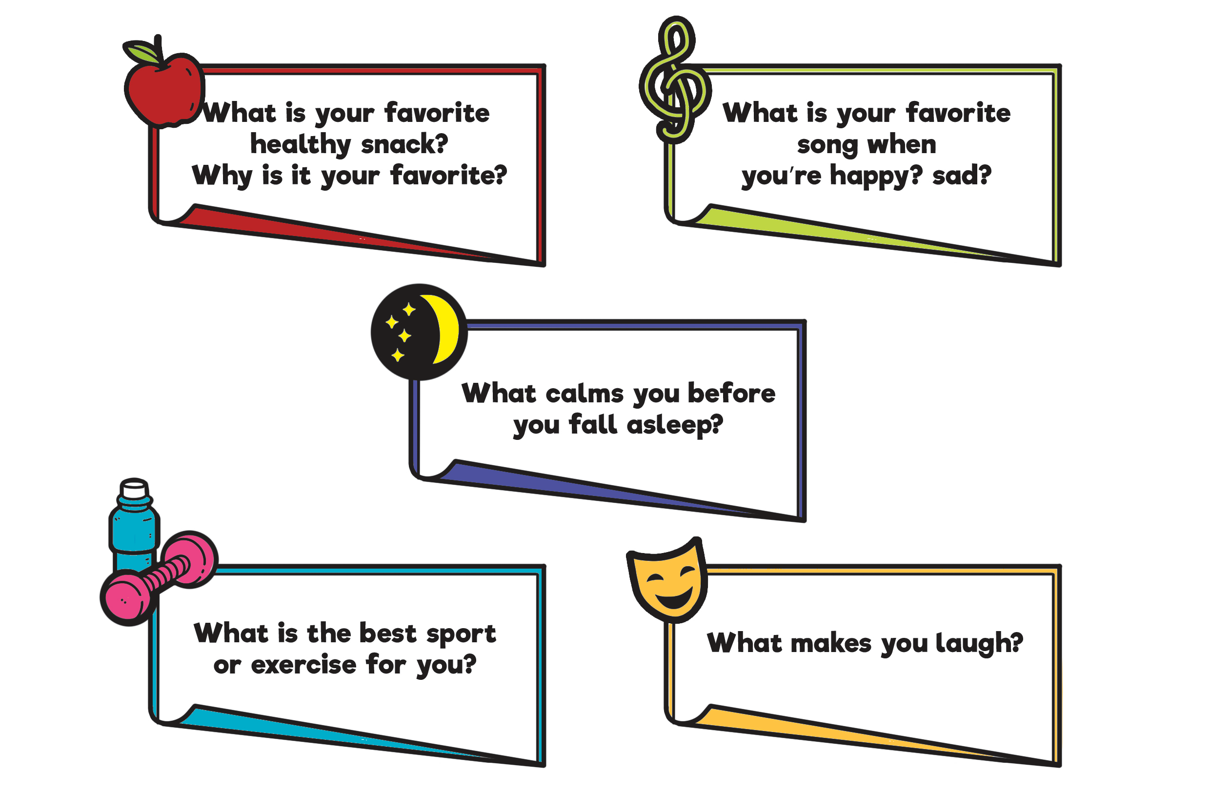
21st Century Skill
To brainstorm means to share your ideas usually to a group.
Here are the questions to brainstorm about what you do to grow your brain:

Slide 7




Oral Language
Listen to what Ana and her mother are talking about.
Sofia will be having a birthday party at her house on Saturday. May I attend her party?
I will allow you to attend the party if you promise to finish your homework by Friday.
I promise, Mom. Please help me buy a gift for Sofia.
Okay, I will help you.
Thank you, Mom!
You’re welcome.

Slide 8
“May I” and “Please” are courteous expressions.
“May I” is used when asking for permission to do something.
“Please” is used when we ask for a favor.
Situations where “May I” and “Please” are used:
You want to take a closer
look at a toy on a display
shelf but cannot reach it.
You want to borrow your
friend’s story book.

Slide 9
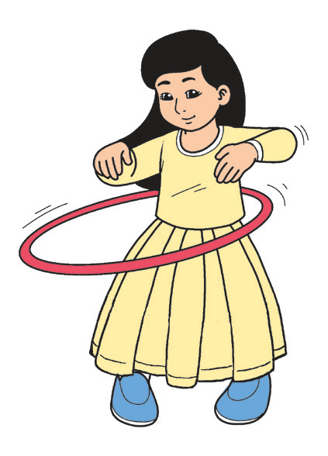

Grammar
Ana saw a hula hoop in a toy store and asked her mom, “May I play with it?”
“Please be careful,” Mom said.
Look at Ana’s hula hoop.
What can you say about its shape?
Names are given to shapes. They are called shape words.

Slide 10









Shapes
–circle –square
–triangle –rectangle
–oval –oblong
–diamond –star
–heart –crescent

