Slide 1
Only One Me

Slide 2
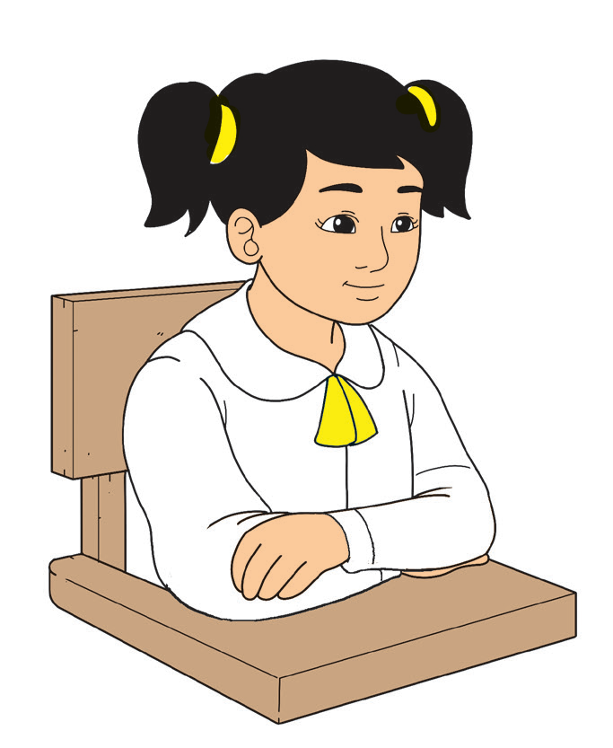
When you listen attentively to others, you pay attention to what you hear. It shows respect.
Remember important details of the story.
Look at the teacher as he/she reads the story.
Remain silent while
your teacher reads
the story.
Sit properly and
comfortably.

Slide 3
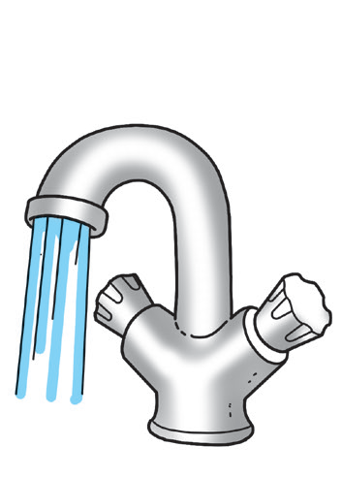
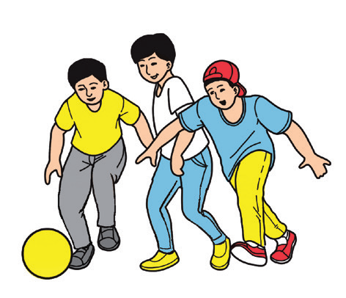
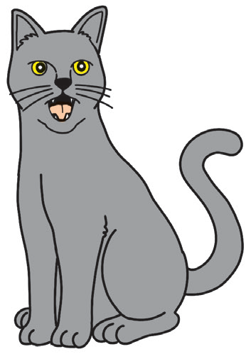
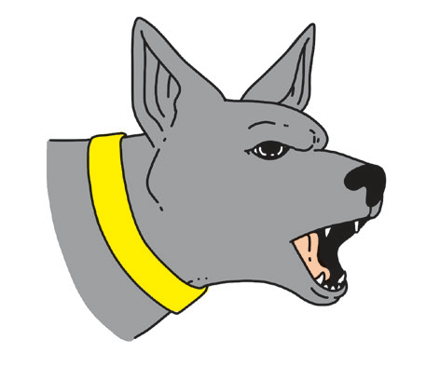
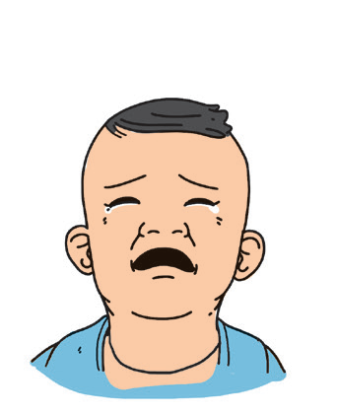
Listen as your teacher plays other sounds from your surroundings. Can you identify them? Can you make these sounds too?

Slide 4

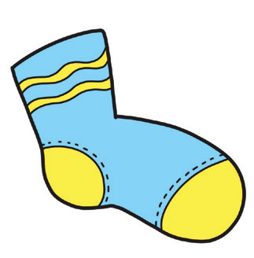



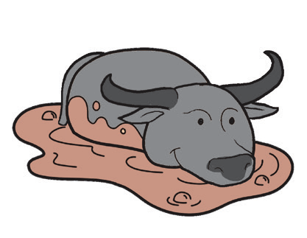


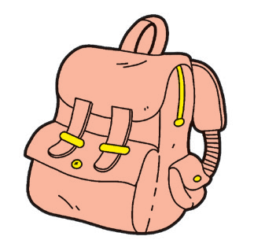
Pair up with a classmate. Say the name of each picture. Listen attentively as your teacher says the names of the pictures. If all three words have the same beginning sound, clap your hands. If not, stomp your feet.
1
2
3

Slide 5
Vocabulary Development
What are the words in your mother tongue for these English words?
name age parents grade one
grandmother siblings older love
Use the words in sentences in English.

Slide 6
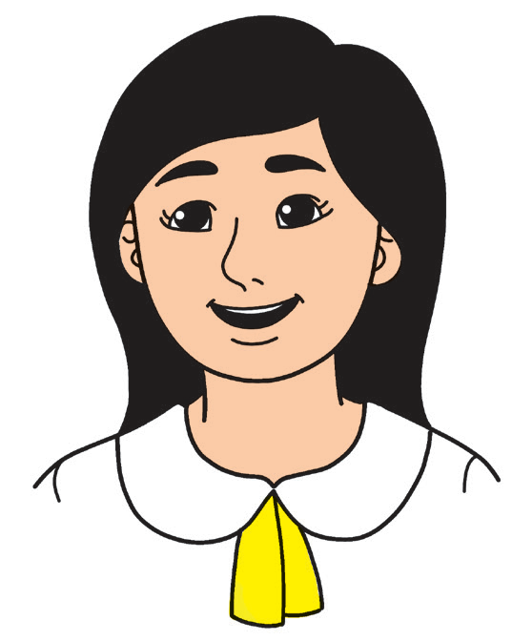
Fluency
The new words you have learned will help you understand the story. It is about a special girl and how she got her name.
Only One Me
Hi! This is me. There is only one me.
I am Ana. I am six years old.
I am in Grade 1.
I asked Mom and Dad why they gave me the name Ana.
They said I got it from my grandmother, Lola Annabel.
I have one older brother and a younger sister.
There is only one me–and I love it!
name
age
parents
siblings

Slide 7
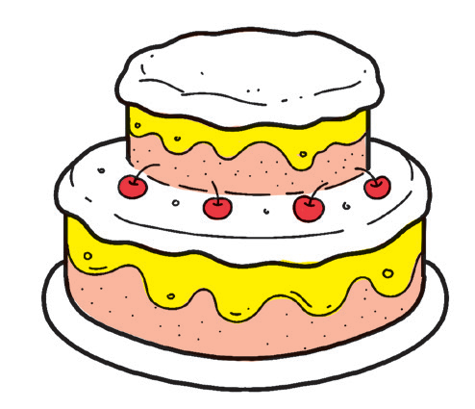
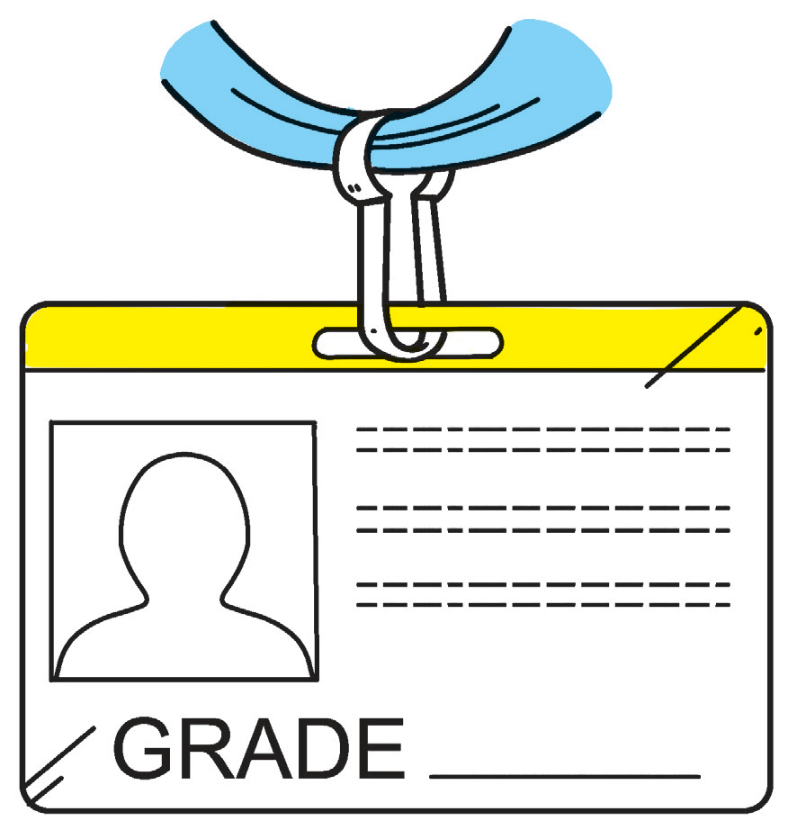
Reading Comprehension
Listen attentively to each question. Then, do what is asked.
1. Who is the girl in the story?
2. How old is she? Draw the right number of candles that show your answer
in your notebook.
3. What grade is she in?
4. From whom did her parents get her name?
Amy | Ana | Ina
Amy | Annabel | Ina

Slide 8
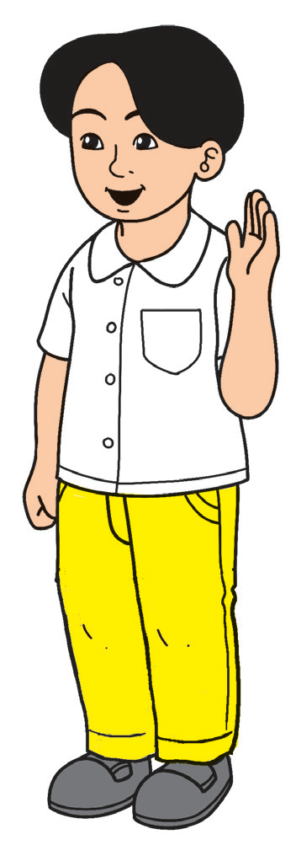
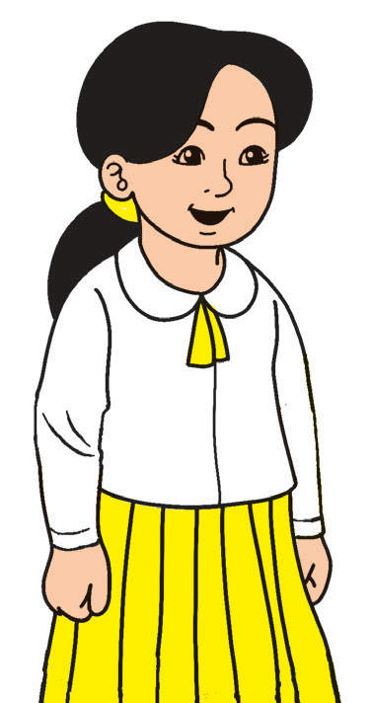
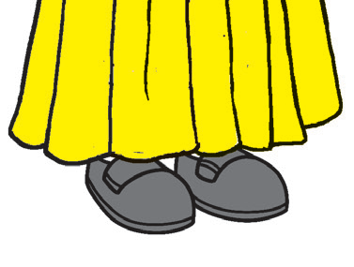
Oral Language
With a partner, take turns in asking and answering these questions:
What is your name | I am _______. My name is ________.
How old are you? | I am _______ years old.
What grade are you in? | I am in Grade _______.
Where did you get your name? What does it mean? | I got my name from _______. It means ________.
What do you like about yourself? | I like myself because _______.

Slide 9

Grammar
What is your favorite toy? Your choice makes you unique, too. Do you know that toys like cars, dolls, and balls are common objects and things?
Common objects and things can be seen or touched and are found almost anywhere. Sometimes, what is common to you may not be common to others.
All objects or things have names.

Slide 10



Can you guess the object being described?
1. I look like a box. You watch shows in me. You use a remote control to turn me on. What am I?

Slide 11

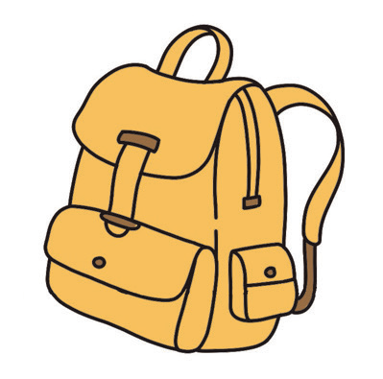

Can you guess the object being described?
2. I have interesting stories and colorful pages. You can learn a lot from me. What am I?

Slide 12



Can you guess the object being described?
3. You can take pictures using me. I can be in different sizes and colors. What am I?

Slide 13

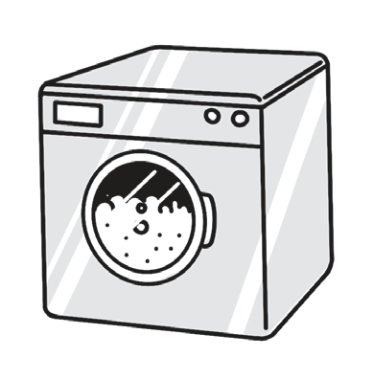
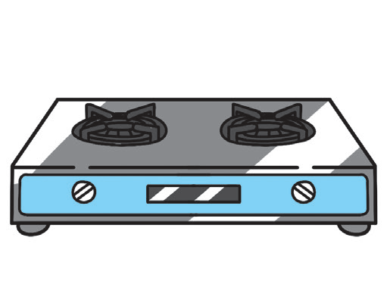
Can you guess the object being described?
4. You store food inside me. I should be kept cold. I come in different sizes and colors too. What am I?

Slide 14
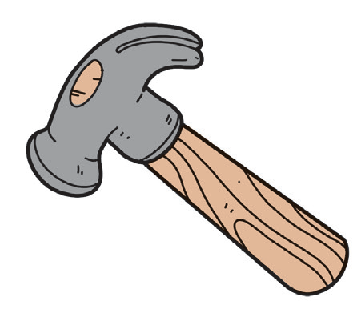


Can you guess the object being described?
5. You use me to open a locked door. I am made of metal. What am I?

Slide 15
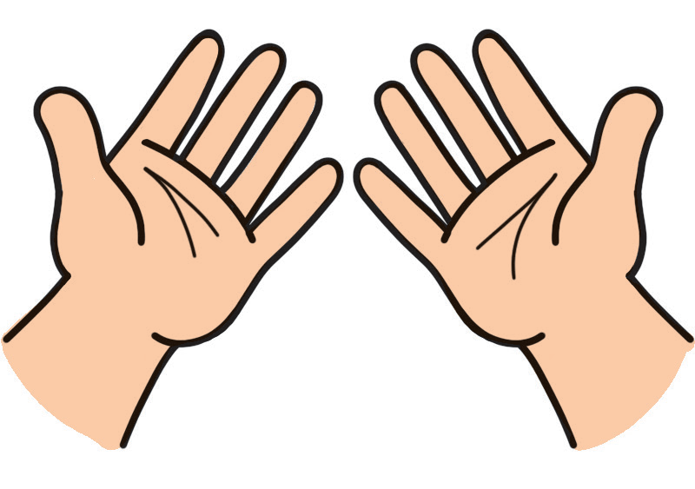
Writing
Your handwriting is unique too.
Left or Right? Are you left -handed or right-handed? Can you use either hand for writing? | • Whichever hand you use for writing and coloring, it is important that your writing is clear (readable) and neat. • Good handwriting starts with the correct grip. This means that you are holding your pencil or crayon properly.

Slide 16
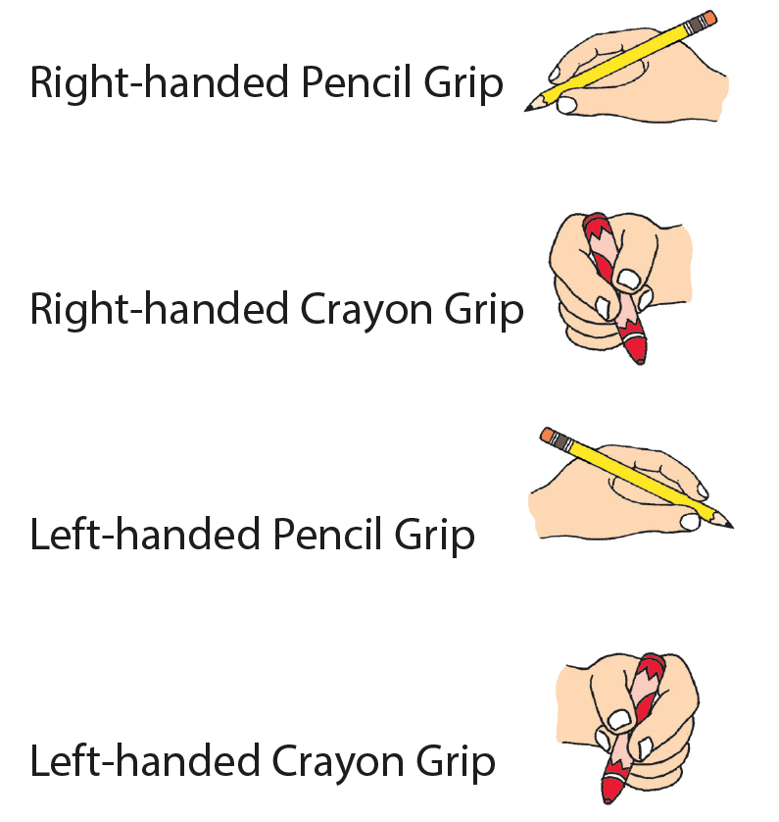
The pictures below show how your hands and fingers should look when writing and coloring.

Slide 17
Get a pencil and do the following:
• Practice the correct grip with a partner.
• Show your grip to your teacher.
• Write your name using the correct grip.

