Slide 1
Clean Up

Slide 2
There are five vowels in the alphabet: Aa, Ee, Ii, Oo, Uu.
Can you think of words that begin with each vowel?
Each vowel makes its own short sound.

Slide 3
Words that have short vowel sounds in the middle:
bag ten kit cop mud
Say the words correctly. Take note of the vowel sound.

Slide 4
Can you give the meaning of the underlined words?
1. The typhoon caused strong winds and heavy rain.
2. The dirt on the floor was swept away by the big broom.
3. I cannot stand the nasty smell coming from the refrigerator.
4. Do not eat those rotten brown tomatoes.
5. I will pile up my books neatly on the shelf.

Slide 5
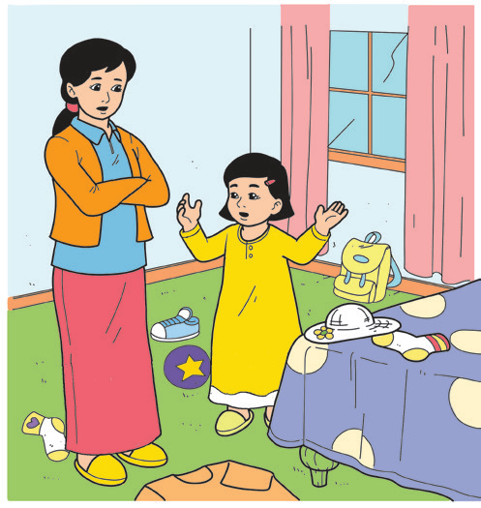

Clean As You Go
One day, Mom went inside Ana’s room.
“It looks like a typhoon hit your room, Ana. The strong wind carried your clothes under the bed and the heavy rains swept your school things all over your bed. And what is that nasty smell? It seems like the typhoon likes rotten apples and sandwiches, too. We need to do something about this typhoon,” said Mom.
Ana chuckled but she knew what Mom meant.
“I’m sorry, Mom. Yesterday in school, Teacher Tonet told us about using the CLAYGO rule in our classroom. If we clean up after ourselves as we go, our trash would not pile up. That is what I will do in my room from now on,” Ana said.
“Way to go, CLAYGO!” Mom joked with a high-five to Ana.

Slide 6
“A-cleaning we will go, a-cleaning we will go! High-ho-da-de-ri-oh,
a-cleaning we will go!”
The trash can is too small to hold our garbage.
Did the big garbage truck pass by?
“Small” and “big” are words that describe size.
There are words that tell about size.
Size tells how big or small a person, animal, or object is.

Slide 7
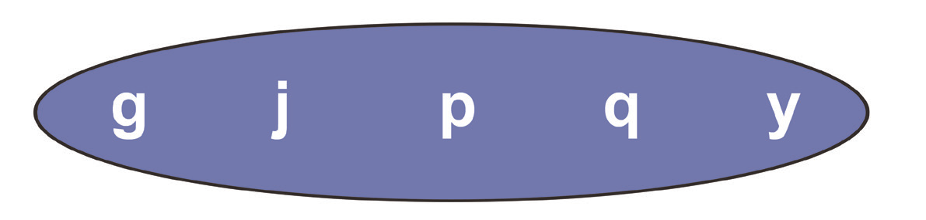
Letters in the alphabet with tails:
Why do you think are they called tailed letters?

