Slide 1
My Second Home
(In, On, and Under)

Slide 2
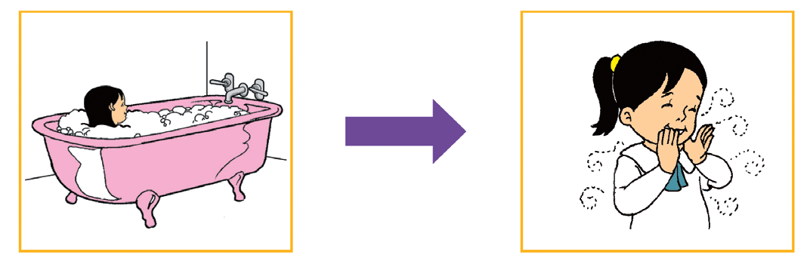
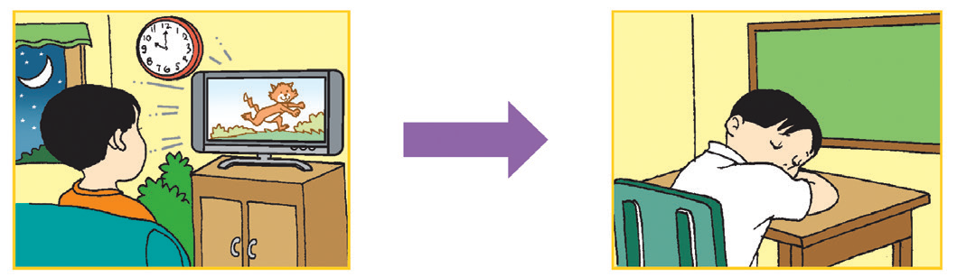
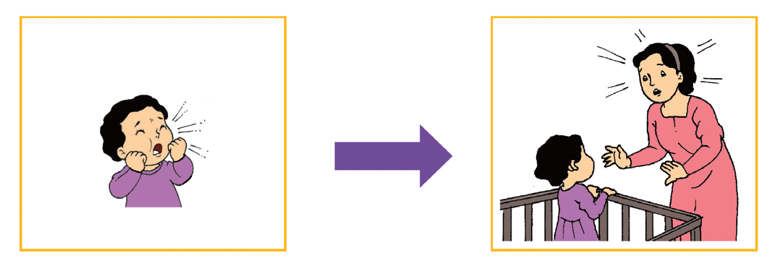
A cause is the reason why something happens.
Cause Effect
Cause Effect
Cause Effect

Slide 3
The pup is in the box.
Mom draws a cub.
short /o/ or /u/ + consonant

Slide 4
b = ob
d = od
g = og
m = om
n = on
p = op
t = ot
x = ox
b = ub
d = ud
g = ug
m = um
n = un
p = up
t = ut
x = ux
O +
U +

Slide 5
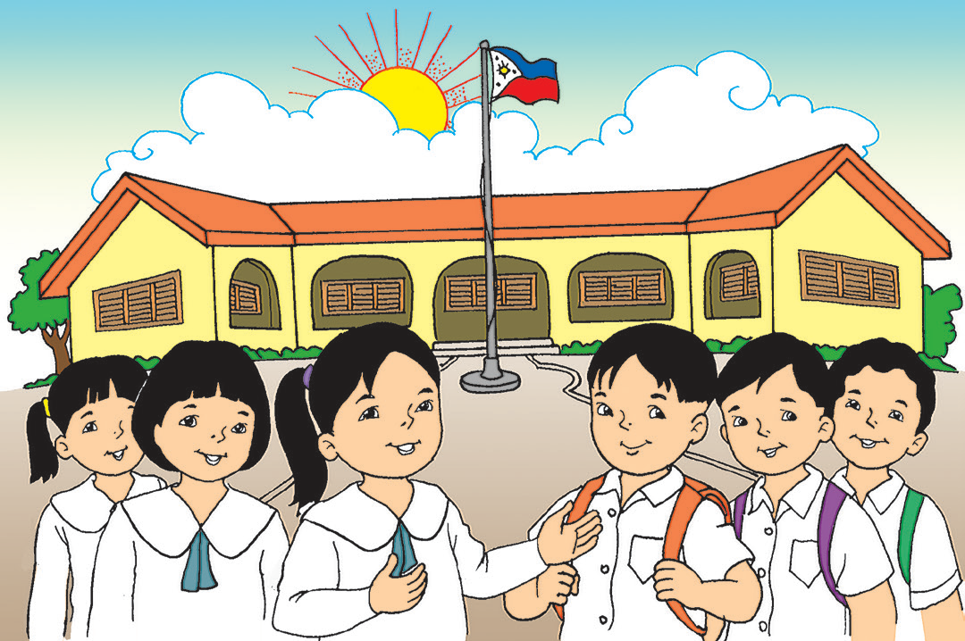
My Second Home
Kit and I have a second home. It is not our neighbor’s house. It is not Grandma nor Grandpa’s house, either. It is our school! Do you know that we have a mother and siblings in school?
Teacher Jen is like my mom. She teaches us well. She guides us on what to do. She makes us love learning. My classmates are like my siblings. Most days, we get along fine. Some days, we argue. But we love each other just the same.
I have to follow rules in school, just like at home. I love my second home. Do you?

Slide 6

What is Ana’s second home?
Who does she consider as her parent in school?
Who are her siblings?
How is her home the same as her school?

Slide 7
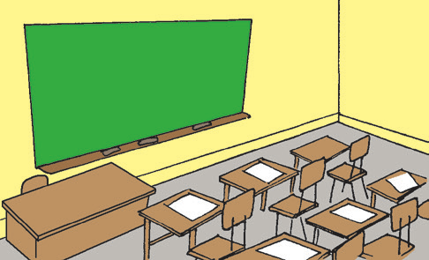
Ana likes going to school. There are different places and things to see in her school.
This is the classroom.
There are tables and chairs in the classroom.
There is a chalkboard too.

Slide 8
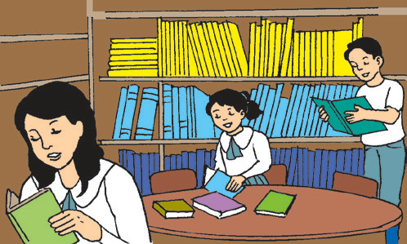
This is the library.
There are many books in the library.

Slide 9
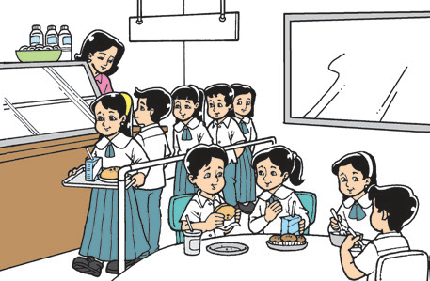
This is the canteen. Food is sold here.

Slide 10
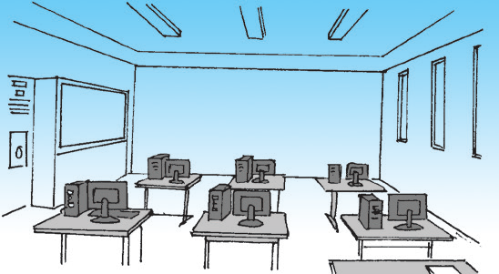
This is the computer room.
Pupils use the computers here.

Slide 11
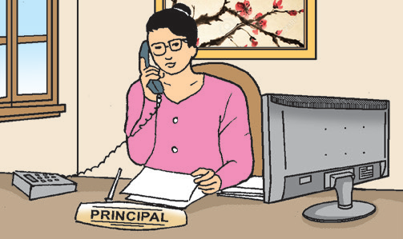
This is the principal’s office.
The principal works here.

Slide 12
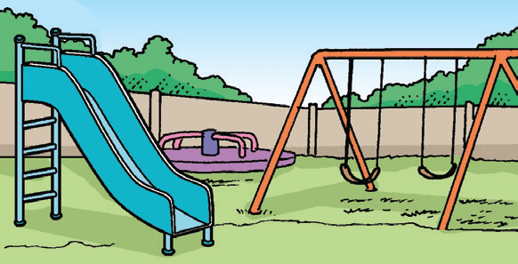
This is the playground.
Children like playing here.

Slide 13
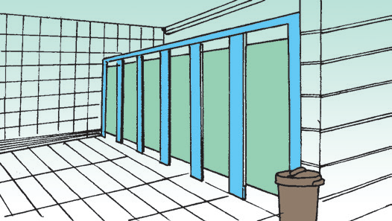
This is the comfort room.
It is always clean.

Slide 14
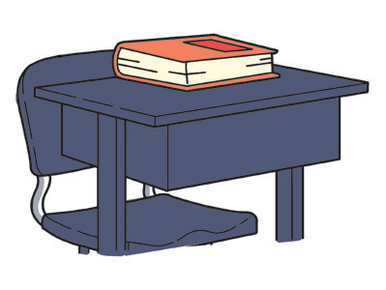
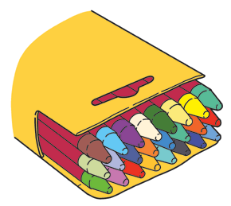
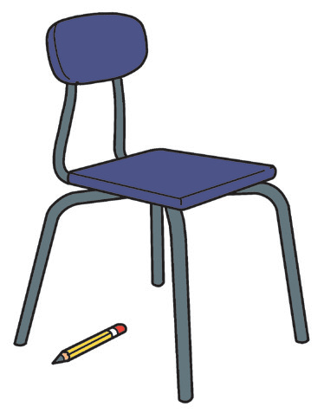
The book is on my desk.
The crayons are in the box.
Your pencil is under the chair.

Slide 15

The words in, on, and under show the location or position of objects or things.

