Slide 1
My Wonderful, Powerful Brain

Slide 2
Listening
Vocabulary Development
Tickle your brain! Pick an object from the Magic Box. Can you say the name of the object?
Repeat these words after your teacher:
pitcher figures billions muscles bulb
These words will appear in the story that your teacher will read. Clap your hands whenever you hear each word.
Then, work with a partner and use each word in a sentence.

Slide 3
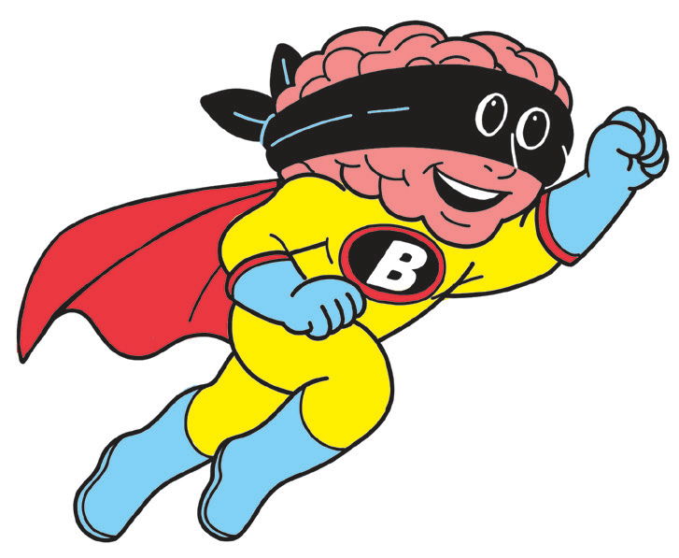
Fluency
What makes your body work? Today, your teacher will read a text that tells about a great organ in your body.
My Wonderful, Powerful Brain
Do you need to pour mango juice from a pitcher to your
glass? Do you want to go up a flight of stairs? Do you like to write in your notebook or do you prefer watching your favorite TV show? Do you love creating figures with clay?
You can do all these and more with your wonderful, powerful brain. Yes, your brain is in-charge of your movement, speech, thoughts, memories, and even feelings and decisions.

Slide 4
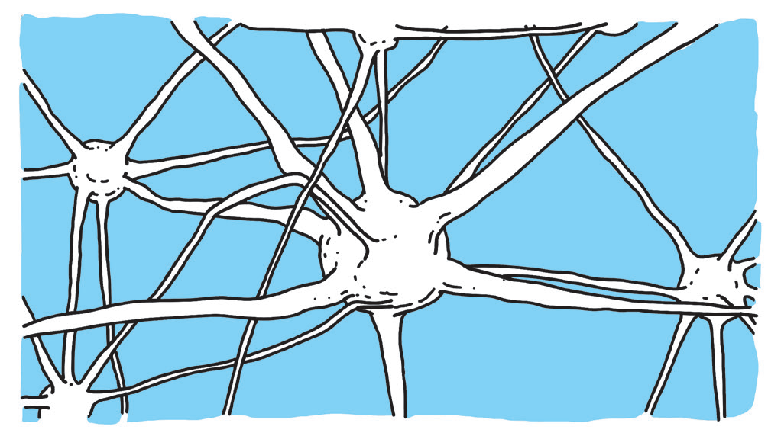
Your brain is made up of billions of neurons that look
like the picture on the right. Neurons pass on signals to and
from the brain. These messages may
be passed to and from the sense organs,
muscles, and other organs.

Slide 5

When you are awake, your brain gives enough energy to power a light bulb. Your brain is more active when you are asleep. It makes sense of everything that has happened throughout the day.
What an amazing, powerful brain you have!

Slide 6





Reading Comprehension
Pair up with a classmate to answer the questions below.
What did you read about?
What new words did you learn?
What is the most interesting information you learned?
How will this information help you?
What questions do you still have?

Slide 7
Oral Language
When working with others, be careful with how you speak.
Say “Thank you” to show that you are grateful for what another person has done for you.
Thank you is answered with “You’re welcome” to show that you are happy and willing to help.

Slide 8
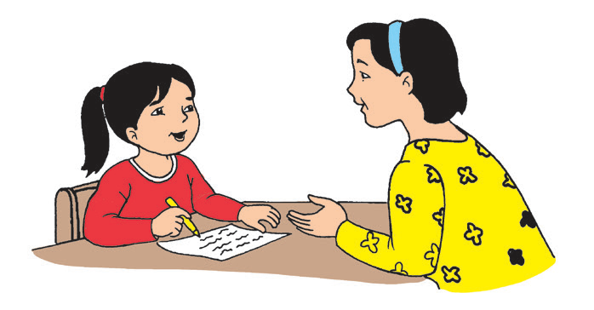
Pay attention to the situations that your teacher will describe. Take note of what the
children and adults are saying.
When your mom helps you with homework…
You’re
Welcome, Ana.
Thanks,
Mom!

Slide 9
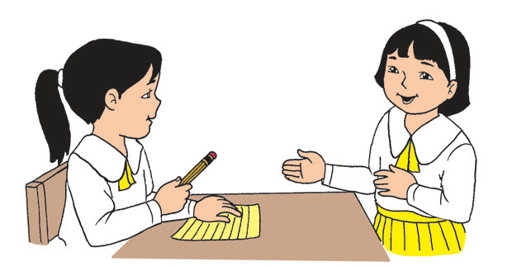
When your classmate lends you her pencil…
You’re
Welcome.
Thank
you, Pat.

Slide 10
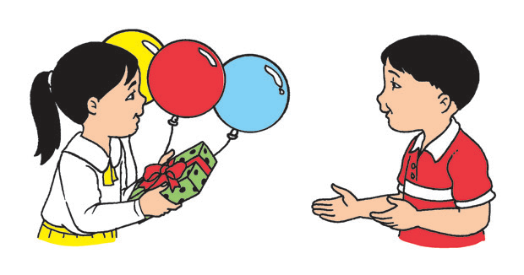
When your friend gives you a birthday gift …
Thank you.
You’re
welcome.

Slide 11
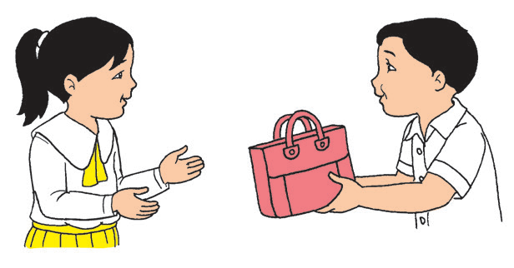
When someone returns your lost bag…
Thank you.
You’re
welcome.

Slide 12

Grammar
Unlike people, animals cannot say “thank you.” But they express their thanks using body language. Interview people with pets to ask about how these animals express their gratitude.
Like people, animals have names too. By giving names to animals, we can recognize them easily.

Slide 13
Work with a partner. Choose the animal that best fits the sentence. Write your answer on your paper. Together, perform the movement of the animal in each sentence.
cat eagle turtle cow dog
1. The ____________ runs fast.
2. The ____________ flies high.
3. The ____________ walks slowly.
4. The ____________ runs aft er the mice.
5. The ____________ eats grass.

Slide 14
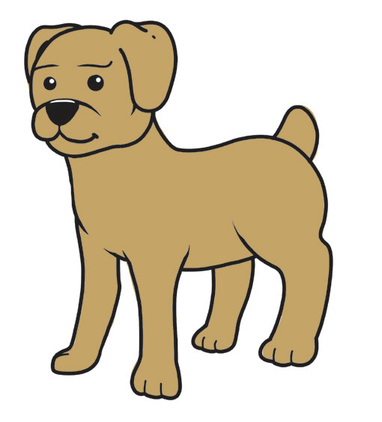
21st Century Skill
Scientists found out that the brains of animals that
played with toys and with other animals were heavier. Their
brain connections were bigger and stronger than those of
animals in bare cages. The animals in the first group were
exercising their brains. They were better at solving problems
and learning new things! What can you say about this?

Slide 15
Writing
Go back to your drawing of neurons. Do you see lines? How about curves?
How are curves different from lines?
Curves are bended like arcs or curls, while lines are straight and even.

