Slide 1


Area Using Grids

Slide 2
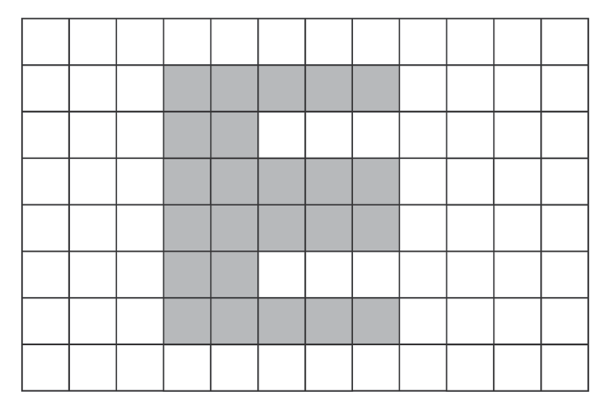
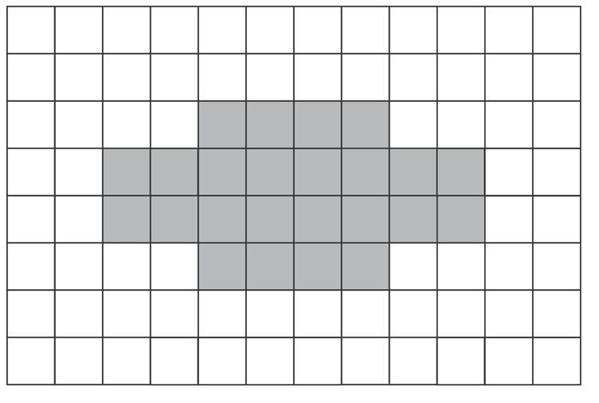
Look at the two figures below:
A. B.
Which do you think has a bigger area? A or B?
Rex Curriculum Resource
WWW.REX.COM.PH

Slide 3
Look at the two figures below:
A. B.
Which do you think has a bigger area? A or B?
If your answer is “both are equal,” then you are correct!
Rex Curriculum Resource
WWW.REX.COM.PH

Slide 4
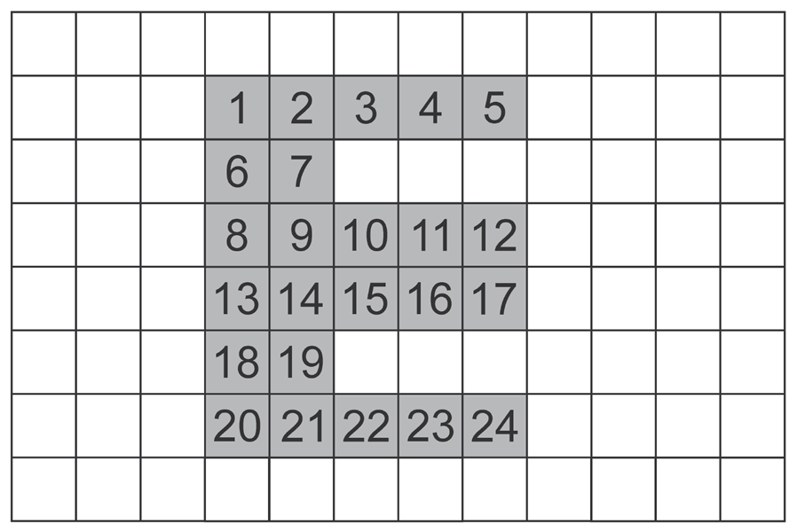
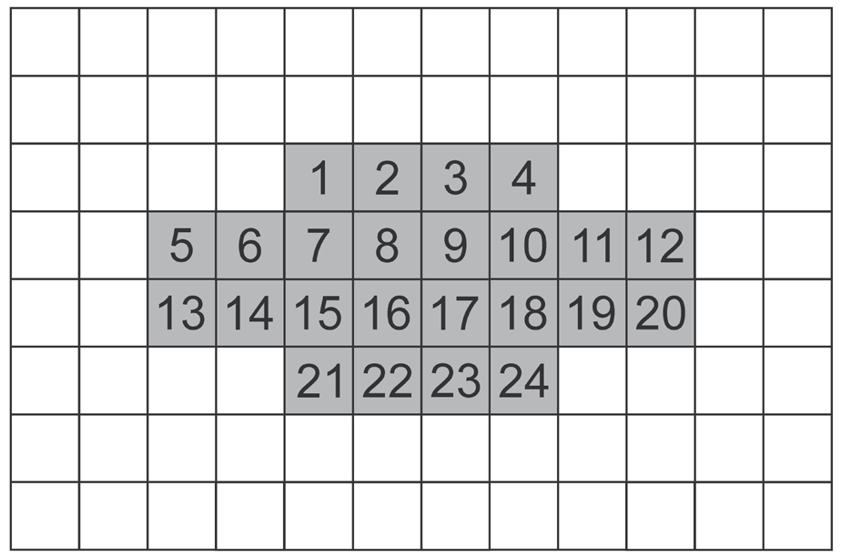
Here, the figures are in an array of squares or grid. Remember
That area is the space occupied by a given shape. Thus, to find the area of a shape, you count the number of shaded squares.
Here, the figures are in an array of squares or grid. Remember that
area is the space occupied by a given shape. Thus, to find the area of a shape, you count the number of shaded squares.
Observe that Figure B has 24 shaded squares. Then, Figure B also has an area of 24 square units.
This means that the areas of both figures are equal.
Rex Curriculum Resource
WWW.REX.COM.PH

Slide 5
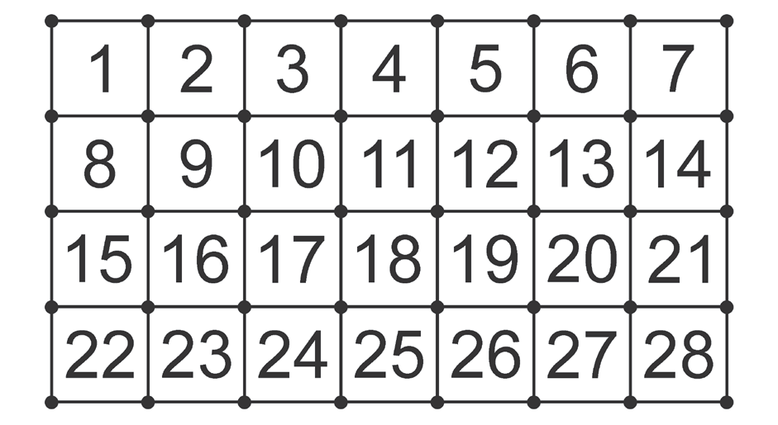
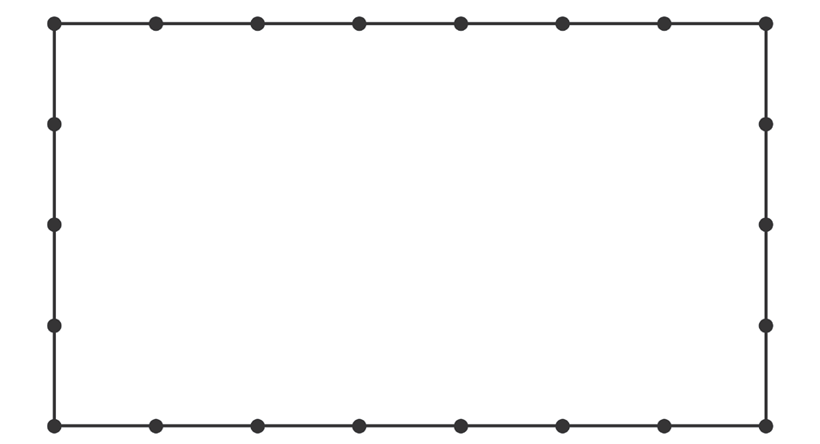
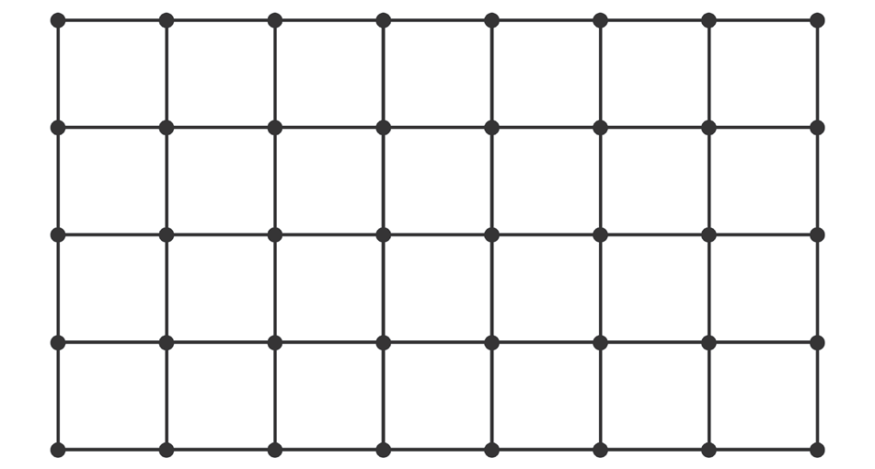
Here is another example to help you visualize area into squares.
This time, let us place a unit.
Example 1: Try to visualize the area of a rectangle into squares with a width of 4 meters and length of 7 meters.
Let us say that one line after each dot is 1 meter. If the width is 4 meters and length is 7 meters, then we have:
If we connect the dots, we will have:
You now have a grid. We defined area as the space covered by the shape. In here, the space is covered by squares. Let us count the squares inside. How many squares are there?
There are 28 squares. In this case, since we use “meter” as a unit, we can say that the area is 28 square meters or 28 sq. m.
Rex Curriculum Resource
WWW.REX.COM.PH

Slide 6
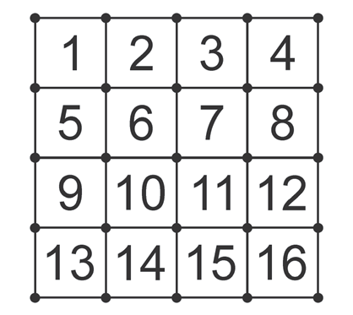
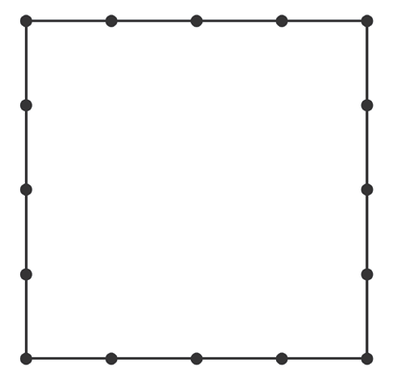
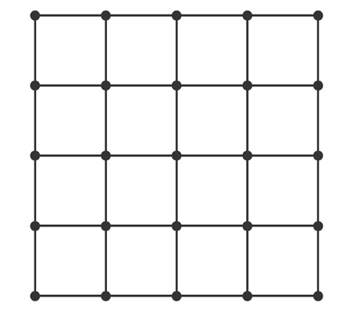
Example 2: Visualize the area of a square shape, where one side measures 4 centimeters, into squares.
Let us say that one line after a dot is 1 centimeter. If one side is 4 centimeters, then we have:
If we connect the dots, we will have:
Let us count the squares inside. How many squares are there?
There are 16 squares. In this case, since we use “centimeters” as
a unit, we can say that the area is 16 square centimeters or 16 sq. cm.
Rex Curriculum Resource
WWW.REX.COM.PH

Slide 7
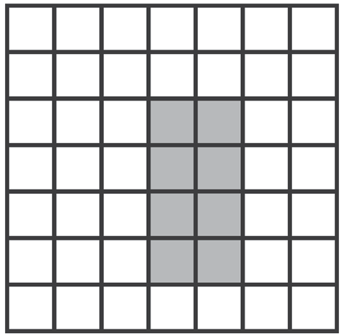
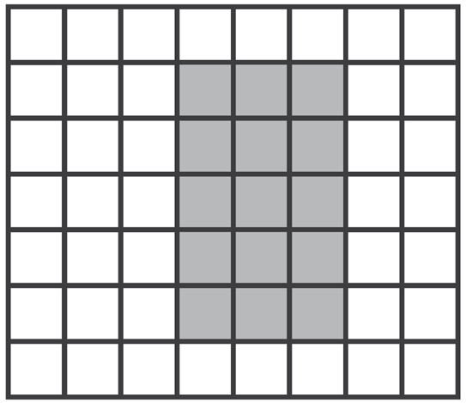
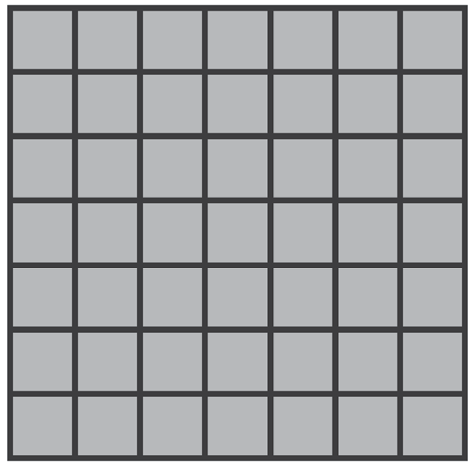
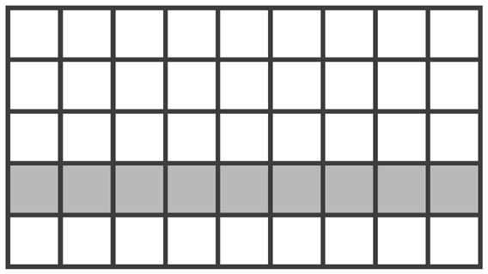
Activity:
Given the figure below, identify the length, width, total number of shaded squares, perimeter, and area. The first item is done for you.
1. Length: 4 units
Width: 2 units
Number of shaded squares: 8
Perimeter: 12 units
Area: 8 square units
3. a. Length:
b. Width:
c. Number of shaded squares:
d. Perimeter:
e. Area:
2. a. Length:
b. Width:
c. Number of shaded squares:
d. Perimeter:
e. Area:
4. a. Length:
b. Width:
c. Number of shaded squares:
d. Perimeter:
e. Area:
Rex Curriculum Resource
WWW.REX.COM.PH

Slide 8
Activity: ANSWER KEY
Given the figure below, identify the length, width, total number of shaded squares, perimeter, and area. The first item is done for you.
1. Length: 4 units
Width: 2 units
Number of shaded squares: 8
Perimeter: 12 units
Area: 8 square units
3. a. Length: 5
b. Width: 3
c. Number of shaded squares: 15
d. Perimeter: 16 units
e. Area: 15 square units
2. a. Length: 9
b. Width: 1
c. Number of shaded squares: 9
d. Perimeter: 20 Units
e. Area: 9 square units
4. a. Length: 7
b. Width: 7
c. Number of shaded squares: 49
d. Perimeter: 28 units
e. Area: 49 square units
Rex Curriculum Resource
WWW.REX.COM.PH

Slide 9


