Slide 1


Conversion of Units for Area

Slide 2
Six students were tasked to clean the playground after lunch. To make sure everyone is productive, the leader decided to divide and assign the area equally.
He/She consulted the school pamphlet and found out that the playground area is 36,000 square centimeters. However, it was difficult to estimate the division of area since it is measured using square centimeters.
The leader then decided to calculate the equivalent measurement in square meters, so that he/she can easily divide the area of the playground.
How did the leader get the answer?
Rex Curriculum Resource
WWW.REX.COM.PH

Slide 3
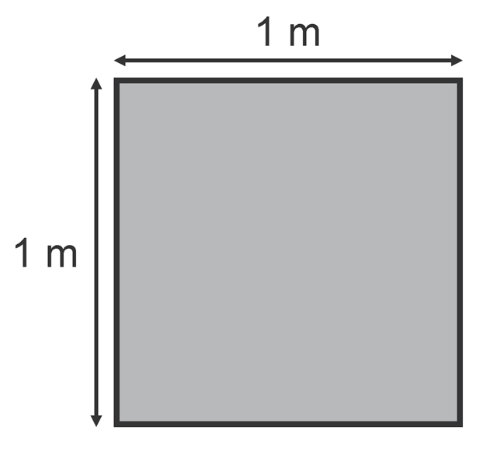
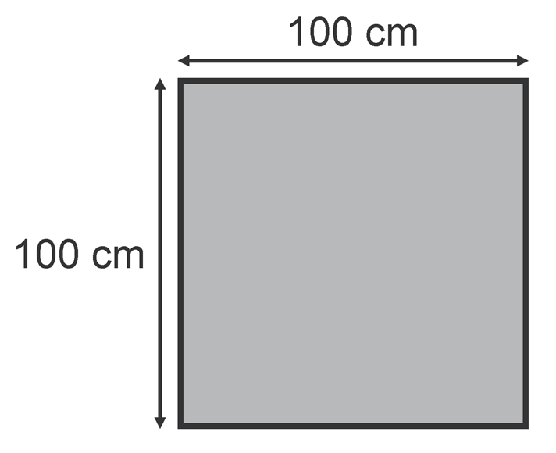
Let us say we have a square that is 1 meter on each side.
Then, its area will have 1 square meter.
We can also visualize this as:
If you will show this figure using a grid, how many squares will there be?
There will be 100 squares per column and 100 squares per row.
Counting all of the shaded squares, there will be 10,000 squares or
10,000 square centimeters! So, 1 sq. m = 10,000 sq. cm. Thus,
To convert square meters to square centimeters, we multiply the given by 10,000.
Example 1: 3 sq. m = ______ sq. cm
3 sq. m × 10,000 = 30,000 sq. cm
To convert square centimeters to square meters, we divide the given by 10,000.
Example 2: 90,000 sq. cm = ______ sq. m
90,000 sq. cm ÷ 10,000 = 9 sq. m
Rex Curriculum Resource
WWW.REX.COM.PH

Slide 4

STUDY TIP!
To make the conversion easier, remember the following:
• Move four decimal places to the right if you are converting from sq. m (the bigger unit) to sq. cm (smaller unit).
3 sq. m = sq. cm = 30,000 sq. cm
• Move four decimal places to the left if you are converting from sq. cm (the smaller unit) to sq. m (the bigger unit).
90,000 sq. cm = sq. m = 9 sq. m
Let us go back to the problem. Since the leader wants to find out
how many square meters there are in 36,000 square centimeters, we
need to move four decimal places to the left.
Then, 36,000 sq. cm = sq. m = 3.6 sq. m.
Since there are 6 students who were tasked to clean the playground, it would be divided by 6:
3.6 sq. m ÷ 6 students = 0.6 sq. m
Therefore, each student would be assigned to clean an area of
0.6 sq. m.
Example 3: Convert 40,000 sq. cm to sq. m.
To convert square centimeters to square meters, we divide by 10,000.
40,000 sq. cm ÷ 10,000 = 4 sq. m
Example 4: Convert 5 sq. m to sq. cm.
To convert square centimeters to square meters, we multiply by 10,000.
3 sq. cm ÷ 10,000 = 30,000 sq. cm
Rex Curriculum Resource
WWW.REX.COM.PH

Slide 5
Activity:
Convert the following units of measurements as indicated. An example is given for you.
Example: 1.45 sq. m = ___________ sq. cm
45 × 10,000 = 14,500 sq. cm
1. 11,000 sq. cm = ___________ sq. m
2. 98,000 sq. cm = ___________ sq. m
3. 10,700 sq. cm = ___________ sq. m
4. 5 sq. m = ___________ sq. cm
5. 7.3 sq. m = ___________ sq. cm
Rex Curriculum Resource
WWW.REX.COM.PH

Slide 6
Answer Key:
1. 11,000 sq. cm = 1.1 sq. m
2. 98,000 sq. cm = 9.8 sq. m
3. 10,700 sq. cm = 1.07 sq. m
4. 5 sq. m = 50,000 sq. cm
5. 7.3 sq. m = 73,000 sq. cm
Rex Curriculum Resource
WWW.REX.COM.PH

Slide 7


