Slide 1


Perimeter and the Concept of Area

Slide 2

Elsa’s teacher in science asked the pupils
to create a portfolio. A portfolio is a compilation of
their past works and activities.
Elsa wanted to decorate the front page of
her portfolio so it will be eye-catching. She decided
to decorate its edges with ribbons and cover the
whole front page with pink art paper.
Before going to a school supplies shop for
her materials, she needed to answer the following questions:
• How many centimeters of ribbon will she need?
• How many pink art papers should be used to cover the whole front
page?
Rex Curriculum Resource
WWW.REX.COM.PH

Slide 3
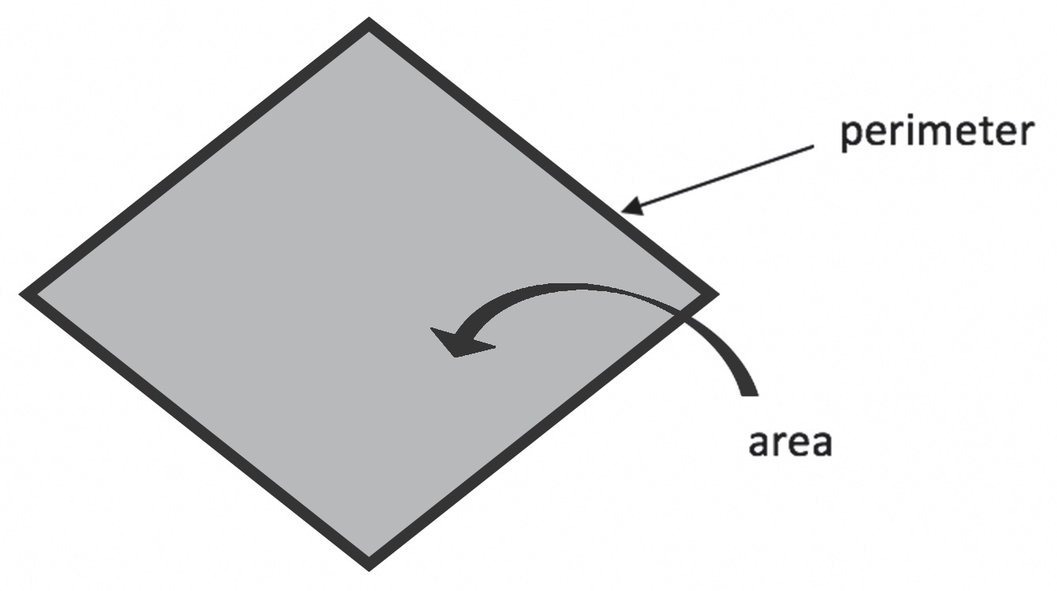
Let us look at the questions again. The first question asks the length of the ribbon Elsa should use to decorate the edges. This means that it asks for the perimeter.
Elsa simply needs to measure all the sides of her front page in centimeters. Then, she should add the measures of all sides to determine how much ribbon she should buy.
How about the second question? The second question asks for the number of art papers she should buy to cover the front page. You can see that the shape of the front page is a rectangle. The space occupied by the rectangle is the space Elsa wants to cover. This is the area.
Therefore, to answer the first question and know the amount of ribbon needed, Elsa should look for the perimeter. To answer the second question and know the number of art papers needed, she needs to look for the area of the front page.
To visualize perimeter and area easily, you may look at the illustration below:
Rex Curriculum Resource
WWW.REX.COM.PH

Slide 4
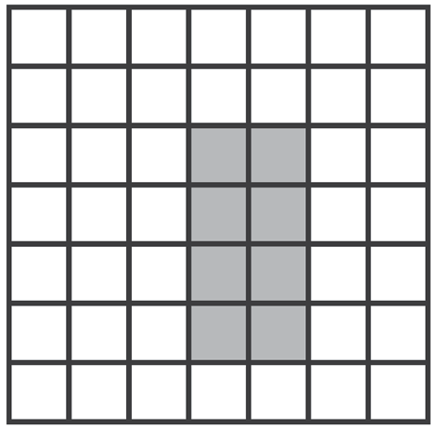
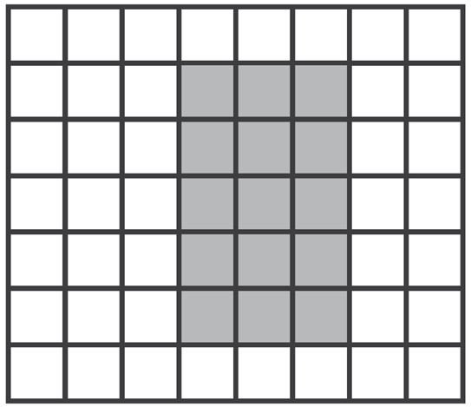
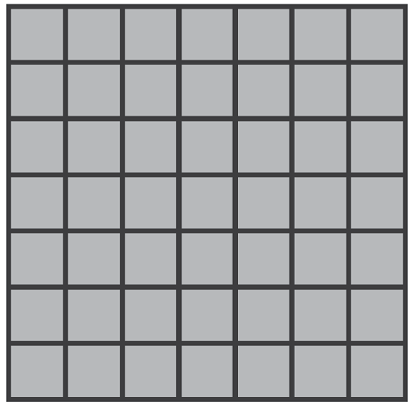
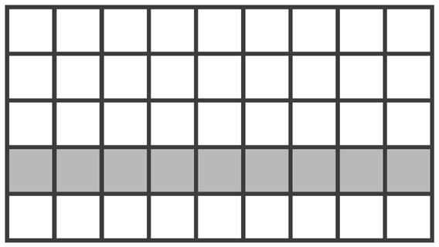
Activity:
Given the figure below, identify the length, width, total number of shaded squares, perimeter, and area. The first item is done for you.
1. Length: 4 units
Width: 2 units
Number of shaded squares: 8
Perimeter: 12 units
Area: 8 square units
3. a. Length:
b. Width:
c. Number of shaded squares:
d. Perimeter:
e. Area:
2. a. Length:
b. Width:
c. Number of shaded squares:
d. Perimeter:
e. Area:
4. a. Length:
b. Width:
c. Number of shaded squares:
d. Perimeter:
e. Area:
Rex Curriculum Resource
WWW.REX.COM.PH

Slide 5
Activity: ANSWER KEY
Given the figure below, identify the length, width, total number of shaded squares, perimeter, and area. The first item is done for you.
1. Length: 4 units
Width: 2 units
Number of shaded squares: 8
Perimeter: 12 units
Area: 8 square units
3. a. Length: 5
b. Width: 3
c. Number of shaded squares: 15
d. Perimeter: 16 units
e. Area: 15 square units
2. a. Length: 9
b. Width: 1
c. Number of shaded squares: 9
d. Perimeter: 20 Units
e. Area: 9 square units
4. a. Length: 7
b. Width: 7
c. Number of shaded squares: 49
d. Perimeter: 28 units
e. Area: 49 square units
Rex Curriculum Resource
WWW.REX.COM.PH

Slide 6


