Slide 1


Area of a Square and a Rectangle

Slide 2
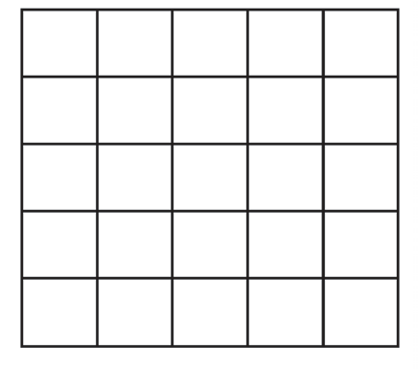
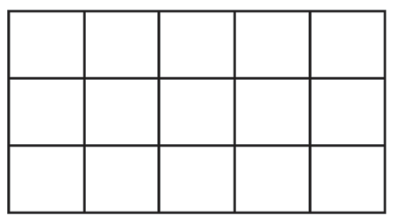
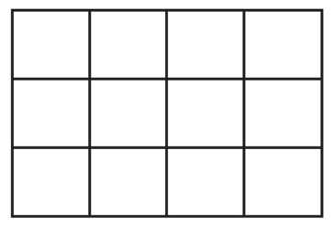
Area of a Square and a Rectangle
Do you have a garden plot at home? At school?
You can use your knowledge in determining the area of your own garden
Having and maintaining a vegetable garden or flowering garden of your own will make you love nature. Through this, you will know how to
take care of plants. What are the things that you should remember in taking care of plants? Larger garden plots will give you more products like
vegetables and flowers.
Look at the diagram garden plots of the pupils below. Their teacher asked the pupils to measure the length and the width of their plots.
PUPIL A PUPIL B PUPIL C
What are the shapes of the garden plots? What are the dimensions of their plots? What are the respective areas of the plots?
If the pupils will plant pechay seedlings, who do you think will plant the greatest amount of pechay?
Who will have the greatest number of pechay to be harvested?
Rex Curriculum Resource
WWW.REX.COM.PH

Slide 3
Area of a Square and a Rectangle
Look at the diagram garden plots of the pupils below. Their teacher asked the pupils to measure the length and the width of their
plots.
PUPIL A PUPIL B PUPIL C
With these areas, pupil A will plant the greatest number of pechay seedlings and will most likely harvest the greatest amount of pechay.
The respective areas of the garden plots were derived by counting the squares. However, to facilitate the process of finding the area of the three garden plots of the pupils, formulas can be used.
What will you do with the length and the width of the rectangular
plots to get the area? Are you going to add, subtract, multiply, or divide?
Given the garden plots, count the number of squares in each plot. The total number of square units corresponds to the area of the plot.
The garden plot of pupil A is a square. It has 25 square units.
The garden plot of pupil B is a rectangle. It has 15 square units.
The garden plot of pupil C is a square. It has 12 square units.
Rex Curriculum Resource
WWW.REX.COM.PH

Slide 4
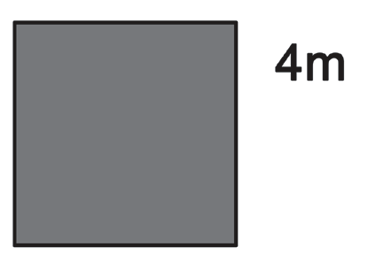
A. Finding the Area of a Square
What do you notice about the sides of the garden plot of pupil A?
PUPIL A
Example 1: The given figure is a square with a side of 4 meters. Find its
Area.
area = side × side
area = 4 m × 4 m
area = 16 sq. m or m2
Since it is a square, the sides are all equal.
The length of each side is 5 units.
The area of 25 square units is the result of multiplying the length of each side with itself.
Thus,
Area of a Square = side × side
= 5 × 5
= 25 square units
If a unit is 1 m, then the area is 25 sq. m.
Note: We can use m2 for square meters.
Rex Curriculum Resource
WWW.REX.COM.PH

Slide 5
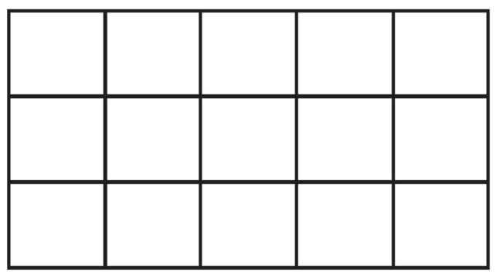
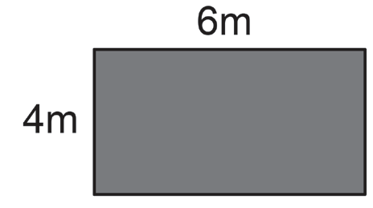
B. Finding the Area of a Rectangle
PUPIL B
Example 2: The given figure is a rectangle with a length of 6 meters and
a width of 4 meters. Find the area.
area = length × width
area = 6 m × 4 m
area = 24 sq. m or m2
What do you notice about the sides of the garden plot of pupil B?
T he length of the garden plot is 5 units and its width is 3 units.
The area of 15 square units is the result of multiplying the length by its width. That is,
area = length × width
area = 5 × 3
area = 15 square units
If 1 unit is 1 m, then the area is 15 sq. m or m2.
Rex Curriculum Resource
WWW.REX.COM.PH

Slide 6
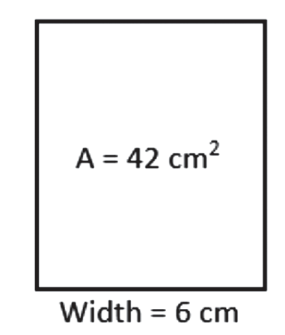
C. Find the Missing Dimension When the Area Is Given
Example 3: The area of a rectangle is 42 square centimeters. If the width is 6 centimeters, what is the length?
area = length × width
Divide the area by the length to get the width.
length = area ÷ width
= 42 cm2 ÷ 6 cm
length = 7 cm
Rex Curriculum Resource
WWW.REX.COM.PH

Slide 7
KEY TAKEAWAYS
• To find the area of a square, multiply the length of the sides.
• To find the area of a rectangle, multiply the length by the width.
• To find the missing dimension, divide the area by the given dimension. If the length is missing, divide the area by its width or
vice versa.
Rex Curriculum Resource
WWW.REX.COM.PH

Slide 8
Activity: ANSWER KEY
Find the area of the following figures.
1. Square with a side of 15 centimeters
2. Square with a side of 6 meters
3. Rectangle with a length of 25 centimeters and a width of 10 centimeters
4. Rectangle with a length of 6 meters and a width of 5 meters
ANSWER KEY
1. 225 cm²
2. 36 m²
3. 250 cm²
4. 30 m²
Rex Curriculum Resource
WWW.REX.COM.PH

Slide 9


