Slide 1
Formulas for Area

Slide 2
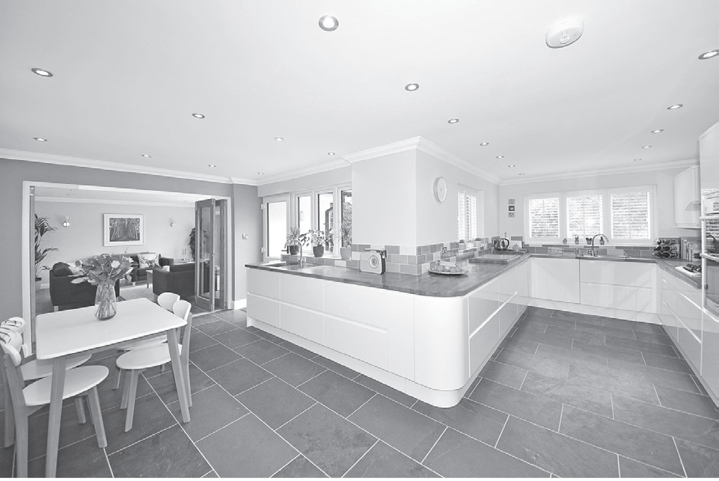
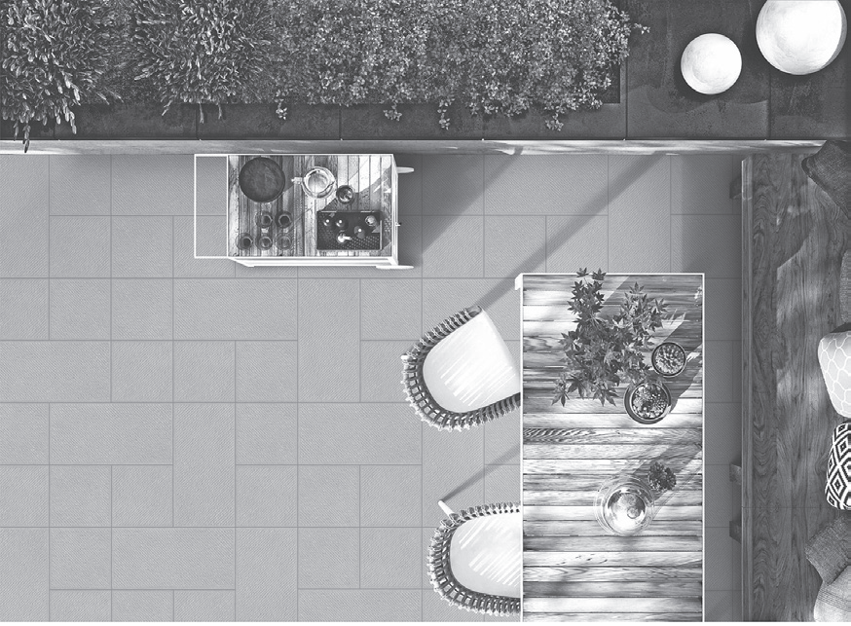
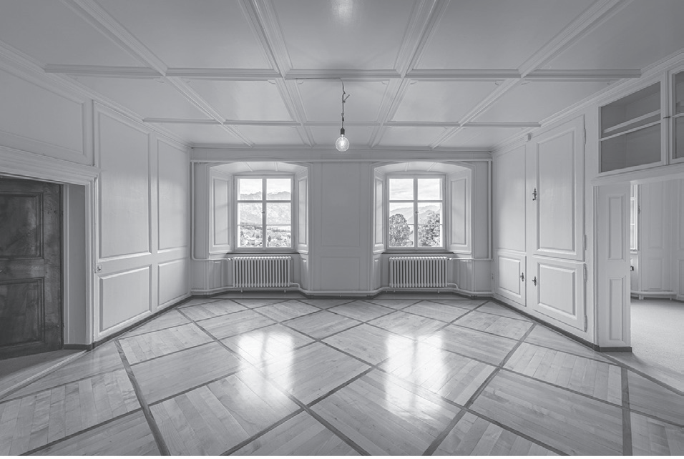
Formulas for Area
Stone tiles, wood, cobblestones, and glass are common among hardware stores. These are used in upgrading and improving households. They have different shapes and sizes. They can cover small to large floor areas, walls, countertops, and other surfaces. However, it is important to measure the area of the plane before covering them with tiles. In this lesson, you will discover which formula is appropriate to use in finding the area of a given plane figure.

Slide 3
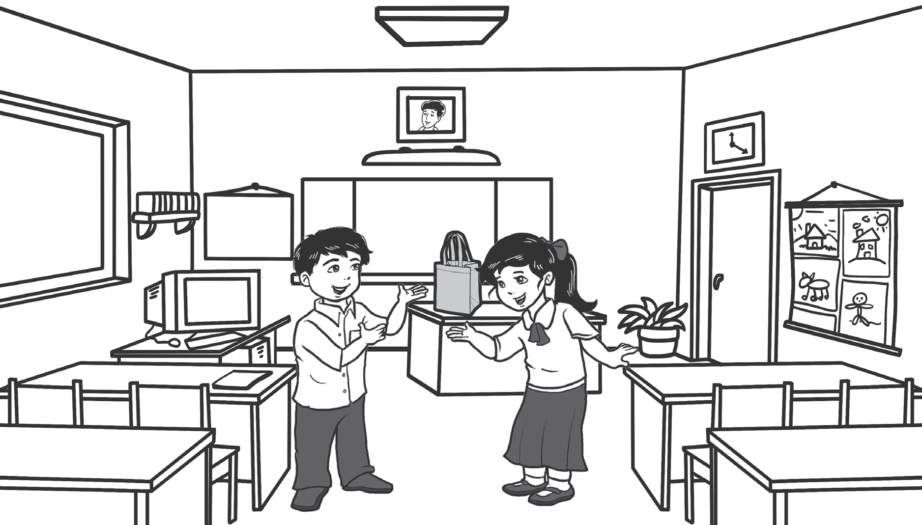
Formulas for Area
Sean and Shane are in their classroom. They were asked by their teacher to look for plane figures around. They must identify the shape of these objects. They need to determine the formula for their respective areas and finally, solve for each one of them.
Let us help Shane and Sean to do this activity. How do you think they will get its area?
Let us now look at how to find the area.

Slide 4
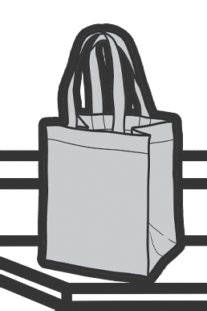
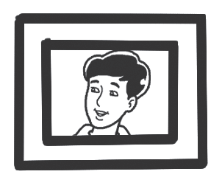
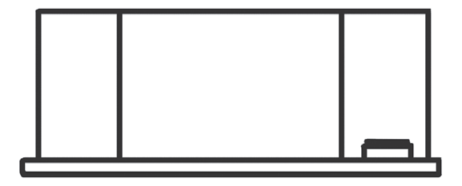

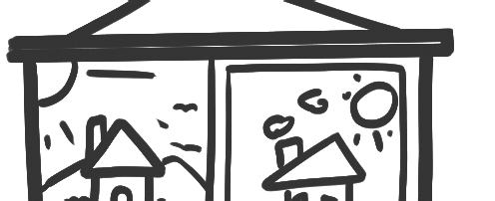
Formulas for Area
OBJECT | portrait
PLANE FIGURE | square
FORMULA | A= side x side
OBJECT | teacher’s bag
PLANE FIGURE | trapezoid
FORMULA | A= ½ x height x (base1 x base2)
OBJECT | blackboard
PLANE FIGURE | rectangle
FORMULA | A= length x width
OBJECT | roofs of the houses
PLANE FIGURE | triangle
FORMULA | A= ½ x base x height
OBJECT | wall clock
PLANE FIGURE | parallelogram
FORMULA | A= base x height

Slide 5
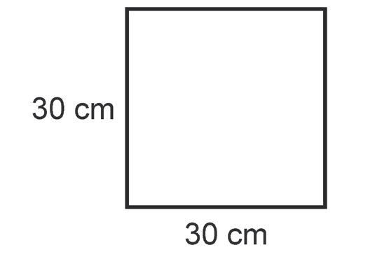
Formulas for Area
Let us apply these formulas in solving problems involving area. Remember to use the appropriate formula in finding the area (A) in each problem below.
Example 1: A portrait measures 30 centimeters on each side. What is the area of the portrait?
Solution:
Since the figure is a square, we will use the formula: A = side x side.
A = side × side
A = 30 cm × 30 cm
A = 900 sq. cm or 900 cm².
The area of the portrait is 900 sq. cm or 900 cm².
Note: Always remember to indicate the correct unit of measurements which is square units (depending on the given unit of measurement). The following units of measurements are equivalent: sq. cm and cm², sq. m and m².

Slide 6
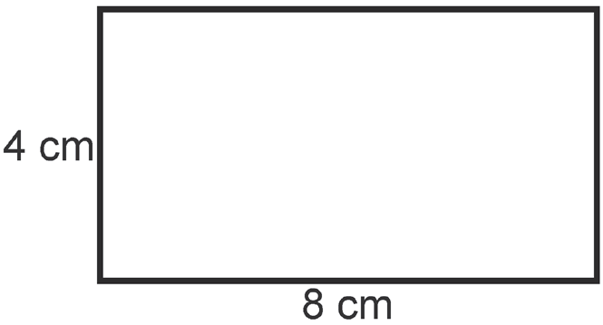
Formulas for Area
Example 2: Ms. Rivera would like to make a curtain for the blackboard which is 4 meters wide and meters long. What is the area of the blackboard that she needs to cover?
Solution:
Since the figure is a rectangle, we will use the formula: A = length x width.
A = length × width
A = 4 cm × 8 cm
A = 32 sq. cm or 32 cm².
The area of the blackboard is 32 sq. cm or 32 cm².

Slide 7
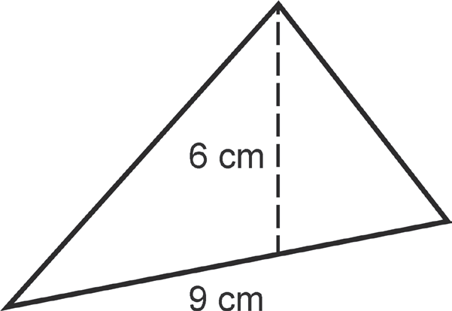
Formulas for Area
Example 3: Angelo would like to paint the roof of his miniature house. The roof is triangular with a height of 6 centimeters and a base of 9 centimeters. What is the area of the roof that needs to be painted?
Solution:
Since the figure is a triangle, we will use the formula: A = ½ x base x height
A = ½ x base x height
A = ½ x 6 cm x 9 cm
A = ½ x 54 cm²
A = 27 sq. cm or 27 cm².
The area of the roof that needs to be painted is 27 sq. cm or 27 cm².

Slide 8
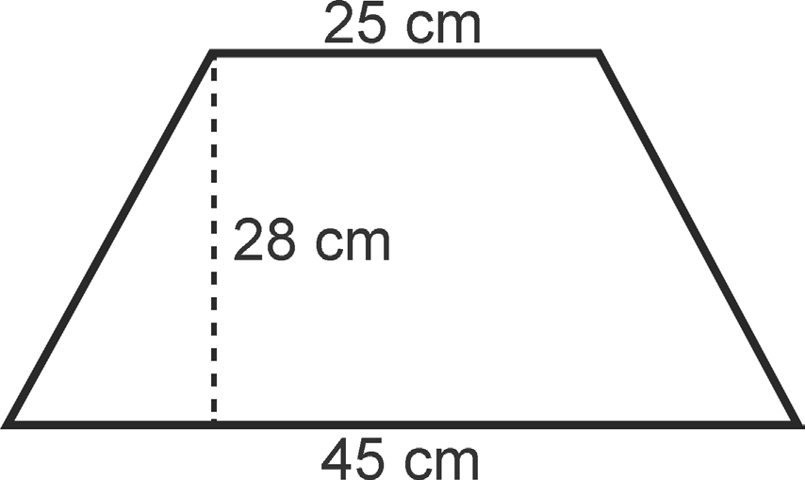
Formulas for Area
Example 4: Mica wants to make a new bag for her teacher. She decided to use a satin cloth to cover the trapezoidal bases of the bag with dimensions as shown below. How much cloth does she need to cover the area of one side of the bag?
Solution:
Since the figure is a trapezoid, we will use the formula:
A= ½ x height x (base1 x base2)
A= ½ x height x (base1 x base2)
A= ½ x 28 cm x (25 cm + 45 cm)
A= ½ x 28 cm x 70 cm
A= ½ x 1,960 sq. Cm
A = 980 sq. cm or cm²
The area of the chosen side of the trapezoidal bag is 980 sq. cm or 980 cm².

Slide 9
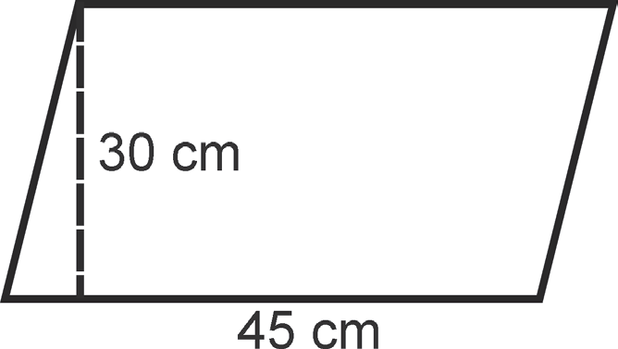
Formulas for Area
Example 5: The teacher needs to replace the broken glass cover of the wall clock. The wall clock is parallelogram in shape with a 30-centimeter height and a 45-centimeter base. How much area needs to be covered with glass?
Solution:
Since the figure is a parallelogram, we will use the formula: A= base x height
A = base × height
A = 30 cm × 45 cm
A = 1,350 sq. cm or cm²
The area to be covered with glass is 1,350 sq. cm or 1,350 cm².

