Slide 1
Routine and Nonroutine Problems on Area

Slide 2
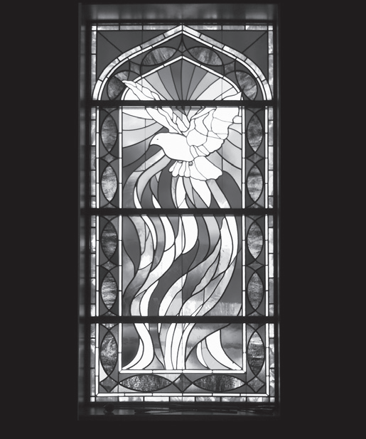
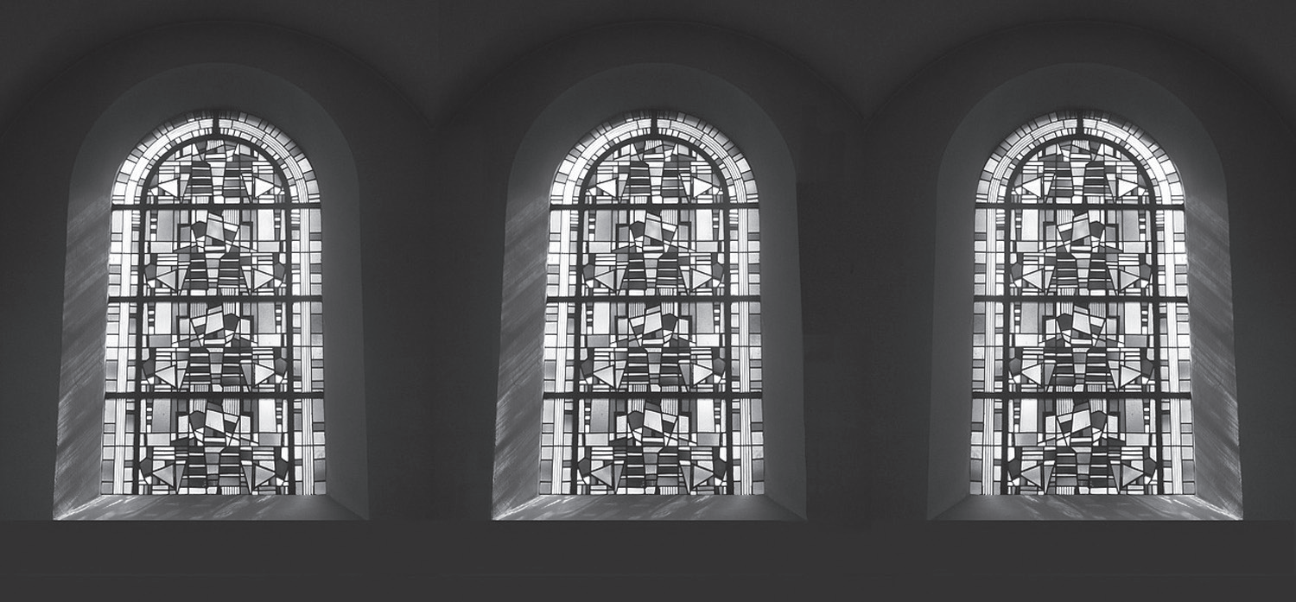
Routine and Non-routine Problems on Area
Stained glass is a popular form of art and architectural design. Different shapes, colors, and images are put together to build stained glass in windows, doors, ceilings, and walls. These are common among churches, museums, and houses. Finding the area according to the intended shape or combination of shapes is essential in designing stained glass for a given part of the house or structure.

Slide 3
Routine and Non-routine Problems on Area
Before we start solving word problems, let us first recall the 4-step strategy in problem-solving introduced by George Polya.
Step 1: Understand the problem.
In this step, we need to check if we understand the given problem by answering the questions: What is asked in the problem? What is/are given? What is the word clue or hidden question?
Step 2: Make a plan.
In this step, we need to think of the strategy on how to solve the problem. Usually, for problems involving geometric figures, we need to consider the formulas that we will use.
Step 3: Carry out the plan.
In this step, we will use the strategy or strategies that we identified to solve the given problem.
Step 4: Look back.
In this step, we need to check if the answers make sense.

Slide 4
Routine and Non-routine Problems on Area
Now, let us determine the difference between routine and non-routine problems.
A routine problem has solutions that can be done using at least one of the four fundamental operations and/or ratio whereas a non-routine problem is a complex problem that can be solved in multiple ways. These types of problems usually do not have immediate solutions. Some strategies that you can use are drawing a diagram and working backward.

Slide 5
Routine and Non-routine Problems on Area
Let us look at the problem of Mrs. Legaspi. She wants to cover their living room floor with carpet. The room is 10 meters long and 7 meters wide. How much carpet is needed to cover the living room floor?
Step 1: Understand the problem.
The shape of the floor to be carpeted is a rectangle with dimensions 10 meters by 7 meters. We are asked to determine the area of the needed carpet to completely cover the floor area.
Step 2: Make a Plan.
What strategy do we use?
We will compute for the area of the living room floor.
The formula that we will use is:
A = length x width
Step 3: Carry out the plan.
Solution:
A = length x width
A = 10 m × 7 m
A = 70 sq. m
The living room has an area of 70 sq. m or m².
The carpeting should cover 70 sq. m or m².
Step 4: Look back.
Ask yourself the following questions:
Did you use the correct formula?
Does the answer make sense?
Did you label the answer correctly?

Slide 6
Routine and Non-routine Problems on Area
Let us have another example.
A triangular flag has a base of 12 centimeters and a height of 35 centimeters. How much cloth was used to make the flag?
Step 1: Understand the problem.
What facts are given? The triangular flag has a base of 12 centimeters and a height of 35 centimeters.
What is asked? The amount of cloth used in making the flag.
Step 2: Make a Plan.
What strategy do we use?
We will compute for the area of the triangular flag.
The formula that we will use is:
A = ½ x base x height
Step 3: Carry out the plan.
Solution:
A = ½ x base x height
A = ½ x 12 cm x 35 cm
A = sq. cm
A = 210 sq. cm
The area of the cloth used to make the triangular flag is 210 sq. cm or 210 cm².
Step 4: Look back.
Ask yourself the following questions:
Did you use the correct formula?
Does the answer make sense?
Did you label the answer correctly?
$\frac{1x420}{2}$

Slide 7
Routine and Non-routine Problems on Area
Let us try to solve a non-routine problem involving area.
The top surfaces of two combined tables are to be covered with a flat linen. A square table with a side length of 60 centimeters needs to be placed adjacent to a rectangular table so that the tables form an L shape. What is the area of the top surface of the combined tables if the rectangle is 180 centimeters long and 60 centimeters wide?
Step 1: Understand the problem.
What facts are given?
1. There are two tables. One is in the shape of a rectangle and the other is a square.
2. The side length of the square table is 60 centimeters.
3. The length of the rectangular table is 180 centimeters and the width is 60 centimeters.
What is asked?
The area of the top surface of the combined tables.
Step 2: Make a plan.
What strategy do we use?
The situation in the problem can be best visualized by drawing a diagram.

Slide 8
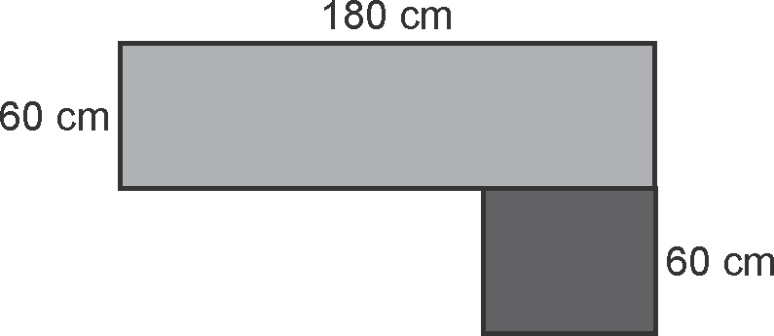
Routine and Non-routine Problems on Area
Let us try to solve a non-routine problem involving area.
The top surfaces of two combined tables are to be covered with a flat linen. A square table with a side length of 60 centimeters needs to be placed adjacent to a rectangular table so that the tables form an L shape. What is the area of the top surface of the combined tables if the rectangle is 180 centimeters long and 60 centimeters wide?
Step 3: Carry out the plan.
Illustration:
If the square table has an area of 400 square centimeters, then
each of its sides is 20 centimeters. Thus, the rectangular table is 120 centimeters long and 20 centimeters wide.
Solution:
A (rectangle) = 180 cm × 60 cm = 10,800 sq. cm
A (square) = 60 cm × 60 cm = 3,600 sq. cm
A (combined tables) = 10,800 + 3,600 = 14,400 sq. cm The area of the combined tables is 14,400 sq. cm or cm².
Step 4: Look back.
Ask yourself the following questions:
Did you use the correct formula?
Does the answer make sense?
Did you label the answer correctly?

