Slide 1
Points, Line Segments, Lines and Rays

Slide 2

Remember the game connect-the-dots?
Each small dot you make with a sharp pencil is called a point.
We usually use a dot or a cross to mark the position of a point.
We use capital letters to name each point.
We refer to these points as point A, point B and point C.

Slide 3
Use a ruler to draw a line to join two points, point A and point B.
The straight line joining point A and point B is a line segment.
We call this line segment AB.
This is the line AB.
We mark the ends of a line with arrows to show that a line has no end.

Slide 4
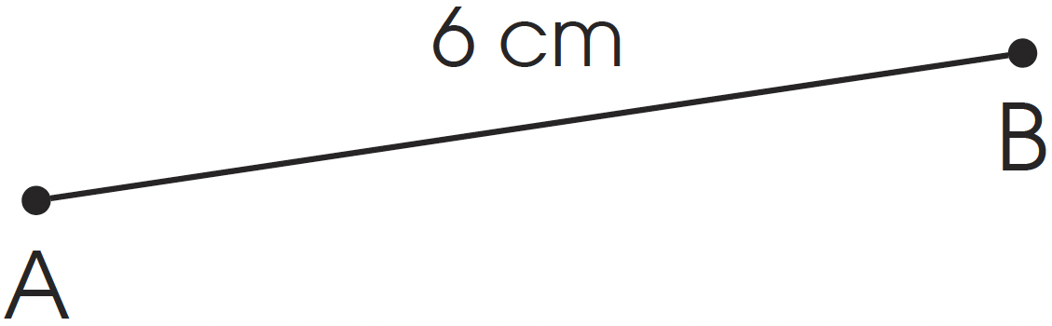
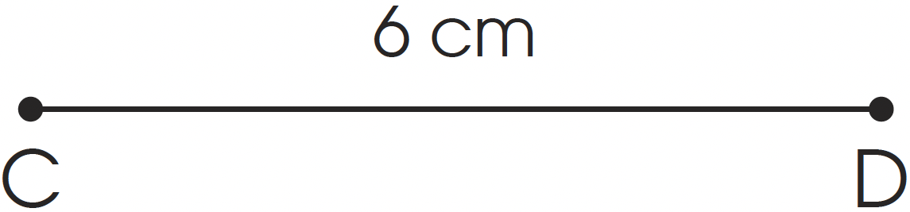
We can draw line segments of the same length.
  First measure the length of line segment AB using a ruler.
  The length of line segment AB is 6 cm.
  Use a ruler and pencil to measure and mark out 6 cm with small dots.
  Join the two points to get line segment CD.
  AB and CD are congruent line segments.
  The two line segments do not have to be parallel to each other.

Slide 5
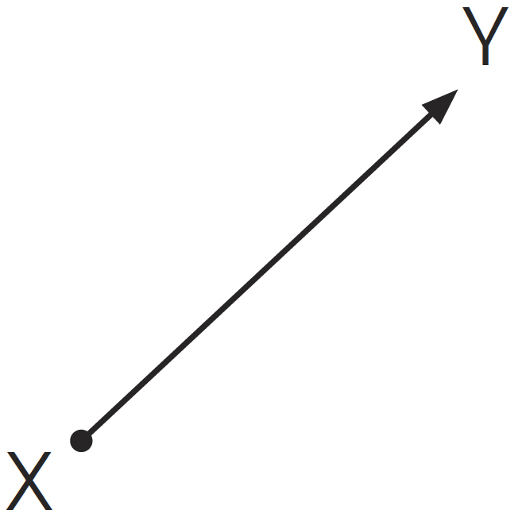
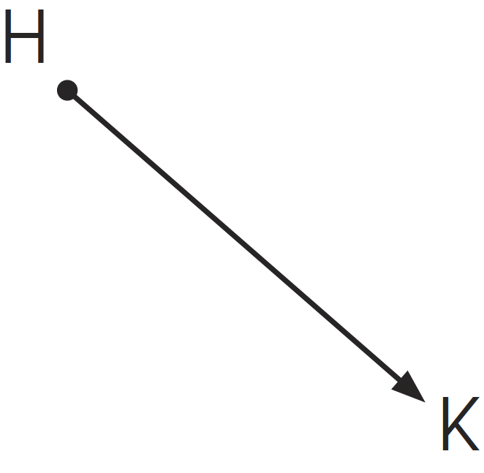
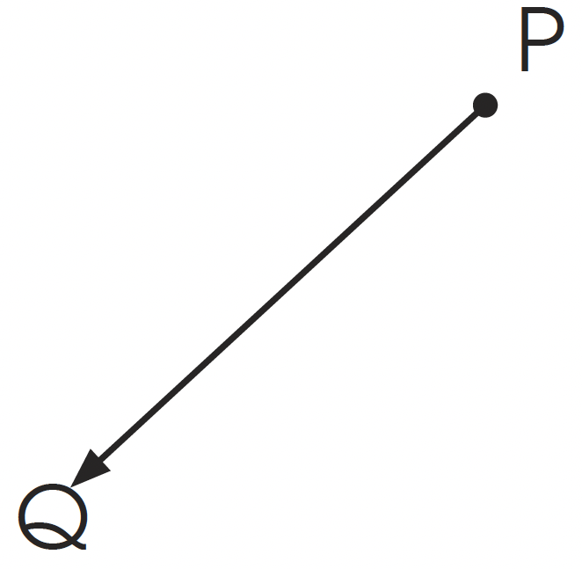
A ray is different from a line. One end is a point and the other end is an arrow. A ray points in only one direction.
We have ray XY, ray HK and ray PQ.

