Slide 1
Intersection Lines

Slide 2
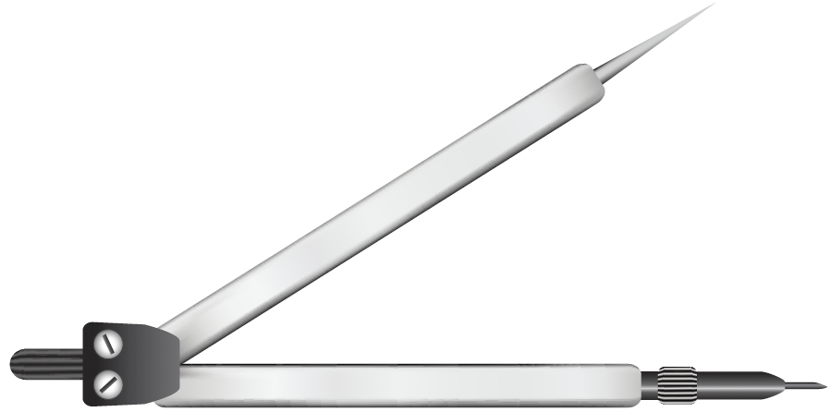

Look at the following sets of lines.
Two lines that meet each other are called intersecting lines.
The angle they form can be smaller than a right angle.

Slide 3
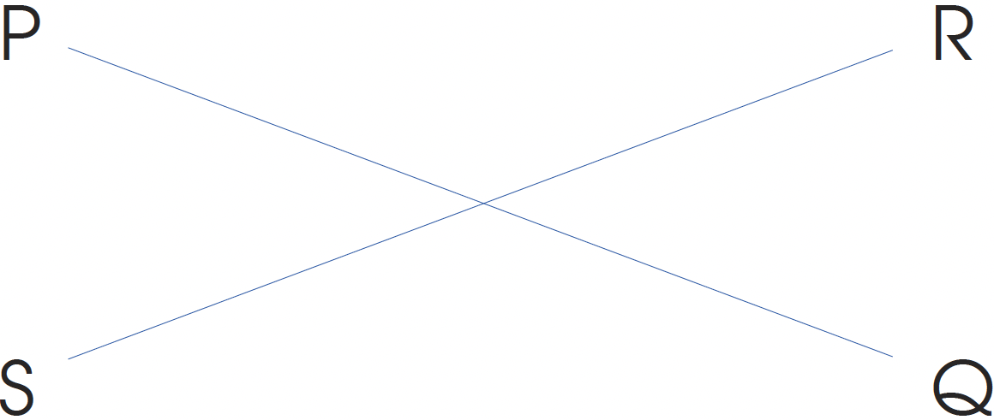
Can you find other examples of intersecting lines in then classroom?
Draw any two lines that meet each other using a ruler.
Label one line PQ and the other line RS.

