Slide 1
Perpendicular Lines

Slide 2

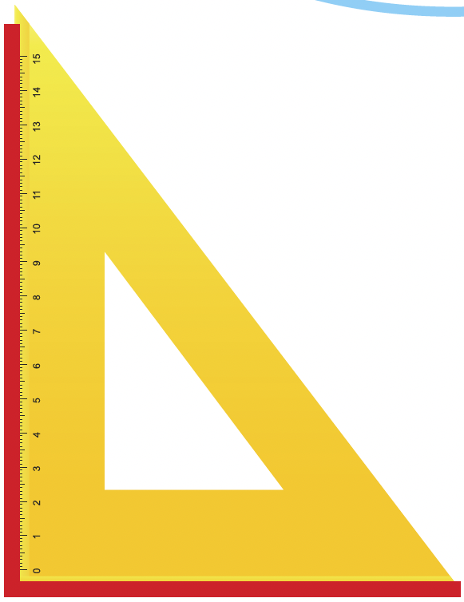
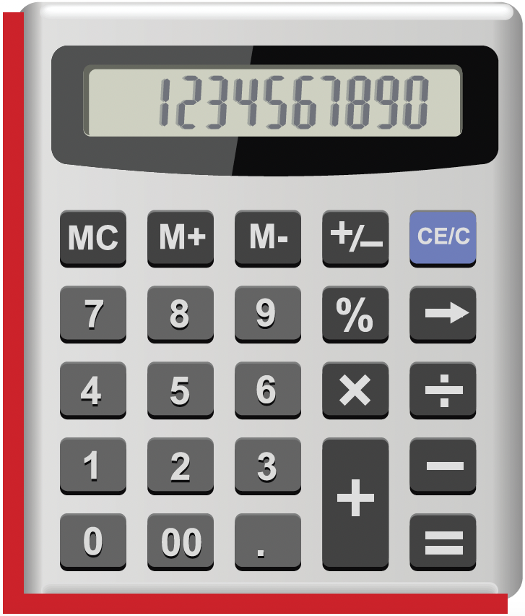
Look at each of the objects below.
In each figure, the angle formed by the marked lines is a right angle.
Such lines are perpendicular lines.
What do you notice about the marked lines?

Slide 3
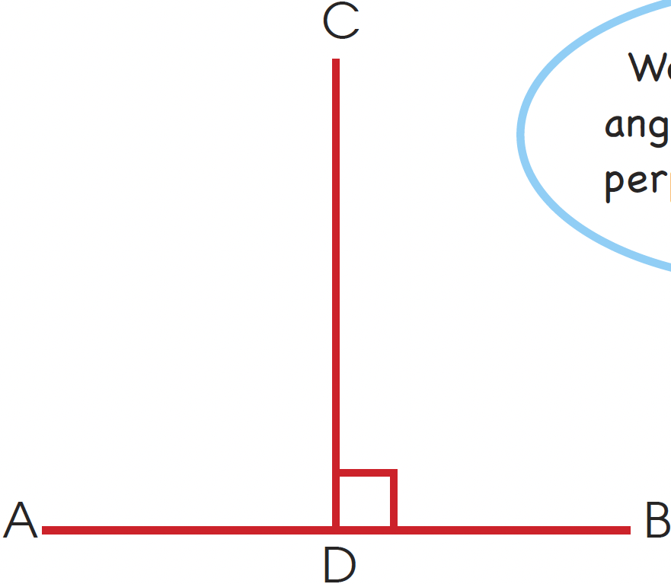

Line AB is perpendicular to line CD.
We write it as AB ⊥ CD.
We mark a right
angle as to show
perpendicular lines.

Slide 4



Perpendicular lines can be found on real-life objects around us.
Can you find other perpendicular lines
on these objects?

Slide 5
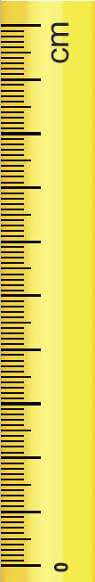
Draw a pair of perpendicular lines, AB and CD, on the square grid.
  Step 1: Draw a pair of perpendicular lines, AB and CD, on the square grid.
  Step 2: Using a ruler, draw a vertical line
  along the square grid that touches
  the line AB.
  Step 3: Label the line CD.
  Step 4: Mark the right angle formed.
ruler
A
B
A
B
C
We say that CD is
perpendicular to AB.
CD ⊥ AB.
A
D
B

Slide 6
Draw a perpendicular line to EF.
F
E
F
Step 1: Place the ruler on the square as shown.
The ruler and EF passes through the corner of the square.
E

Slide 7
Step 2: Draw a line against the ruler.
Step 3: Remove the ruler and mark the right angle.
F
E

Slide 8
Draw a perpendicular line to EF.
A
B
Step 1: Place the ruler on the green rectangle as shown.
A
B

Slide 9
Step 2: Draw a line against the ruler.
Step 3: Remove the ruler and mark the right angle.
A
B

