Slide 1
Parallel Lines

Slide 2
Look at the following sets of line.
These lines never intersect, no matter how far they are extended.
They are called parallel lines.
Zebra crossing
Airplanes flying in formation

Slide 3
Look at the pairs of parallel lines.
The distance between the parallel lines is always the same.
We draw arrowheads to show parallel lines.

Slide 4
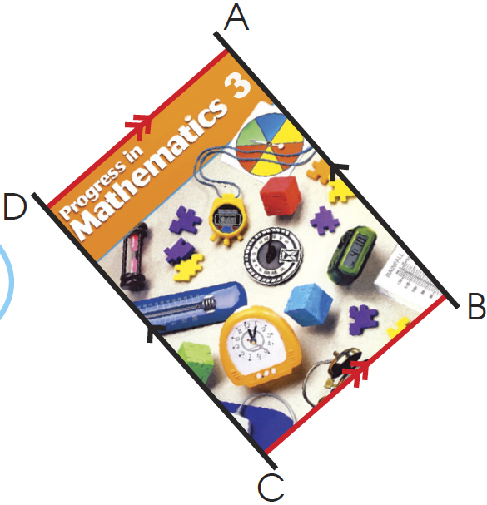
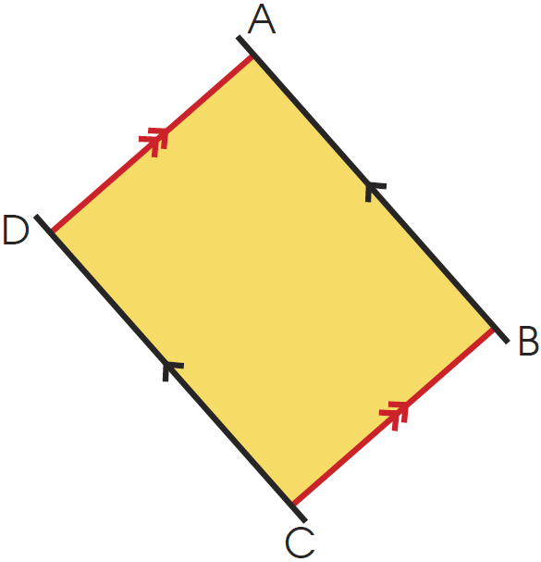
Look at the edges of your textbook. Do you see any parallel lines? The textbook is rectangular in shape.
The opposite sides of a rectangle are parallel to each other.
AB is parallel to DC.
We write it as AB // DC.
AD is parallel to BC.
We write it as AD // BC.
We can find parallel lines in other shapes, too. What shapes are they?

Slide 5
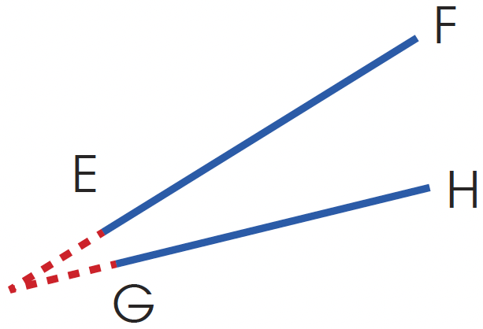
Intersecting lines are not parallel lines.
Lines which meet if extended are also not parallel lines.

Slide 6
Which pair of lines are parallel?
Check that the distance between the two lines is always the same.
AB is parallel to CD.
JK is parallel to MN.
UT is parallel to WV.
A
B
G
E
C
D
J
M
F
H
U
W
R
P
S
K
N
T
V
Q

Slide 7

Draw a pair of parallel lines XY and TU on the square grid.
Step 1: Draw a line on the grid line and label it XY.
Step 2: Count an equal number of squares from points X and Y. Mark each point and label the points T and U.
Y
X
Y
1
2
3
U
x
x
X
1
2
3
T

Slide 8
Step 2: Draw a line joining points T and U.
Mark the lines with arrowheads.
XY // TU
Y
U
X
T

Slide 9
Draw a pair of parallel line to MN.
Step 1: Mark two points where the line MN touches the corners of the square grid as shown.
Step 2: Count equal number of squares (for example, 2 squares) from each point and label the points P and Q.
N
N
M
M
N
Q
x
1
2
P
x
M
1
2

Slide 10
Step 2: Draw a line joining points P and Q.
Mark both lines with arrowheads.
N
Q
M
P

