Slide 1


Kinds of Line Pairs

Slide 2
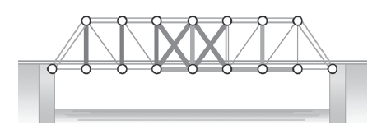
Look closely at the drawing of the bridge below;
The beams that make up the bridge are made of line segments.
  A line segment is a part of a line having two endpoints.
Each beam on the bridge is connected at a point.
  A point is also described as an exact location in space.
Rex Curriculum Resource
WWW.REX.COM.PH

Slide 3



This is a point.
  We read it as point M.
This is a line segment.
  We read this as line segment TA.
This is a line.
  We read this as line MG.
A line is a straight figure which extends endlessly in both directions.
Rex Curriculum Resource
WWW.REX.COM.PH

Slide 4
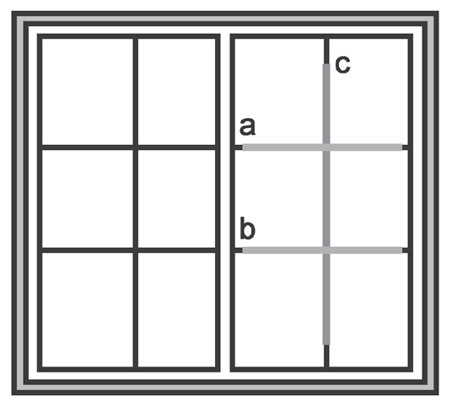
Look at the lines a, b, and c on this window.
Can you tell which direction they go?
How are lines a and b related?
How about lines a and c?
Which pair of lines meet? Which pair of lines do not meet?
Look for objects around you where you can see lines that meet.
Search for objects where you can see lines that meet.
Rex Curriculum Resource
WWW.REX.COM.PH

Slide 5
Now that you have encountered the different kinds of lines, let us define
and learn the procedures by drawing them using a ruler and set square.
Notes:
Lines that do not meet are called parallel lines.
Lines that meet are called intersecting lines.
Lines that meet at a right angle are called
perpendicular lines.
Rex Curriculum Resource
WWW.REX.COM.PH

Slide 6
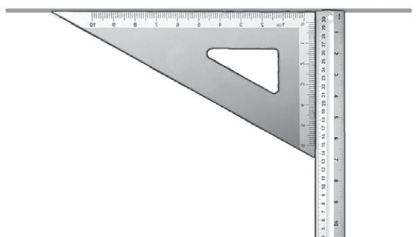
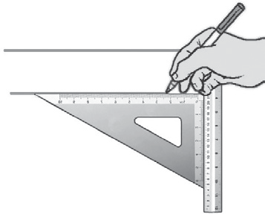
Below are the procedures for drawing parallel, perpendicular, and
intersecting lines.
A. Parallel Lines
1. Draw a horizontal line using
the side of the ruler.
2. Align the edge of the triangle
along the first line.
3. Then, align the ruler at the base of the triangle.
4. Slide the triangle downward along the side of the ruler and draw
another line from the edge of the triangle.
Rex Curriculum Resource
WWW.REX.COM.PH

Slide 7

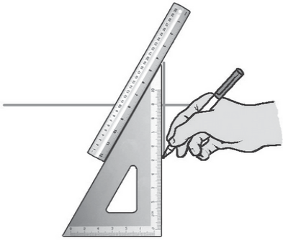
Below are the procedures for drawing parallel, perpendicular, and
intersecting lines.
B. Perpendicular Lines
1. Draw a horizontal line using
the side of the ruler.
2. Align the base of the triangle
along the first line.
3. Align the ruler along the side of the triangle.
4. Slide the triangle downward along the side of the ruler.
5. Draw a line along the side of the triangle.
Rex Curriculum Resource
WWW.REX.COM.PH

Slide 8
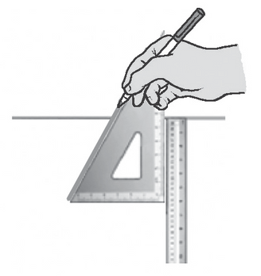
Below are the procedures for drawing parallel, perpendicular, and
intersecting lines.
C. Intersecting Lines
1. Do steps 1–4 in drawing a
perpendicular line.
2. Draw a line along the
hypotenuse of the triangle.
Rex Curriculum Resource
WWW.REX.COM.PH

Slide 9
KEY TAKEAWAYS
• Parallel lines are lines that do not meet. These
lines are always of the same distance from each
other.
• Intersecting lines are lines that meet at a point.
These lines cross over each other at a point.
• Perpendicular lines are lines that meet or intersect
at a right angle.
Rex Curriculum Resource
WWW.REX.COM.PH

Slide 10
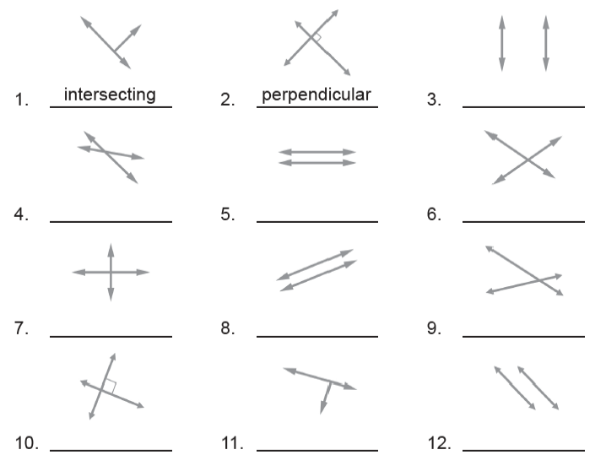
Guided Activity:
Try to classify the pair of lines as intersecting, parallel, or perpendicular.
Write your answers in your math notebook. The first two numbers are done for you to serve as a guide.
Rex Curriculum Resource
WWW.REX.COM.PH

Slide 11
Guided Activity:
Classify the pair of lines as intersecting, parallel, or perpendicular.
The first two numbers are done for you to serve as a guide.
Activity Key to Correction
3. parallel lines
4. intersecting lines
5. parallel lines
6. intersecting lines
7. perpendicular lines
8. parallel lines
9. intersecting lines
10. perpendicular lines
11. perpendicular lines
12. parallel lines
Rex Curriculum Resource
WWW.REX.COM.PH

Slide 12


