Slide 1


Line Pairs and Angles in Real Life

Slide 2
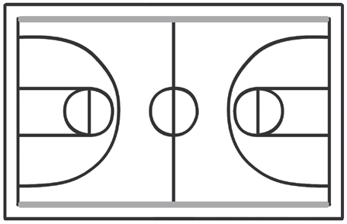





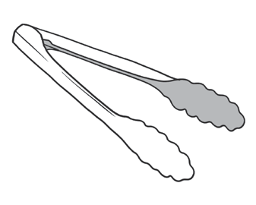
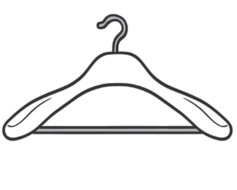
Look at the objects below and the highlighted line pairs.
Can you describe the line pairs? Can you identify them?
Examine the objects below. Can you tell where the angles are?
Trace them with your finger or by using a protractor.
Name the kind of angle you can see in each figure. Describe them.
Look at the objects below and the highlighted line pairs.
Can you describe the line pairs? Can you identify them?
Examine the objects below. Can you tell where the angles are?
Trace them with your finger or by using a protractor.
Name the kind of angle you can see in each figure. Describe them.
book door scissors tongs fan hanger
Rex Curriculum Resource
WWW.REX.COM.PH

Slide 3
Now, look around. Search around your house.
Hunt for things that represent line pairs. Look for intersecting, parallel, and perpendicular lines. Draw them in your math notebook.
How are the line pairs represented in the objects you found? How do they differ from each other?
This time, explore around your bedroom and look for objects that show different types of angles. Draw them in your math notebook.
Now, identify and highlight the part of the objects that represent an angle. How do the angles differ from each other?
Which objects form a right angle?
Are there any objects that form an acute or obtuse angle?
Which objects can show all types of angles?
Line pairs may be parallel, perpendicular, or
intersecting lines.
Angles may be right, acute, or obtuse.
Rex Curriculum Resource
WWW.REX.COM.PH

Slide 4
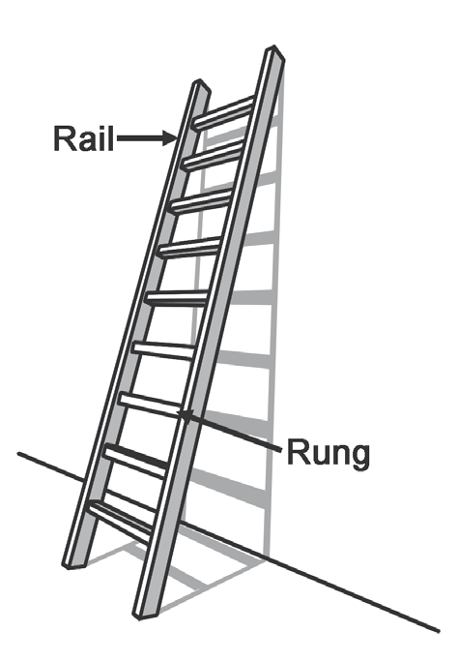
As you go through your daily routine, you will realize that you encounter situations that show line
pairs and angles in real life.
Here is a picture of a ladder leaning on a wall.
Its shadow falls on the wall.
It illustrates the different line pairs we have previously learned.
The side rails of the ladder form parallel lines. The rungs of the ladder
are also parallel to each other. Meanwhile, the side rail and the rungs of the ladder form perpendicular lines.
Now, focus on the ladder and its shadow. Can you see the intersecting lines they form?
Intersecting lines cross each other and meet at a point.
Rex Curriculum Resource
WWW.REX.COM.PH

Slide 5
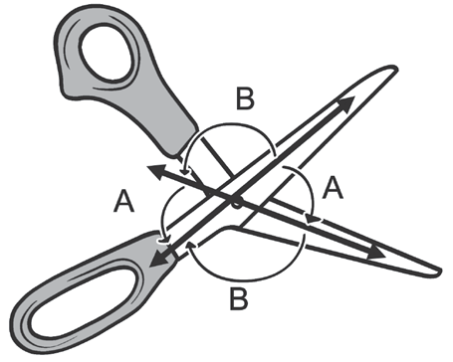
This time look at the picture of the scissors below.
The blades and handles of the scissors form a pair of lines that intersect.
This time look at the picture of the scissors at the right. The blades
and handles of the scissors form a pair of lines that intersect.
Angle A formed by the two lines is an acute angle.
Angle B is an obtuse angle.
The ladder and scissors are some of the real-world examples where
we can see line pairs and angles.
Rex Curriculum Resource
WWW.REX.COM.PH

Slide 6
KEY TAKEAWAYS
• Line pairs such as intersecting and perpendicular lines form an
acute, right, or obtuse angle.
• Two lines are perpendicular if they intersect and create right angles.
• Line pairs may be represented by real-life objects.
Rex Curriculum Resource
WWW.REX.COM.PH

Slide 7
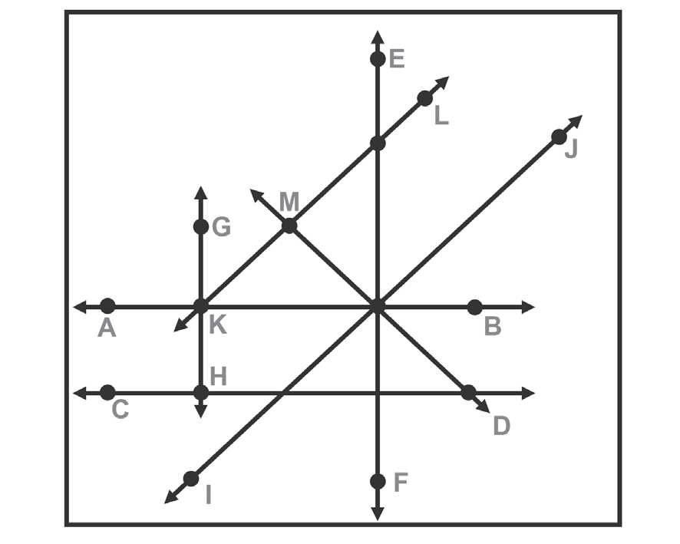
Activity:
Look for the lines in the figure. Then, tell if the lines are parallel, intersecting, or perpendicular.
1. Lines AB and CD
2. Lines EF and KB
3. Lines IJ and MD
4. Lines GH and EF
5. Lines EF and IJ
6. Lines AB and MD
7. Lines KL and IJ
8. Lines GH and AB
9. Lines MD and LK
10. Lines LK and EF
Rex Curriculum Resource
WWW.REX.COM.PH

Slide 8
Activity: KEY TO CORRECTION
Look for the lines in the figure. Then, tell if the lines are parallel, intersecting, or perpendicular.
1. Lines AB and CD
2. Lines EF and KB
3. Lines IJ and MD
4. Lines GH and EF
5. Lines EF and IJ
6. Lines AB and MD
7. Lines KL and IJ
8. Lines GH and AB
9. Lines MD and LK
10. Lines LK and EF
1. parallel lines
2. perpendicular lines
3. perpendicular lines
4. parallel lines
5. intersecting lines
6. intersecting lines
7. parallel lines
8. perpendicular lines
9. perpendicular lines
10. intersecting lines
Rex Curriculum Resource
WWW.REX.COM.PH

Slide 9


