Slide 1
Counting to 1000

Slide 2
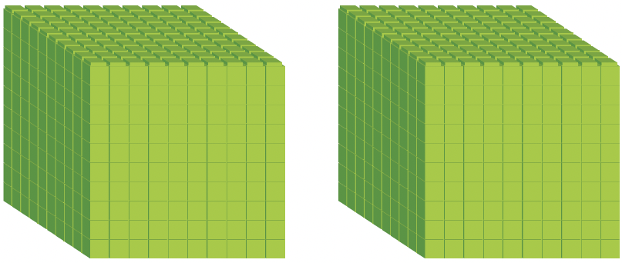
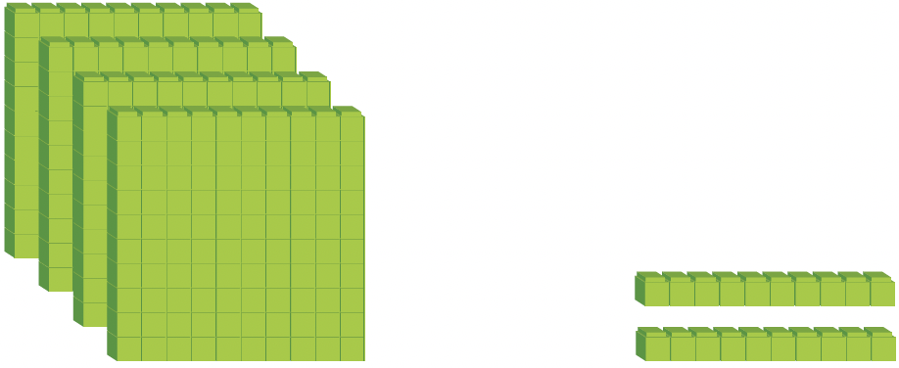

Count the units in the base-ten blocks.
We can show the number using
a place-value chart.
2 thousands 4 hundreds 2 tens 5 ones = 2000 + 400 + 20 + 5 = 2425
We write 2425 as two thousand, four hundred and twenty-five
2000
400
20
5
Thousands | Hundreds | Tens | Ones
2 | 4 | 2 | 5

Slide 3
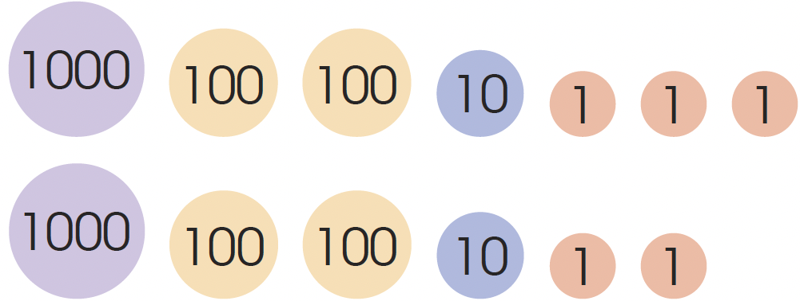
We can also show this number using number discs.
Thousands | Hundreds | Tens | Ones
2 | 4 | 2 | 5

Slide 4
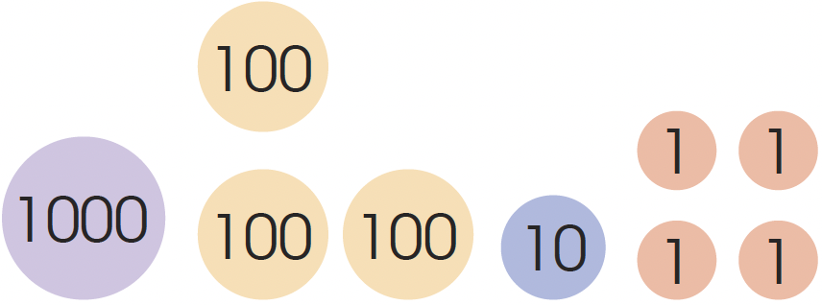
What number is shown in each place-value chart?
1 thousand 3 hundreds 1 ten and 4 ones = 1000 + 300 + 10 + 4
= 1314
We write 1314 as one thousand, three hundred and fourteen.
Thousands | Hundreds | Tens | Ones
1 | 3 | 1 | 4

Slide 5
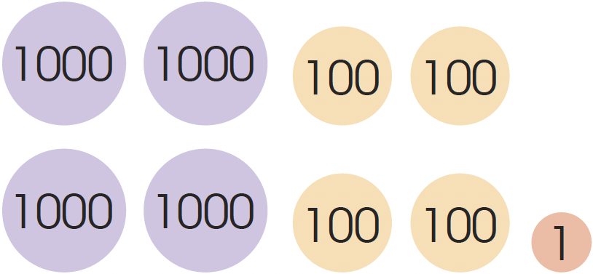
4 thousands 4 hundreds 0 tens and 1 one = 4000 + 400 + 1
= 4401
We write 4401 as four thousand, four hundred and one.
Thousands | Hundreds | Tens | Ones
4 | 4 | 0 | 1

Slide 6
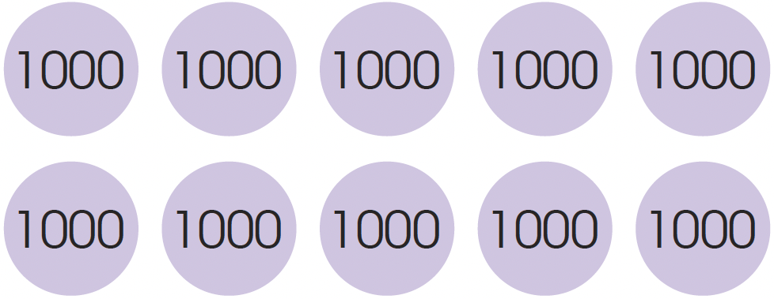
1 ten thousand 0 thousands 0 hundreds 0 tens 0 ones
= 10 000 + 0 + 0 + 0 + 0
= 10 000
We write 10 000 as ten thousand.
Ten Thousands | Thousands | Hundreds | Tens | Ones
1 | 0 | 0 | 0 | 0

Slide 7
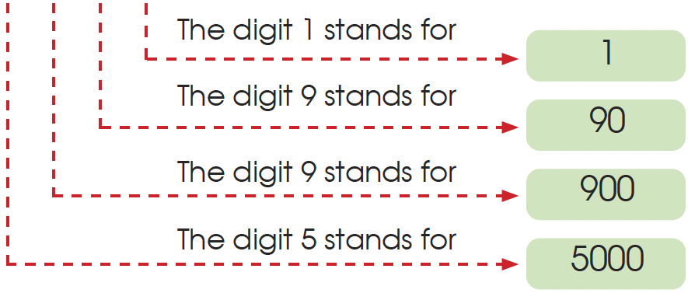
What is the value of each digit in 5991?
  5991 = 5000 + 900 + 90 + 1
  5 9 91

Slide 8
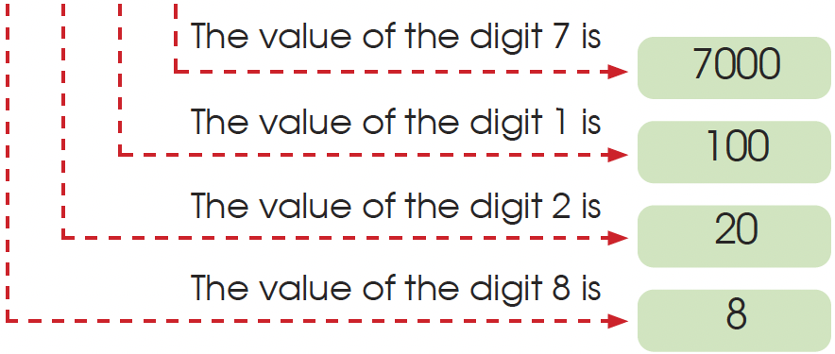
What is the value of each digit in 7128?
  7128 = 7000 + 100 + 20 + 8
  7 1 28

Slide 9
What is the value of each digit in 10 000?
10 000 = 10 000 + 0 + 0 + 0 + 0
  The value of the digit 1 in the ten thousands place is 10 000.
  The value of the digit 0 in the thousands place is 0.
  The value of the digit 0 in the hundreds place is 0.
  The value of the digit 0 in the tens place is 0.
  The value of the digit 0 in the ones place is 0.

