Slide 1
Ordinal Numbers to 100th

Slide 2
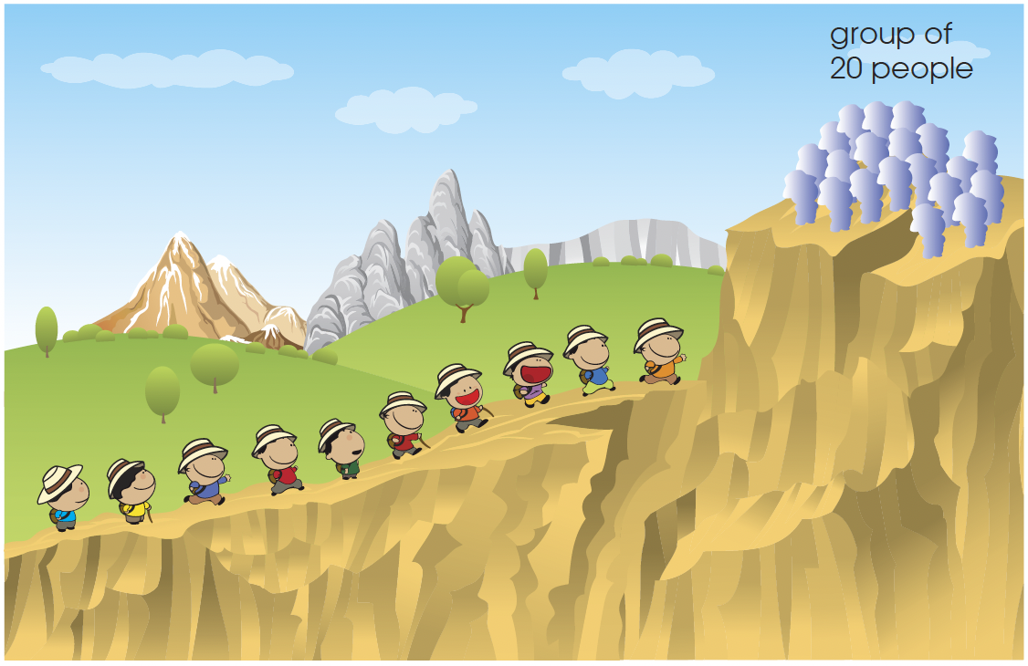
20 people have reached the top of the mountain.
There are 10 more people on the way up.
Can you name their positions?

Slide 3
The pattern repeats from the 21st onward.
  21st – twenty-first
  22nd – twenty-second
  23rd – twenty-third
  24th – twenty-fourth
  ·
  ·
  ·
  30th – thirtieth

Slide 4
The position of the last person in each group of ten climbers is listed below.
10th – tenth 20th – twentieth 30th – thirtieth 40th – fortieth 50th – fiftieth 60th – sixtieth 70th – seventieth 80th – eightieth 90th – ninetieth 100th – hundredth
Notice that we drop the ‘y’ and add ‘ieth’ to form each of these ordinal numbers from 20th to 90th.
What is the thirtieth number after the number 7?

Slide 5
We list the numbers.
1, 2, 3, 4, 5, 6, 7, 8, 9, 10, 11, …
Starting from 8 as the first number, we count on.
The thirtieth number after the number 7 is 37.
The 91st number is between the 90th number and the 92nd number.
What is the position of the number that is between the 90th number and the 92nd number?

