Slide 1
Desiree’s Masterpiece
(Demonstrative Pronouns:
This and That)

Slide 2
Phonics and Word Recognition
Words with short /i/ sound
bit dig hit dig sit
kick fit gift lit lift
mist nip pin rib sip
tip tint win wind

Slide 3
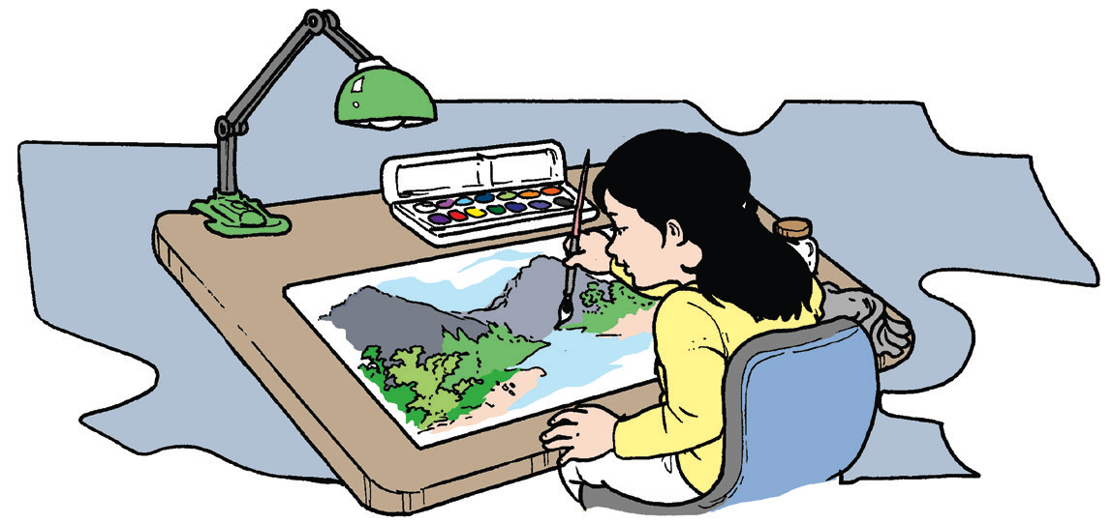
Desiree’s Masterpiece
by Dylan Zarza
Desiree had been working on her art project the entire day. She was at the working room of their house. She was preparing for the exciting art contest in school. She drew a beautiful river with trees and plants all around. She used watercolor.
What do you think is the masterpiece?

Slide 4
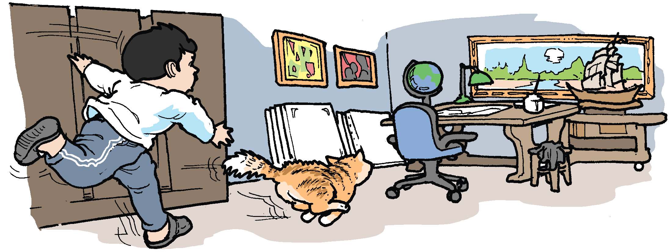
She carefully placed her painting on the table beside her painting materials. She left her work to let her mother see it. On her way to her mother’s room, she met Zach, her brother, chasing their pet cat, Borjie.
When she and her mother got back to the working room, Desiree suddenly cried out loud.
Where do you think would the chasing end up?
What do you think happened?

Slide 5
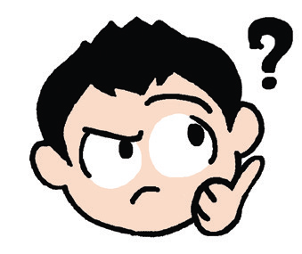
Recall
1. Where did the story happen?
2. What was Desiree working on?
3. Why did Desiree leave her work?
4. What was Zach doing when Desiree saw him?
Think Well
1. What clues in the story helped you with your predictions?
2. What can you say about Desiree? What can you say about Zach?
3. A good reader makes predictions when reading a story. What can
help you in making good predictions?

Slide 6
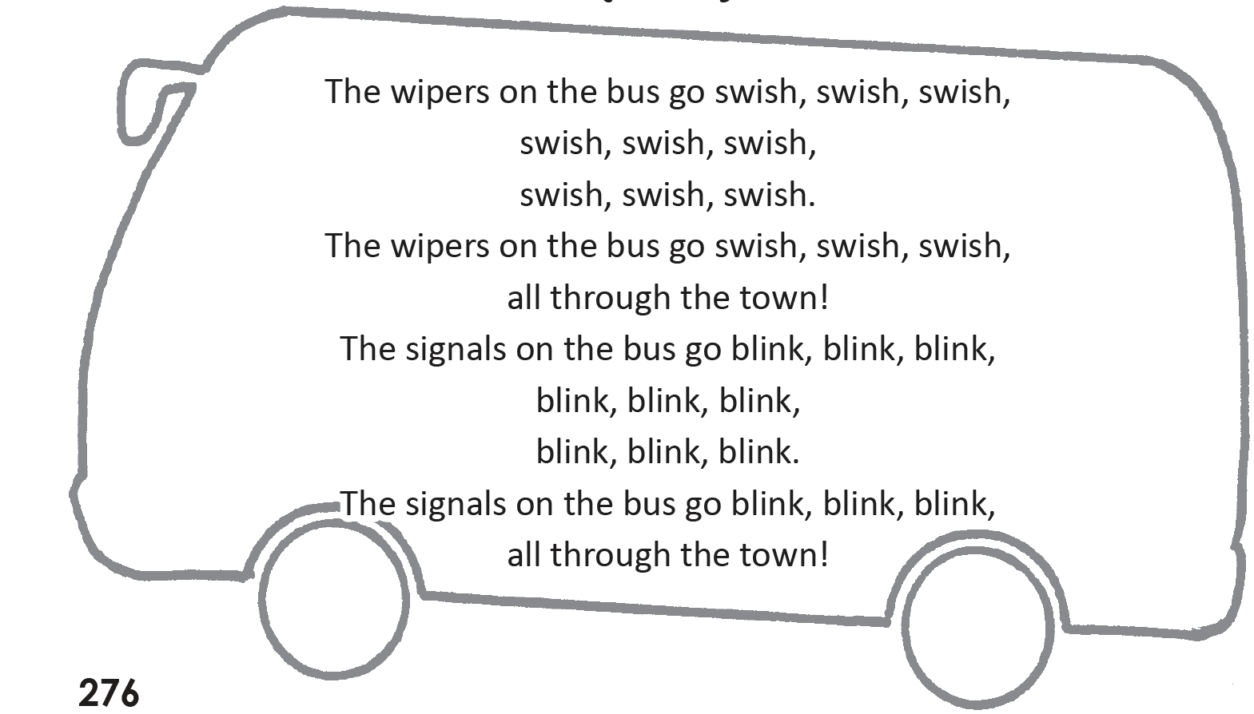
Oral Language
The Wheels on the Bus Go Round and Round
(Part 2)

Slide 7
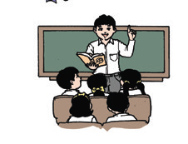
Grammar
This and That are demonstrative pronouns. The pronoun this is used to show something near the person speaking. It is used with a singular noun or pronoun. The pronoun that is used to show something far from the person speaking. It is used with a singular noun or pronoun.

Slide 8
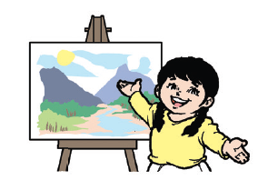
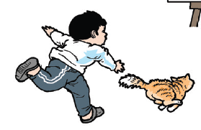
Grammar
Read the following sentences:
1. This painting is my masterpiece.
2. He is chasing that cat.

Slide 9
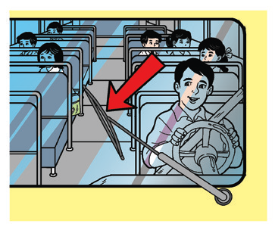
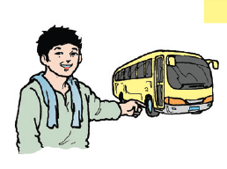
Grammar
Read the following sentences:
3. The wipers on this bus are making
sounds.
4. The wheels of that bus are new.

Slide 10
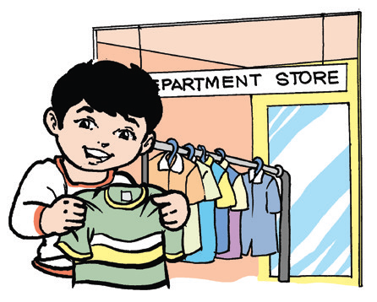
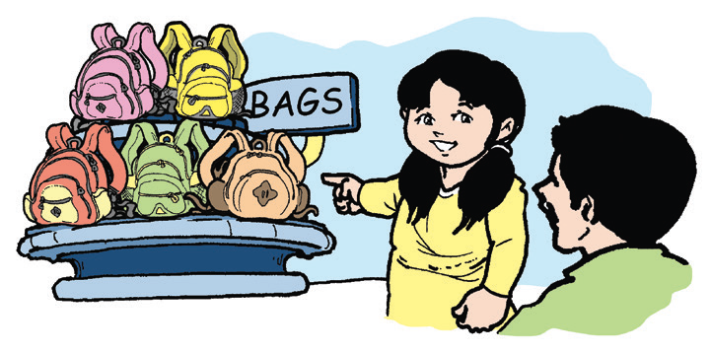
Grammar
Other sentences:
1. I like this shirt.
2. Please buy that brown bag for me.

